Slide 1

Wood Smoke Screening Study Update:
RTF Staff & Abt Associates
May 13th, 2014

Slide 2
Presentation Objectives
Brief the RTF on subcommittee investigation of a methodology to quantify and monetize healthcare benefits from reducing wood smoke
An opportunity to ask the experts about the fundamental underpinnings of the methodology
Obtain RTF feedback.

Slide 3
More Context
Further analysis required to generate usable NEB values.
Today’s presentation will not address policy implications of analysis.
Reminder: The Council is the ultimate decider on whether or not health impacts are quantifiable as NEB for the work products of the Council
Results of the RTF investigation into the quantifiability and monetizability of health impacts will go to RTF Policy Advisory Committee and the Council

Slide 4
Genesis of the Problem
Ductless Heat Pumps (DHP) displace some wood heat in some residential homes.
  This reduces wood smoke emissions
    Which results in reduced PM 2.5 formation, the cause of health benefits being investigated.
  Back of the envelope analysis showed the health benefits from avoided wood smoke to be significant, larger than value of electric savings
Significant supplemental wood heat in electrically- heated homes means other EE measures, like weatherization and lighting measures, may also impact wood smoke emissions.

Slide 5
A screening level study was commissioned.
Objective of study to understand the quantifiability of health impacts and determine if further research is warranted. Study investigated:
  Relationship between changes in wood smoke emissions and health impacts
  Magnitude of monetary impact from reducing wood smoke.
  Geographical implications. “How does wood smoke reduction in a county affect surrounding areas?”
Chosen contractor: Abt Associates.
Subcommittee formed to guide and review project.

Slide 6
Monetized Health Impacts: Methodology
U.S. EPA’s Co-Benefits Risk Assessment (COBRA) model
Calculate Change in Health Outcomes
- Standard concentration response functions to link the changes in particulate matter to epidemiological studies
Outputs = Tables and maps of
illnesses and deaths avoided and the related economic value.
Quantify Changes in Air Quality
- Use a simple air quality model, the Source Receptor (S-R) Matrix, to estimate effects of changes on ambient particulate matter.
Calculate Monetary Value
- Use standard values based on willingness-to-pay, cost of illnesses , value of a statistical life and direct medical costs.
Modified the baseline for wood smoke emissions to match estimates for the PNW
Adjusted the outputs for population and income growth to match council values

Slide 7
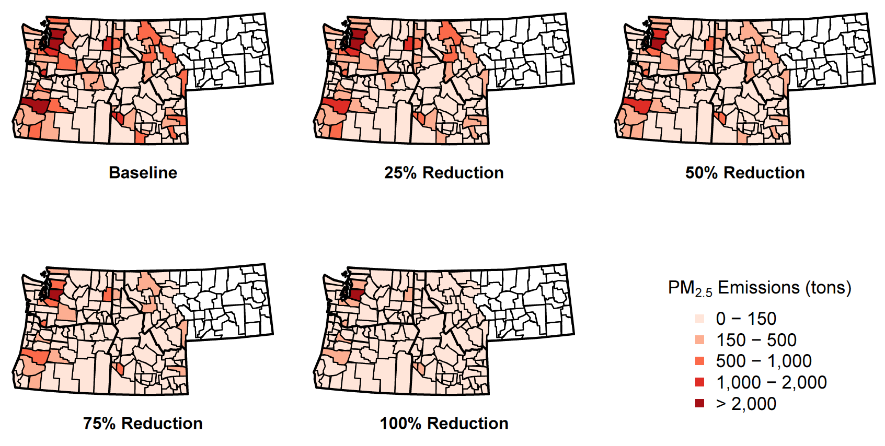
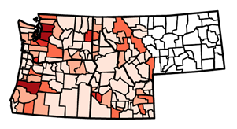
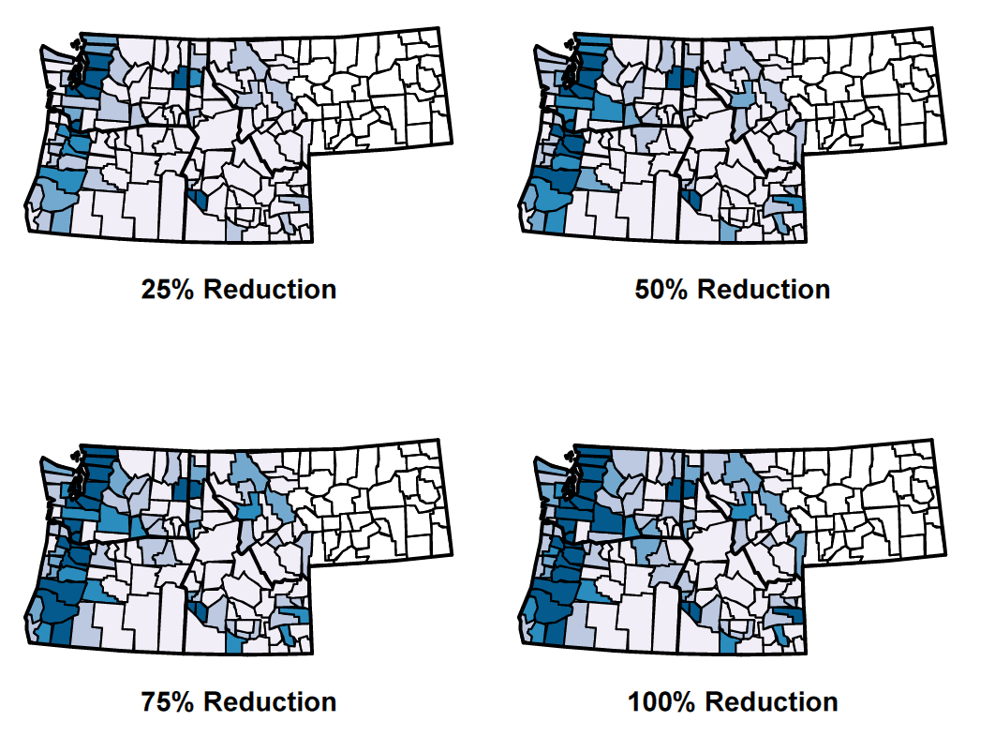
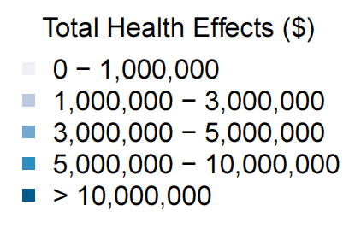
COBRA Monetized Health Impacts: Sample Results- Screening Study
Changes in PM_{2.5} Emissions
Value of Total Health Effects Avoided

Slide 8
Quantify Changes in Air Quality
Baseline emissions estimated using existing data sources
  Residential Building Stock Assessment (RBSA) and the U.S. EPA Residential Wood Combustion (RWC) tool
4 air quality scenarios simulated
  25%, 50 %, 75%, and 100% wood smoke reduction for certain residential wood burning appliances across the study area
Scenarios reduced emissions for all wood burning appliances that are used primarily for residential heating:
  All types of wood stoves, pellet stoves, wood-fired furnaces, and wood-fired boilers
  Did not include fireplaces or outdoor burning (e.g. firepits); these emissions were left unchanged

Slide 9
Quantify Changes in Air Quality (contd.)
What is PM_{2.5} and how is it formed?
  Mixture of microscopic solids and liquid droplets suspended in air; primarily resulting from combustion
  Can be emitted directly or formed secondarily in the atmosphere
S-R Matrix dispersion model in COBRA
Wood smoke reductions in a given county affect PM_{2.5} concentrations and health outcomes in neighboring counties
  For example, in the 100% wood smoke reduction scenario, 30-50% of health benefits in a given county are attributable to wood smoke reductions in the rest of the counties in the study area
  Current analysis focuses on the PNW study area, so results represent an impact of a fixed percentage reduction of wood smoke emissions occurring concurrently in all counties of the PNW study area

Slide 10
Calculate Change in Health Outcomes – Scientific Basis
COBRA embeds the latest suite of health impact relationships for PM_{2.5} used by EPA’s Office of Air Quality Planning and Standards for Regulatory Impact Assessments
In quantifying health impacts (i.e., selection of endpoints and epidemiological relationships) EPA relies on the synthesis of the clinical, toxicological, and epidemiological evidence regarding PM_{2.5} exposure and the health risks by EPA’s Office of Research and Development:
  Integrated Science Assessment (ISA) for Particulate Matter released in 2009 [FRL-9090-9; Docket ID No. EPA-HQ-ORD-2007-0517]

Slide 11
Calculate Change in Health Outcomes – Mortality Example
EPA ISA states that “[c]ollectively, the evidence is sufficient to conclude that a causal relationship exists between long-term exposures to PM_{2.5} and mortality”
Adult mortality impacts are quantified using two studies evaluating the link between PM_{2.5} and survival durations (controlling for individual confounders):
  Harvard Six Cities Cohort (Lepeule et al., 2012): tracks ~8,000 participants living in 6 Eastern/Midwestern US cities starting from 1974; PM_{2.5} range 11 to 24 ug/m³; Age 25+; Beta = 0.013103 (High estimate).
  American Cancer Society Cohort (Krewski et al., 2009) tracks ~500,000 participants in 116 US cities starting from 1982; PM_{2.5} range 5.8 to 22.2 ug/m³; Age 30+; Beta = 0.007511 (Low estimate).

Slide 12
Calculate Change in Health Outcome
Sample Results for the Northwest: Screening Study
Health Incident Avoided | Number of Cases Avoided
 | 25% Reduction | 50% Reduction | 75% Reduction | 100% Reduction
Adult Mortality | 55-126 | 111-251 | 166-376 | 222-501
Infant Mortality | >0 | >0 | >0 | >0
Non-fatal Heart Attacks | 6-54 | 12-108 | 17-161 | 23-214
Hospital Admissions | 25 | 50 | 75 | 100
Acute Bronchitis | 91 | 182 | 273 | 364
Respiratory Symptoms | 2,829 | 5,654 | 8,476 | 11,295
Asthma ER Visits | 24 | 48 | 72 | 95
MRAD | 48,683 | 97,316 | 145,898 | 194,430
Work Loss Days | 8,220 | 16,435 | 24,645 | 32,849
Asthma Exacerbations | 1,745 | 3,489 | 5,232 | 6,975

Slide 13
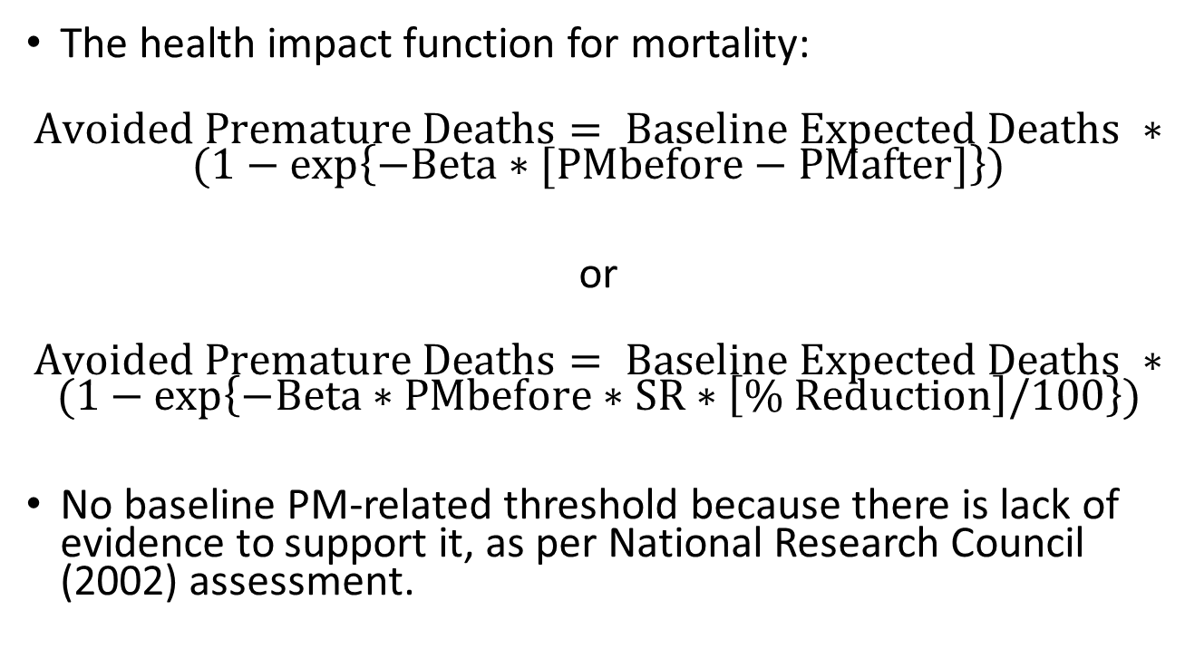
Calculate Change in Health Outcome – Linearity I
  The health impact function for mortality:
  $$Avoided Premature Deaths= Baseline Expected Deaths ∗$$
  $$(1−exp\left\{−Beta∗[PMbefore−PMafter]\right\})$$
  or
  $$Avoided Premature Deaths= Baseline Expected Deaths ∗$$
  $$(1−exp\left\{−Beta∗PMbefore∗SR∗\left[\% Reduction\right]/100\right\})$$
  No baseline PM-related threshold because there is lack of evidence to support it, as per National Research Council (2002) assessment.

Slide 14
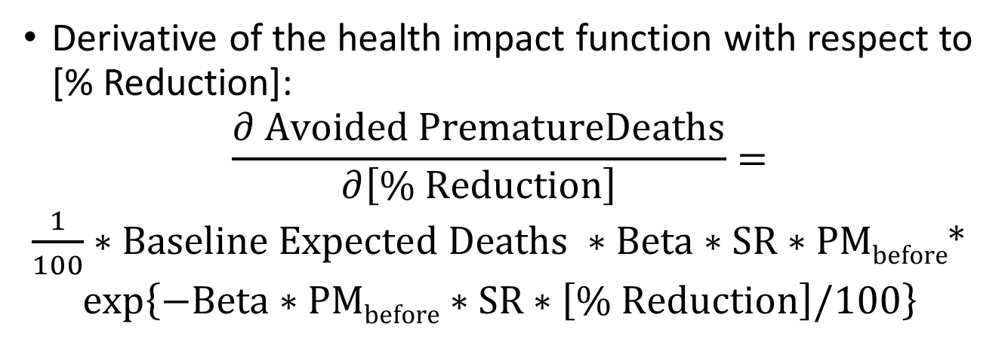
Calculate Change in Health Outcome – Linearity II
  Derivative of the health impact function with respect to [% Reduction]:
  $$\frac{∂ Avoided PrematureDeaths}{∂\left[\% Reduction\right]}=$$
  $\frac{1}{100}∗Baseline Expected Deaths ∗Beta∗SR∗PMbefore$*
  $$exp\left\{−Beta∗PMbefore∗SR∗\left[\% Reduction\right]/100\right\}$$
[% Reduction] | SR Elasticity | PM_{2.5} (avg.) | Beta (Krewski) | Baseline Deaths (CDC, 2010) | Deaths per 1% reduction
25 | 0.08 | 4.6 | 0.007511 | 97,303 | 2.693482447
50 | 0.08 | 4.6 | 0.007511 | 97,303 | 2.691617818
75 | 0.08 | 4.6 | 0.007511 | 97,303 | 2.68975448
100 | 0.08 | 4.6 | 0.007511 | 97,303 | 2.687892431

Slide 15
Calculate Economic Value of Avoiding Adverse Health Effects
Two approaches:
  Willingness to Pay (WTP) to reduce risk of mortality or morbidity
  Cost of Illness (COI) estimates, including direct medical and opportunity costs
Values used in Wood Smoke Analysis

Slide 16
Calculate Economic Value of Avoiding Premature Death I
Valuation concept: Aggregate WTP by a population of a given size for a small reduction in annual mortality risk
Estimates of WTP for mortality risk reductions come from two types of economics studies:
  Revealed preference (job-risk related wage differences)
  Stated preference (direct elicitation of values through choice experiments)

Slide 17
Calculate Economic Value of Avoiding Premature Death II
Value per Statistical Life (VSL) is…
  A WTP estimate normalized by the magnitude of mortality risk reduction, i.e. VSL = WTP/Risk Reduction
  Not the value of preventing a certain death of a given person
  EPA VSL is $9.4 Million (2010$ at 2017 income level)
  Based on a synthesis of 26 WTP studies that have been identified in the Clean Air Act Section 812 Reports to Congress as “applicable to policy analysis.”

Slide 18
Calculate Economic Value of Avoiding Premature Death III
Example:
  A valuation study estimated a per person average WTP of $10 to reduce mortality risk by 10^-5
  A health impact study found a reduction in mortality risk of 10^-6 in a population of 300 Million (or 300 premature deaths avoided)
  Based on (1), per-person WTP for 10^-6 risk reduction is $1.
  Aggregate WTP for 10^-6 risk reduction by a population of 300 Million will be $300 Million
    i.e., 300 premature deaths avoided that were valued using VSL of $1 Million per case.

Slide 19
COBRA Outputs: Economic Value of Health Impacts
Economic value of health benefits is a product of the estimated reduction in expected number of adverse health outcomes and the economic value per case
  Health Incidence Results for Study Area
Health Incident Avoided | Economic Value (Millions 2010$, 7% discount rate)
 | 25% Reduction | 50% Reduction | 75% Reduction | 100% Reduction
Total Health Effects | $425.8 - $960.9 | $851.3 - $1,920.0 | $1,276.5 - $2,877.5 | $1,701.3 - $3,833.3
Adult Mortality | $418.1 - $947.4 | $835.9 - $1,893.2 | $1,253.3 - $2,837.3 | $1,670.4 - $3,779.7
Infant Mortality | $1.1 | $2.1 | $3.2 | $4.3
Non-fatal Heart Attacks | $0.7 - $6.4 | $1.4 - $12.8 | $2.1 - $19.1 | $2.8 - $25.4
Hospital Admissions | $0.8 | $1.7 | $2.5 | $3.4
Acute Bronchitis | >$0.0 | $0.1 | $0.1 | $0.2
Respiratory Symptoms | $0.1 | $0.2 | $0.2 | $0.3
Asthma ER Visits | >$0.0 | >$0.0 | >$0.0 | >$0.0
MRAD | $3.3 | $6.6 | $9.9 | $13.2
Work Loss Days | $1.6 | $3.2 | $4.8 | $6.4
Asthma Exacerbations | $0.1 | $0.2 | $0.3 | $0.4

Slide 20
Abt Recommendations for Study Refinement
County-level COBRA modeling to generate a spatial matrix
Development of an Access-based tool that uses the spatial matrix to enable customized and predefined county-groupings; user-defined county-level wood smoke reductions; user-defined efficiencies
Customizing health functions and values to the PNW study area
Accounting for re-dispatching of electricity
Employing a more sophisticated dispersion model, such as CMAQ
Accounting for additional benefits, such as reduced materials deterioration

Slide 21
Next Steps & Future Analyses
Staff is researching the following:
  Additional model runs
    Isolate geographic and volumetric effect
    Study effects of lower levels of wood smoke reduction
  Limitations of study (scaling, baseline, re-dispatch)
  Monetization assumptions used and approved by the EPA
Following said research, staff will draft a report on quantifiability and monetizability of wood smoke for the Policy Advisory Committee and the Council
  Staff will seek approval from the RTF before submitting report.

