Slide 1
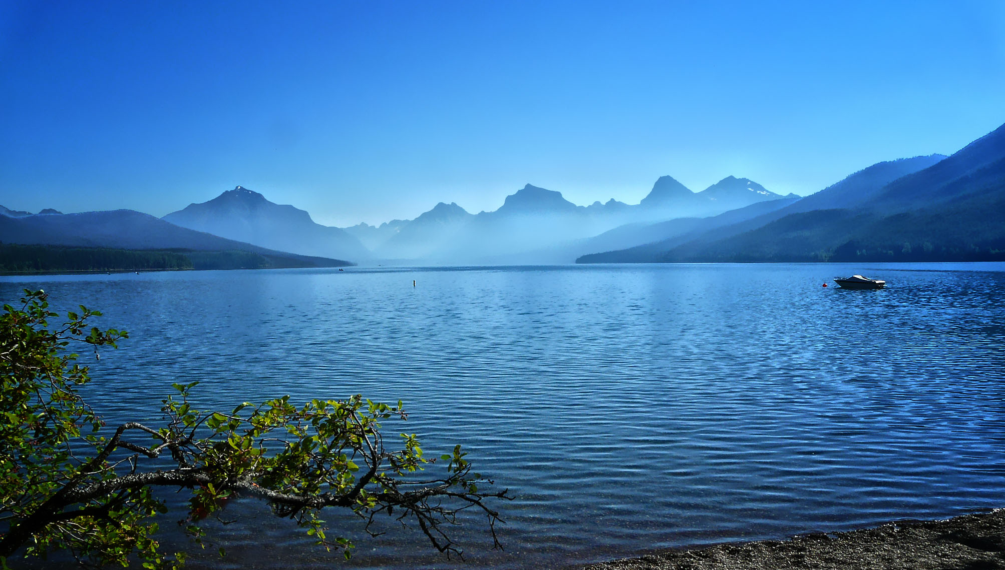
Council Staff Work Session:
PNAMP
Regional Habitat Indicators Project (RHIP)
Polson, Montana
August 9, 2016
Photo by Jourdren Jacky

Slide 2
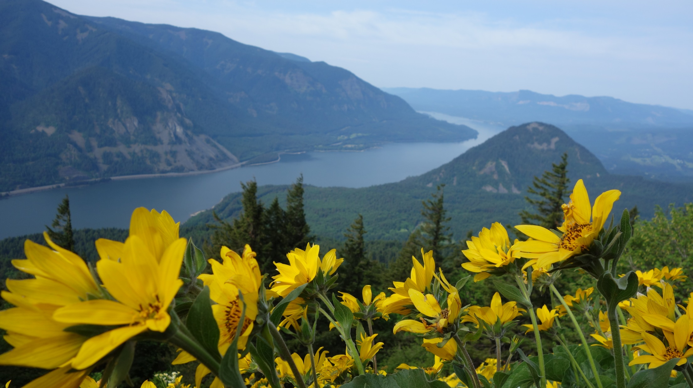
Agenda
11:45 welcome and introductions
12:00 NPCC program guidance & Regional Habitat Indicator Project (RHIP)
12:30 RHIP questions discussion
12:50 quick peek at survey
12:55 next steps
1:00 adjourn
Council meeting resumes at 1:30pm in Michel/Victor Room

Slide 3
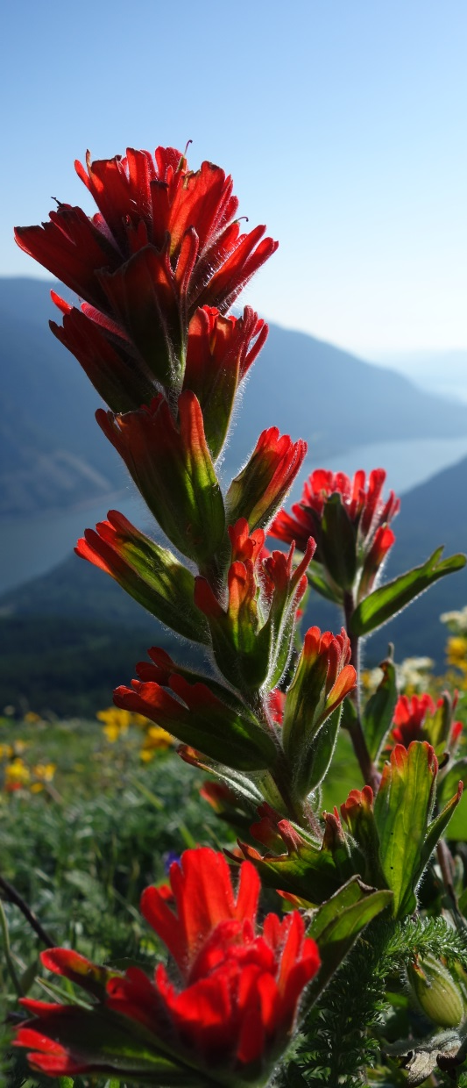
Work Session Objectives
Learn more about RHIP
Identify missing questions
Discuss if current questions are applicable to the Columbia River Basin
Learn about the multiple ways to contribute

Slide 4

2014 Fish and Wildlife Program
Refining program goals and objectives
Council will oversee a regional process to refine quantitative objectives for program species and habitat
Refined objectives should:
  Be specific, measurable, attainable, relevant, time-bound, and based on an explicit scientific rationale.
  Rely on existing monitoring data.
  Consider existing relevant Columbia River Basin documents and objectives.
The Council will ask ISAB to review objectives.

Slide 5
2014 Fish and Wildlife Program
Refining program goals and objectives

Slide 6
2014 Fish and Wildlife Program
Refining program goals and objectives
(c) Ecosystem function, habitat, and hydrosystem objectives
The Council will identify measureable objectives in the region.
The data needed for these objectives should be available.
The Council will support regional efforts to develop ecosystem health indicators and to identify quantitative biological objectives.
(c) Ecosystem function, habitat, and hydrosystem

Slide 7


Synergy
Program’s
Ecosystem and habitat objective refinement task
PNAMP’s
Regional Habitat Indicator Project (RHIP)
 | Interested in aquatic habitat topics (e.g., water quality, quantity) | 
 | Applying an approach based on compiling existing information | 
 | Focused on using available data to inform question/indicators/objectives | 
 | Engaging diversity of experts in the region | 

Slide 8

PNAMP provides a forum for coordination and collaboration among aquatic monitoring programs
Open & inclusive process, voluntary participation
www.pnamp.org

Slide 9
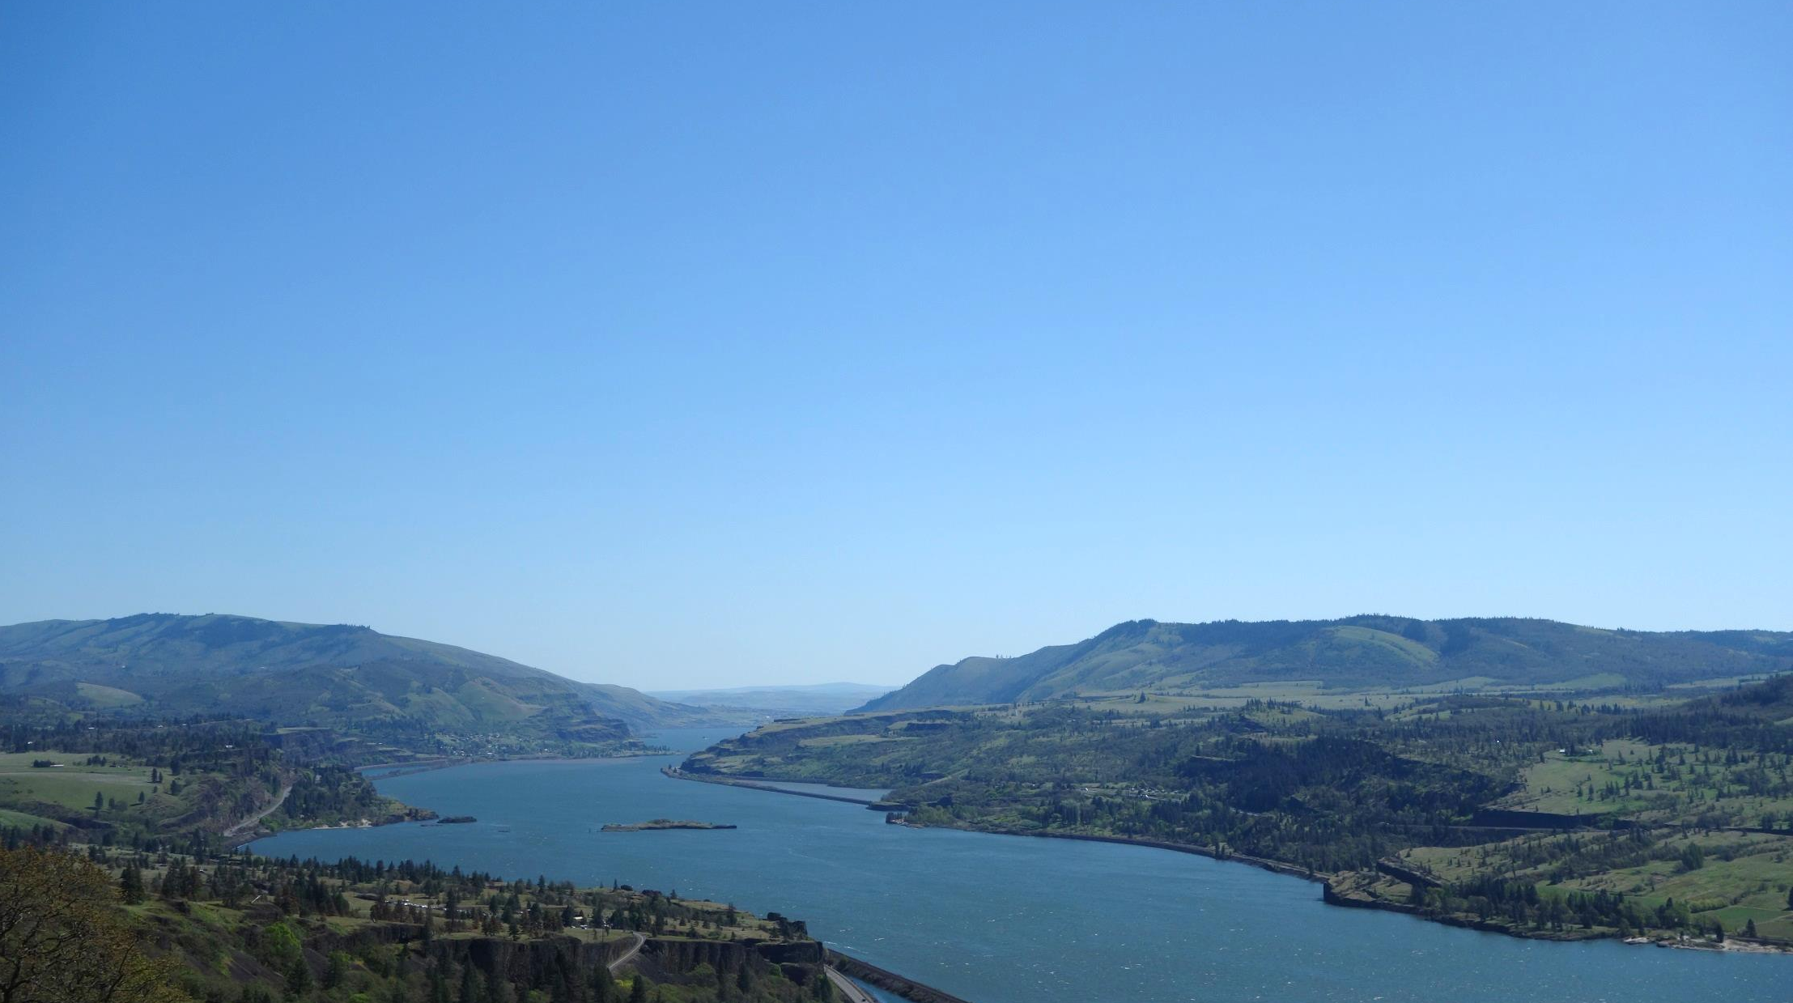
Regional Habitat Indicators Project (RHIP)
Pilot effort - indictors related to surface water attributes
  Flow
  Macroinvertebrates
  Water Temperature
  Water Quality Index

Slide 10
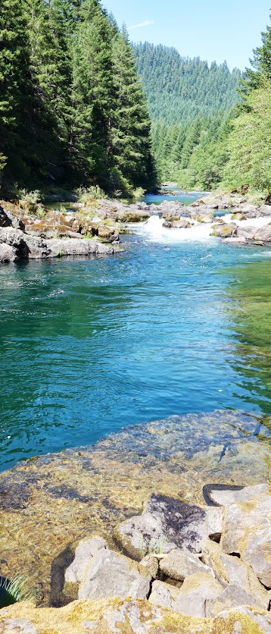
RHIP - Desired Outcomes
Short list of questions, indicators, and objectives for each topic area
Guidance for how to improve indicator data compatibility and accessibility
Suggestions for how to improve reporting for the identified indicators

Slide 11
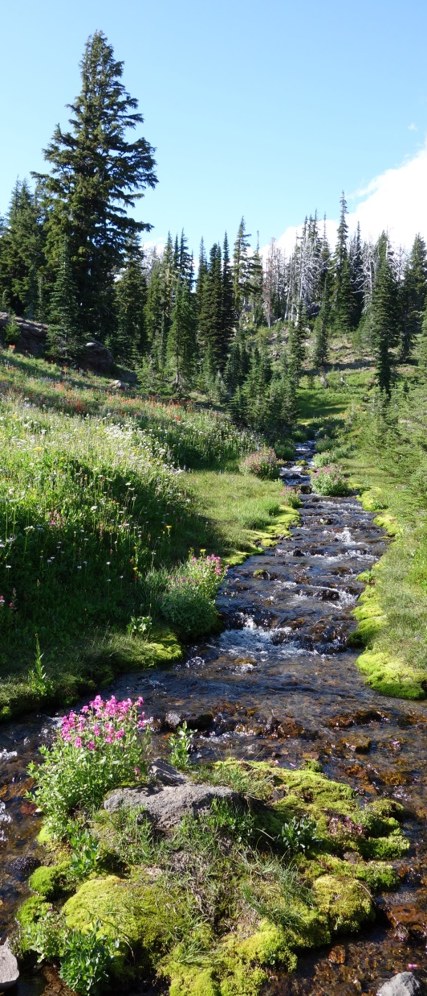
RHIP – Project Benefits
Facilitated data sharing and regional reporting
Enhanced understanding of aquatic habitat condition
Improved ability to communicate to stakeholders, legislatures, governors, and the public

Slide 12
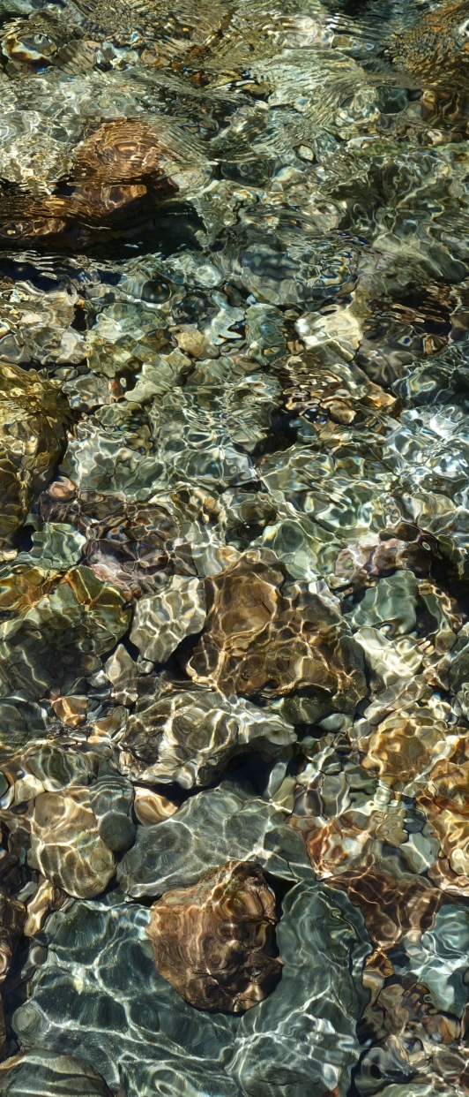
RHIP - Approach
Open, transparent, and collaborative process
Wide breadth of participants – monitoring practitioners, managers, policy makers, academics
Focus on data that is currently available

Slide 13

RHIP – Who’s Involved
Leadership Team
Ken Fetcho (OWEB)
Gretchen Hayslip (EPA)
Dan Rawding (WDFW)
Joel Salter (EPA)
Stephen Waste (USGS)
Chris Wheaton (StreamNet)
Katie McDonald (BPA)
Coordination Team
Amy Puls (USGS/PNAMP)
Nancy Leonard (NPCC)
Jen Bayer (USGS/PNAMP)
Total Project Participants
58 People from
31 organizations
(and growing)

Slide 14
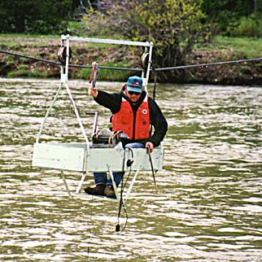
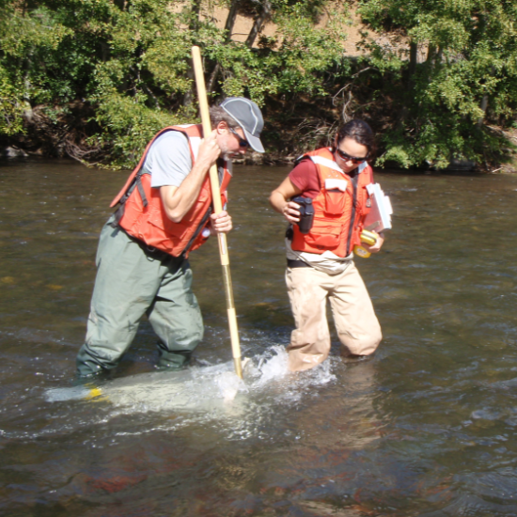
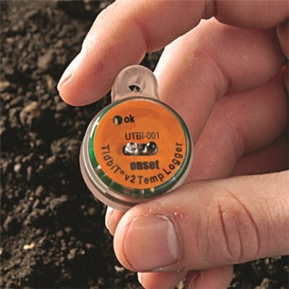
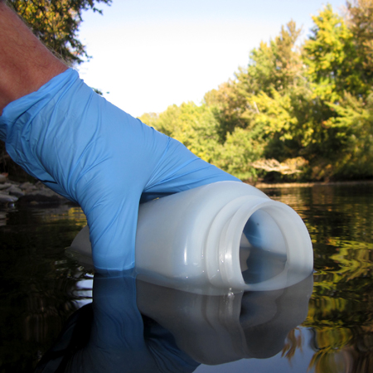
RHIP - Indicator Work Groups
flow
macroinvertebrates
water temperature
water quality

Slide 15
RHIP – Completed Work
Mar | Apr | May | Jun | Jul | Aug | Sep | Oct | Nov | Dec | Jan | Feb | Mar | Apr | May
March - August 2016
Kick-off Meeting March 21, formed work groups
Compiled existing questions and indicators that are being reported in the PNW

Slide 16
RHIP – Collected Information
Information captured |  | One example
Assessment question |  | Is the water clean enough for salmon?
Indicator |  | Water Quality Index
Indicator description |  | Percent of sites where water quality index is improving, declining, or remaining the same
Data needed to calculate indicator |  | temperature, pH, fecal coliform bacteria, dissolved oxygen, total suspended sediment, turbidity, total phosphorus, and total nitrogen
Target or threshold |  | None listed
Information source |  | Washington State of Salmon in Watersheds
Information source citation/URL |  | http://www.stateofsalmon.wa.gov/statewide/indicators/water-quantity/

Slide 17
RHIP – Current Work
Mar | Apr | May | Jun | Jul | Aug | Sep | Oct | Nov | Dec | Jan | Feb | Mar | Apr | May
August - September 2016
Condensed ~70 Questions to 22
NPCC August 9th Staff Work Session
Online surveys to get input from PNW stakeholders to inform selection of short list of questions
Workshop 1 – Sept 22, 2016

Slide 18
RHIP – Future Work
Mar | Apr | May | Jun | Jul | Aug | Sep | Oct | Nov | Dec | Jan | Feb | Mar | Apr | May
October-January: Identify specific indicator(s) that should inform each question.
December 15, check in during NPCC regional coordination meeting
January-April: Examine current accessibility and quality of data for identified indicators
April-May: Develop guidance to improve data compatibility, access, quality and data sharing for identified indicators
Check in with Council members to solicit input

Slide 19
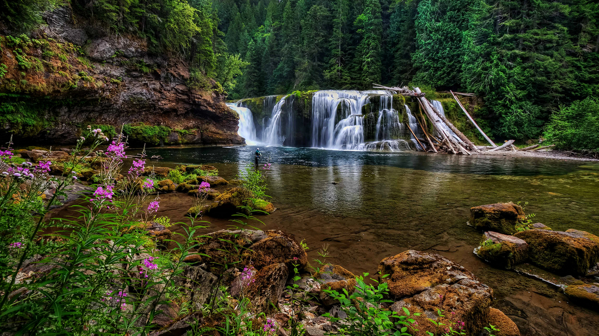
selecting management questions to focus next steps

Slide 20
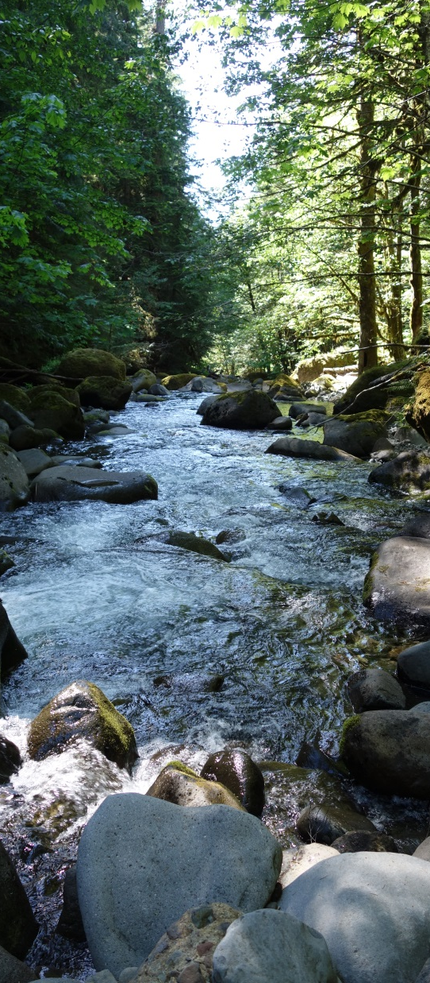
RHIP - Contributing Feedback
Today’s Work Session
Email
Surveys
Workshops
Work Groups
Participate as best fits

Slide 21

RHIP – Survey Rationale
Maximize participation
Minimize time and cost for participants
Anonymity helps prevent self-censorship and group influences
Gives participants the flexibility to modify their views from one round to the next as they learn from others

Slide 22
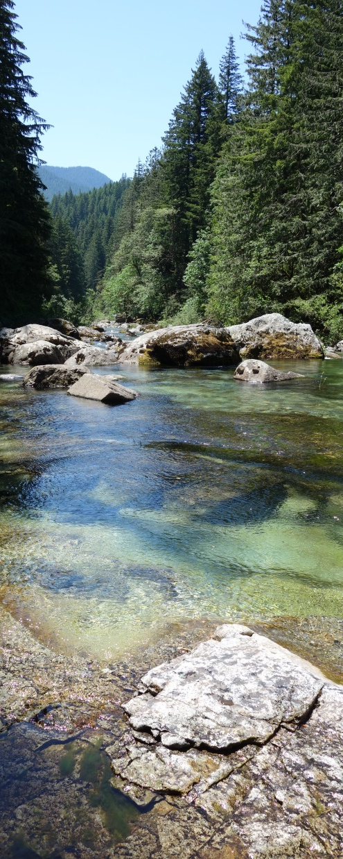
RHIP - Survey Timeline
August 1-15: survey 1 open for responses (extended to August 22 below dates to be adjusted accordingly)
August 16-23: work groups reword questions as needed
August 24: survey 1 results shared
August 24-31: survey 2 open for responses
September 2: survey 2 results shared
September 5-13: work groups discuss survey results and select 3 questions
September 15: workshop agenda and materials distributed
September 22: first workshop

Slide 23
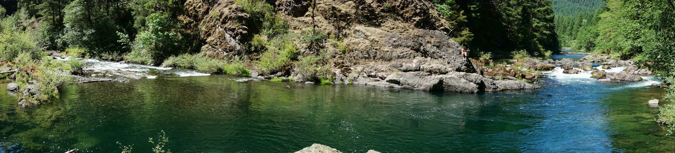
RHIP – 5 Criteria for Ranking Questions
Is the question relevant to regionally based issues?
Is the question applicable at multiple geographic scales?
How beneficial/meaningful is the question to your organization?
Is your organization interested in reporting on this question?
Can the question be answered with available data?

Slide 24
Stream Flow Questions to Rank
Are trends in stream flow improving? Are stream flow targets being met?
Are Best Management Practices (BMPs) having a positive impact on flow?
Are flows achieving a more natural hydrological pattern that reflects seasonal fluctuations, rate of fluctuations, peaks, etc.?
Are flows adequate for resident and anadromous adult fish?
Are flows adequate for juvenile fish?
Is climate change affecting stream flow needed for sustainable fish populations?

Slide 25

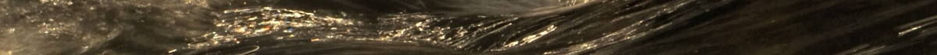
Macroinvertebrates Questions to Rank
Are environmental conditions improving? Are environmental condition targets met?
What are the causes of biological impairments (e.g. sediment, nutrients, temperature)?
Are Best Management Practices (BMPs) having a positive impact on macroinvertebrate indicator scores?
How are land use stressors affecting the status and trends of macroinvertebrate indicators?
What is the macroinvertebrate productivity (diversity and biomass) of the watershed?
Is climate change affecting water quality needed for sustainable fish populations?

Slide 26

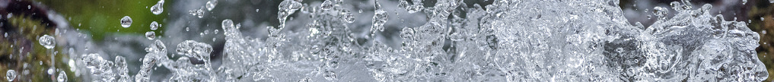
Water Quality Questions to Rank
Are trends in water quality improving? Are water quality targets being met?
Are Best Management Practices (BMPs) resulting in compliance and attaining standards?
Is water quality adequate to support targeted species?
How does the water quality of streams coming from various land use categories compare? How have the parameter values changed over time?
Is climate change affecting water quality needed for sustainable fish populations?

Slide 27

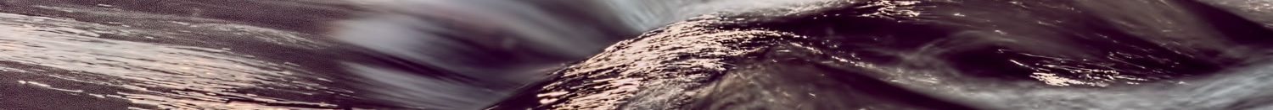
Water Temperature Questions to Rank
Are state water temperature standards for salmon, steelhead, or bull trout exceeded? How often and where?
Are stream temperature conditions generally improving or deteriorating for juvenile and adult fish?
Are Best Management Practices (BMPs) having a positive impact on stream temperatures?
Is climate change impacting stream temperature in the Pacific Northwest significantly enough to affect the survival of aquatic species?

Slide 28
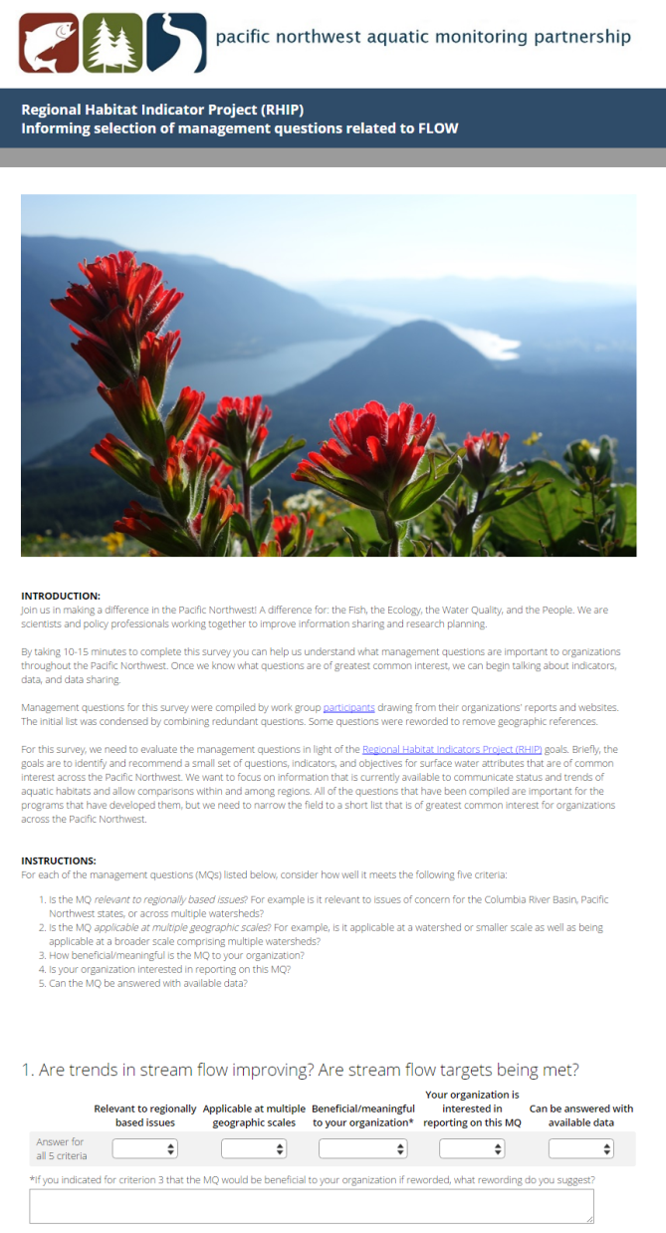
Sneak peak at the surveys

Slide 29
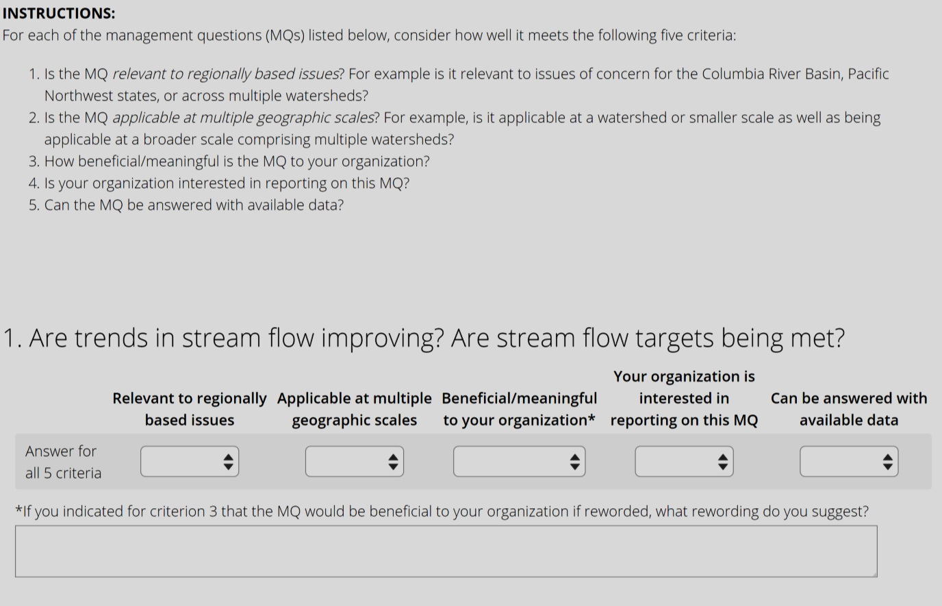
Sneak peak at the surveys

Slide 30
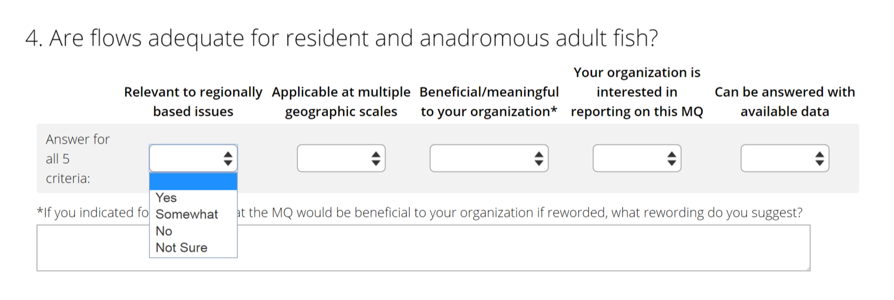
Sneak peak at the surveys

Slide 31
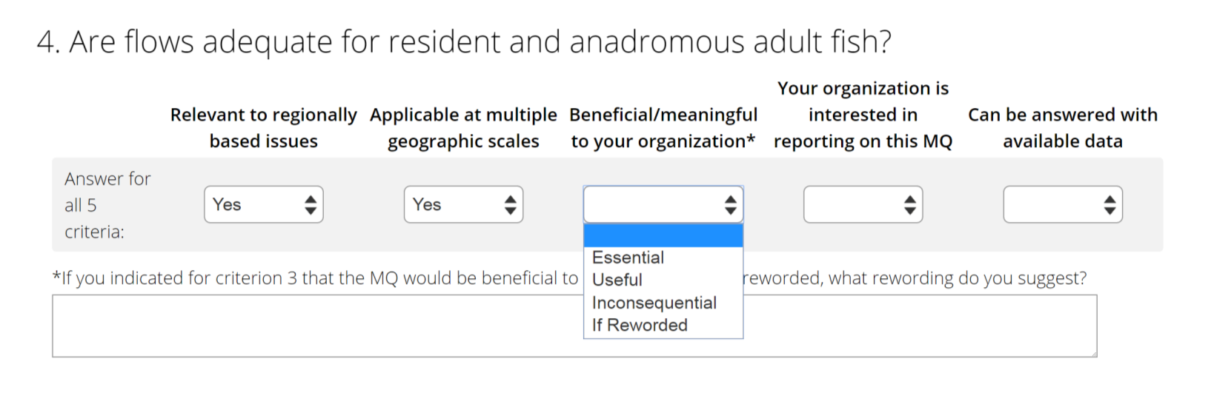
Sneak peak at the surveys

Slide 32
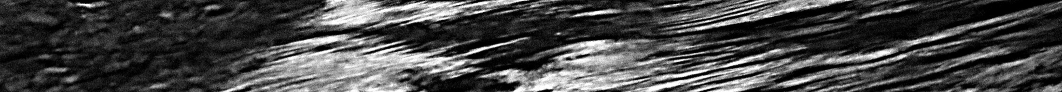
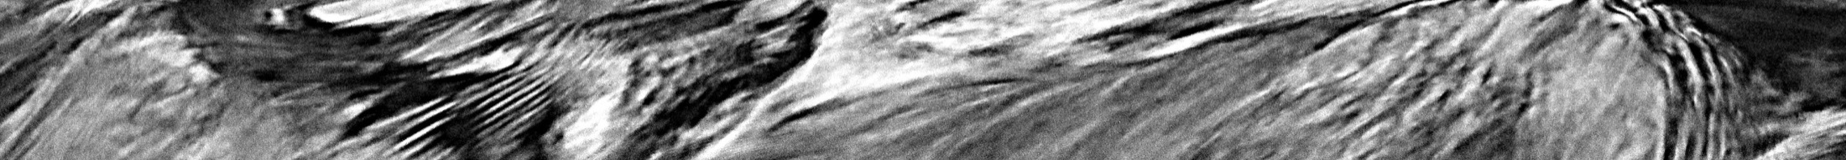
Next Steps
August 12th, Staff will email meeting minutes and survey links
August 18th, Staff will share survey results
August – December, Staff will email additional information
December 15, update during Regional Coordination Meeting
Early summer 2017, Staff work session during a Council meeting to receive input on indicators, metrics, and data
All material will be posted on Council website: http://www.nwcouncil.org/fw/am/goals-objective/

Slide 33
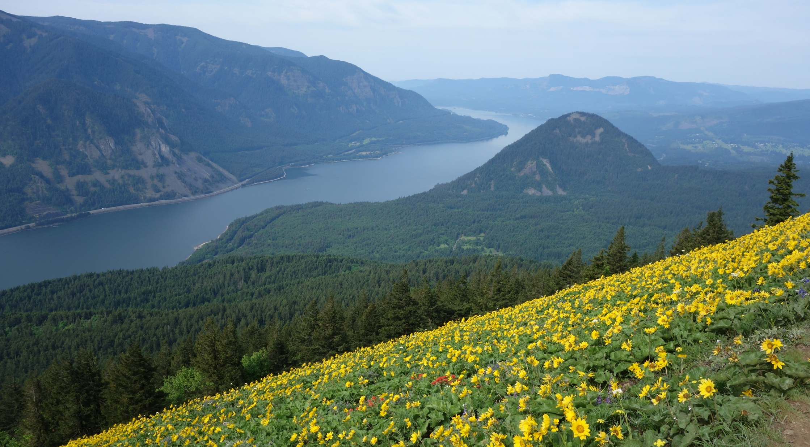
questions, comments, concerns?

Slide 34
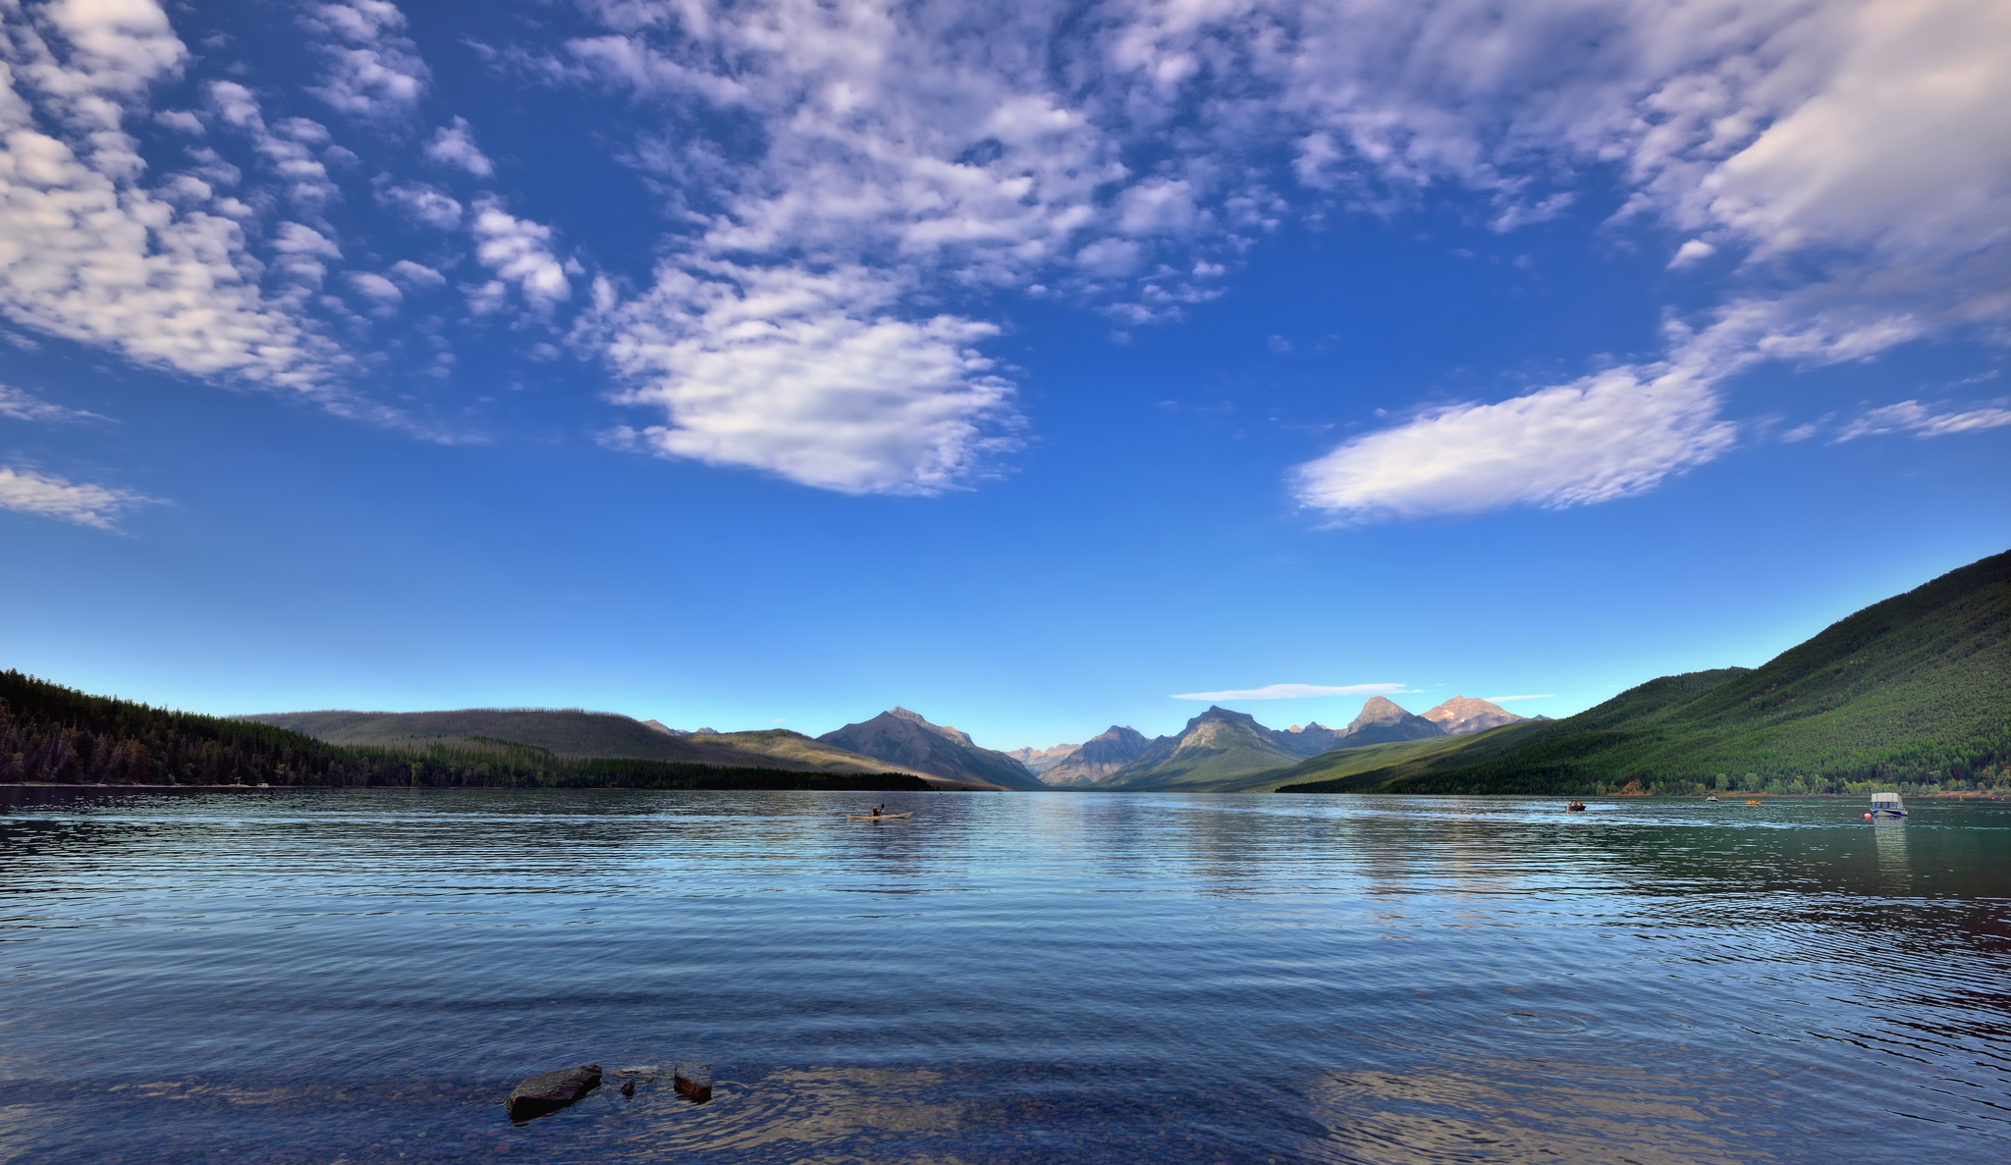
Thanks for joining us!
Photo by Mark Stevens

