Slide 1
Model Conservation Standards and Surcharge Recommendations
CRAC Meeting
June 24, 2015

Slide 2
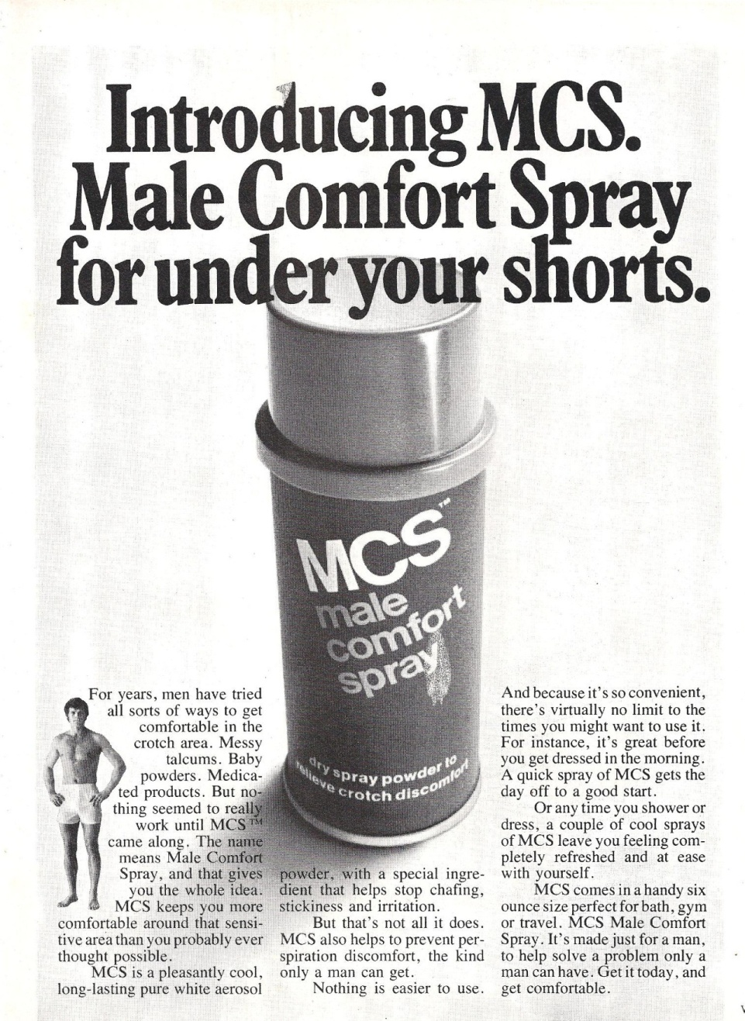
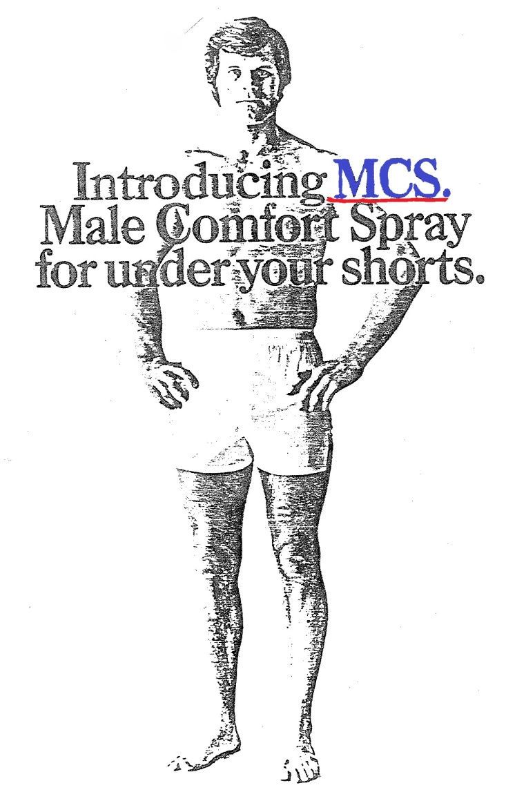
What is the MCS?

Slide 3

OK, Really - What is the MCS?
Section 839b(f)1 of the Power Act:
  “Model conservation standards to be included in the plan shall include, but not be limited to, standards applicable to (A) new and existing structures, (B) utility, customer, and governmental conservation programs, and (c) other consumer actions for achieving conservation.”

Slide 4

What is the “ Policy”?
Surcharge is intended to be cost recovery mechanism for costs incurred on the system
The Council’s Plan must contain a recommendation to the Administrator regarding whether a utility’s failure to achieve MCS savings should be subject to a surcharge on all of its power purchases from Bonneville
  “Such surcharges shall be established to recover such additional costs as the Administrator determines will be incurred because such projected energy savings attributable to such conservation measures have not been achieved;
  Surcharges may not be less than 10%, nor greater than 50% of Bonneville’s rate”

Slide 5
Model Conservation Standards – Decision Criteria
The Act requires that the MCS be set at levels that:
  achieve all regionally cost-effective power savings; and,
  that are economically feasible for consumers, taking into account financial assistance that may be made available through Bonneville

Slide 6
Scene 1 – The Hearing before the Committee on Energy and Natural Resources United States Senate, 95th Congress, Second Session on S. 2080 on the Pacific Northwest Electric Power Supply and Conservation Act, Seattle, WA, April 8, 1978
The MCS - A Short History:
Chapter 1
The Chairman (Senator Henry M. Jackson) – Mr. Tom Eckman will be our next witness.
Mr. Eckman, Chair of the Washington Environmental Council Energy Committee settles nervously into the witness chair.
Senator Jackson - Mr. Eckman, we are delighted to have you as a witness. As you know, we are limiting the individual witnesses to 15 minutes and, of course, you can put your whole statement in and summarize it, however, you wish to proceed.
Mr. Eckman presents his testimony and upon concluding the Chairman proceeds to ask his first question.
Senator Jackson. Mr. Eckman, what is the single most important thing that we could undertake in the Pacific Northwest to bring about true conservation?
Mr. Eckman. I think regionwide the institution of cost-effective building performance standards either in terms of engineering standards or heat loss standards would have the greatest potential for reducing electricity demands.

Slide 7

The MCS - A Short History:
Chapter 2
Council adopted first MCS April 27, 1983
  Established space heating performance targets for new electrically heated residences for three Northwest Climate Zones
    Less than 6,000 Heating Degree Day (HDD)
    6000 – 8000 HDD*
    More than 8000 HDD*
  MCS requirements were 40% better than toughest existing energy codes in region
  Recommended that MCS be adopted by January 1, 1986 or BPA impose 10% surcharge on utilities serving non-complying areas
*Now Zone 2 = 6000 – 7499 HDD, Zone 3 = 7500 HDD and greater

Slide 8
The MCS – A Short History:
Chapter 3
1983 – 1991
  Council sued by Seattle Master Builders contesting legality and level of the MCS
    Conclusion – Ninth Circuit Rules for Council
  Utilities demand that Bonneville sponsor “R&D” project (RSDP) to test “cost-effectiveness” of MCS
    Conclusion – Bonneville finds MCS cost-effective
  Bonneville, following Council’s Plan, sponsors “early code” adoption and “energy efficient” new homes marketing program (Super Good Cents)
    Conclusion – Tacoma adopts MCS, multiple WA and ID cities and counties follow . . .

Slide 9
The MCS – A Short History:
Chapter 4
1986
  Washington State Legislator enacts state energy code that achieves about 50% of the savings called for by the MCS
  Oregon Energy Conservation Board revises state energy code that achieves about 40% of savings called for by MCS beginning in 1987 and 55% beginning in 1989
1991/92 – Oregon and Washington update codes to near MCS levels
2009 – Idaho and Montana adopt codes roughly equivalent to MCS

Slide 10
The MCS – A Short History:
Chapter 4a
Notes:
Today, codes are even more stringent and meet or exceed MCS

Slide 11
The MCS – A Short History:
Chapter 5
Sixth Plan MCS included:
  Recommendations for residential building codes with suggested minimum R-values
  Minimum requirements for new commercial buildings, at least equivalent to current ASHRAE Standard 90.1
  Objectives for all other conservation programs
Notes:
Today, codes are even more stringent and meet or exceed MCS

Slide 12

MCS – Next Steps
What should the MCS be for the Seventh Plan?
  Act provides for broad application
  Focus on utility and BPA program design
  Keep all cost-effective measure requirement for fuel conversion to electric space/water heat
  Eliminate specific language on code provisions

Slide 13
Our Ideas
Expand upon 6P Objectives for conservation programs (see attachment)
Add that programs should:
  Better reach underserved customers
  Continue to work toward enhancing codes & standards
  Ensure utilities will adopt Conservation Voltage Regulation (CVR) or Volt/VAR Optimization (VVO)

Slide 14
Other Ideas
Use MCS to ensure public utilities are acquiring their share of target
This would require that:
  Utilities perform CPA to determine share of target
    Option: all utilities, or subset based on # of customers or total load
    Phase in requirement, starting with larger utilities
  A mechanism for BPA to determine achievements
Could be MCS (surchargeable) or Action Item (no surcharge)

Slide 15

Feedback & Discussion
Need Comments by July 3 to incorporate in Draft Plan

