Slide 1
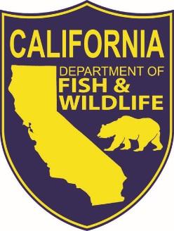
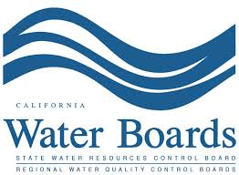
Klamath Fish Health Assessment Team
Sara Borok & Katharine Carter
Presentation to the
Northwest Power & Conservation Council
Regional Coordination Forum - May 12, 2016
Notes:
Good morning, thanks for having us here today to talk about the Klamath Fish Health Assessment Team (or KFHAT as we call ourselves)…
Katharine Carter, Environmental Scientist, with California’s North Coast Regional Water Quality Control Board
Our agency is part of the California EPA and our mandate is to develop and enforce water quality standards in accordance with the Clean Water Act.
Participating in KFHAT since 2004
Joining me today is Sara Borok, a Environmental Scientist with the California Department of Fish and Wildlife.
Which is under the umbrella of the California Natural Resource Agency. CDFW oversees management of fishery, wildlife, and plant resources in California.
Sara is a founding member of KFHAT participating since 2002.
Together Sara and I have been coordinating KFHAT since 2005. Our role is to facilitate data & information sharing among members of the KFHAT group and to the general public.

Slide 2
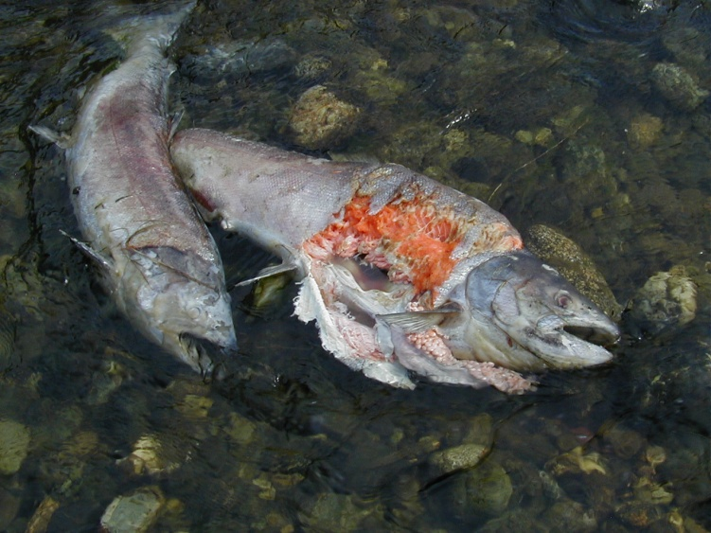
Presentation Topics
Overview
  Klamath Basin
  KFHATs Formation
Klamath Fish Health Assessment Team
    Who
    What
    How
Example of KFHAT in Action
Notes:
(Review who will present what)
Sara – Overview: 1) Klamath Basin & its fishery 2) Factors leading to the formation of KFHAT
Sara & Katharine – KFHAT details
Katharine – Example from 2014.

Slide 3
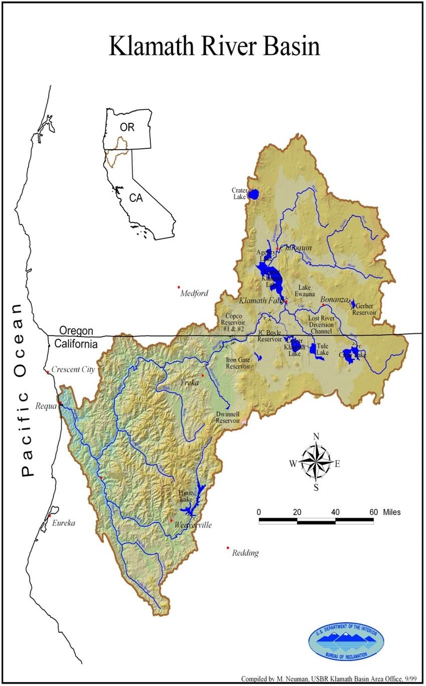
Overview
Why is the Klamath River Important?
2nd largest river in CA
263 miles long
Drains over 16,000 sq miles.
Straddles CA/OR border
Used as the surrogate for all coastal stream anadromous fall run Chinook in Ocean Harvest Modeling up and down West coast CA
Multiple uses of the water
Iron Gate Dam
River
Shasta River
Klamath
Scott River
Salmon River
Trinity
River
Notes:
Sara
Review/discuss Klamath overview/background info:
-river system, dams locations
-Lower/Mid Klam anadromous up to dams (IGD and Lewiston), Upper Klam above IGD. Extent of histoprical anadromy.
Basin upside down 65-75 % of upper basin fresh water storage(wetlands) converted to ag.
As will be discussed later KFHAT focuses on the Anadramous portion of the basin (point out on Map the area below iron gate dam).
Multi uses in basin -used for Ag, commercial/sport/ subsistance fishing, cultural use, recreation, etc.
Monitoring and research is very collaborative> Natural Spawner Escapement data gathered by most of the same folks who are KFHAT members.
Six dams on Klamath, Iron Gate (point out on slide), Copco I and II, JC Boyle, Keno and Link River…on Fall Creek there is also a dam.

Slide 4
Overview
Why is the Klamath River Important?
Historic anadromous run in upper basin
Water quality impairments
  TMDL
Fish disease
“Upside down” river
  Flat upper basin - 65% of historic wetlands/marshes converted to agriculture
  Steep lower basin
Iron Gate Dam
River
Shasta River
Klamath
Scott River
Salmon River
Trinity
River
Notes:
Sara
Review/discuss Klamath overview/background info:
-river system, dams locations
-Lower/Mid Klam anadromous up to dams (IGD and Lewiston), Upper Klam above IGD. Extent of histoprical anadromy.
Basin upside down 65-75 % of upper basin fresh water storage(wetlands) converted to ag.
As will be discussed later KFHAT focuses on the Anadramous portion of the basin (point out on Map the area below iron gate dam).
Multi uses in basin -used for Ag, commercial/sport/ subsistance fishing, cultural use, recreation, etc.
Monitoring and research is very collaborative> Natural Spawner Escapement data gathered by most of the same folks who are KFHAT members.
Six dams on Klamath, Iron Gate (point out on slide), Copco I and II, JC Boyle, Keno and Link River…on Fall Creek there is also a dam.

Slide 5
Overview
Why was KFHAT formed?
2000
2001
2002
2003
Drought
Notes:
Sara
2000 to 2004 Drought
2001 Water shut off to farmers in upper basin
2002 was a water adjudication year and farmers were trying to recoup losses of 2001.
2002 Lower Klamath Run size was predicted to be above average.
2002 lower Klamath fish die off…and spring chinook die off.
2002 fish kill:
Over 34,000 adult fish killed
Early, large run of fall Chinook salmon
Low flow & channel geometry caused migration barriers
Warm water temperatures optimal for parasite & bacterium proliferation
(CDFW 2004, USFWS 2003)
Disease
2003 Governors of OR and CA recognized that coordinated effort needed to ensure another fish kill didn’t occur. Direct formation of a workgroup to work on klamath basin issues.
2003 Meeting with policy makers to start an early warning system in the basin. KFHAT is born…
2004 CA/OR Governors, Dept of Interior, and others signed the “Klamath River watershed coordination agreement” which solidified the need for KFHAT and other programs in the Klamath Basin.

Slide 6
Overview
Why was KFHAT formed?
2000
2001
2002
2003
Drought
Drought
Upper basin water shut off
Notes:
Sara
2000 to 2004 Drought
2001 Water shut off to farmers in upper basin
2002 was a water adjudication year and farmers were trying to recoup losses of 2001.
2002 Lower Klamath Run size was predicted to be above average.
2002 lower Klamath fish die off…and spring chinook die off.
2002 fish kill:
Over 34,000 adult fish killed
Early, large run of fall Chinook salmon
Low flow & channel geometry caused migration barriers
Warm water temperatures optimal for parasite & bacterium proliferation
(CDFW 2004, USFWS 2003)
Disease
2003 Governors of OR and CA recognized that coordinated effort needed to ensure another fish kill didn’t occur. Direct formation of a workgroup to work on klamath basin issues.
2003 Meeting with policy makers to start an early warning system in the basin. KFHAT is born…
2004 CA/OR Governors, Dept of Interior, and others signed the “Klamath River watershed coordination agreement” which solidified the need for KFHAT and other programs in the Klamath Basin.

Slide 7
Overview
Why was KFHAT formed?
2000
2001
2002
2003
Drought
Drought
Upper basin water shut off
Drought
Above average predicted fall Chinook run
Low flows/channel geometry caused migration barrier
High water temperatures
Disease
FISH KILL
Notes:
Sara
2000 to 2004 Drought
2001 Water shut off to farmers in upper basin
2002 was a water adjudication year and farmers were trying to recoup losses of 2001.
2002 Lower Klamath Run size was predicted to be above average.
2002 lower Klamath fish die off…and spring chinook die off.
2002 fish kill:
Over 34,000 adult fish killed
Early, large run of fall Chinook salmon
Low flow & channel geometry caused migration barriers
Warm water temperatures optimal for parasite & bacterium proliferation
(CDFW 2004, USFWS 2003)
Disease
2003 Governors of OR and CA recognized that coordinated effort needed to ensure another fish kill didn’t occur. Direct formation of a workgroup to work on klamath basin issues.
2003 Meeting with policy makers to start an early warning system in the basin. KFHAT is born…
2004 CA/OR Governors, Dept of Interior, and others signed the “Klamath River watershed coordination agreement” which solidified the need for KFHAT and other programs in the Klamath Basin.

Slide 8
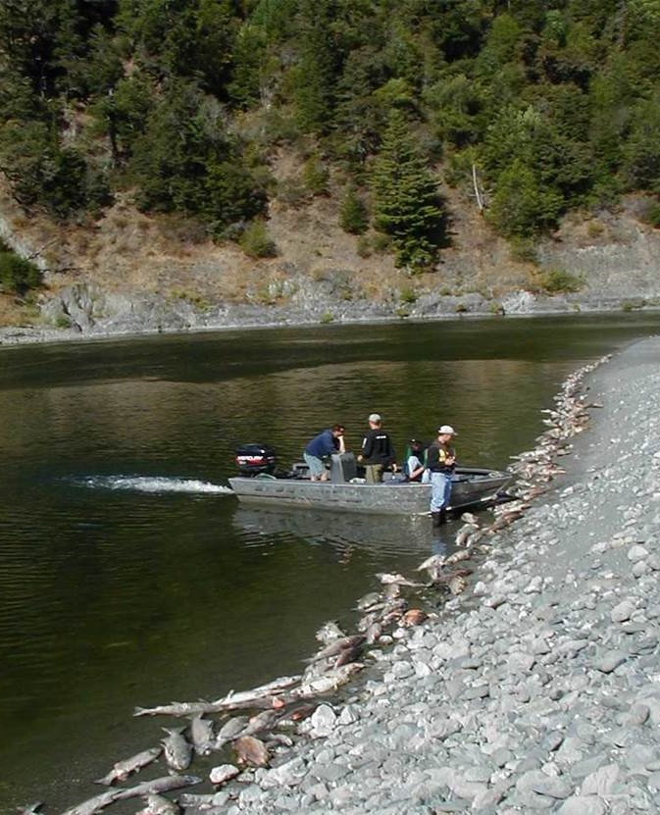
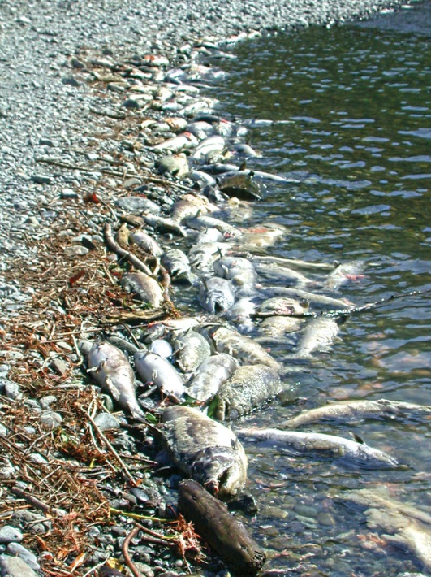
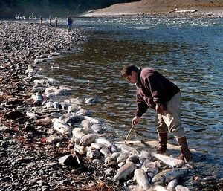
Overview
2000
2001
2002
2003
FISH KILL
34,000-70,000 fish died (mostly fall Chinook)
Drought
Notes:
Sara
2000 to 2004 Drought
2001 Water shut off to farmers in upper basin
2002 was a water adjudication year and farmers were trying to recoup losses of 2001.
2002 Lower Klamath Run size was predicted to be above average.
2002 lower Klamath fish die off…and spring chinook die off.
2002 fish kill:
Over 34,000 adult fish killed
Early, large run of fall Chinook salmon
Low flow & channel geometry caused migration barriers
Warm water temperatures optimal for parasite & bacterium proliferation
(CDFW 2004, USFWS 2003)
Disease
2003 Governors of OR and CA recognized that coordinated effort needed to ensure another fish kill didn’t occur. Direct formation of a workgroup to work on klamath basin issues.
2003 Meeting with policy makers to start an early warning system in the basin. KFHAT is born…
2004 CA/OR Governors, Dept of Interior, and others signed the “Klamath River watershed coordination agreement” which solidified the need for KFHAT and other programs in the Klamath Basin.

Slide 9
Overview
Why was KFHAT formed?
2000
2001
2002
2003
Drought
Drought
Upper basin water shut off
Drought
Above average predicted fall Chinook run
Low flows/channel geometry caused migration barrier
High water temperatures
Disease
FISH KILL
CA/OR Governors Workgroup
KFHAT formed
Notes:
Sara
2003 Governors of OR and CA recognized that coordinated effort needed to ensure another fish kill didn’t occur. Direct formation of a workgroup to work on klamath basin issues.
2003 Meeting with policy makers to start an early warning system in the basin. KFHAT is born…
Because of lack of coordination and timely collection and centralized collection of data a plan needed to be made in case this happens again.
2004 CA/OR Governors, Dept of Interior, and others signed the “Klamath River watershed coordination agreement” which solidified the need for KFHAT and other programs in the Klamath Basin.

Slide 10
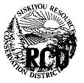
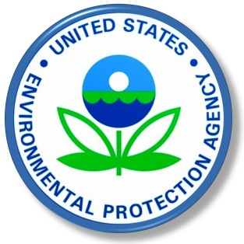

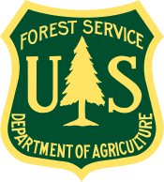

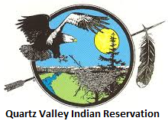


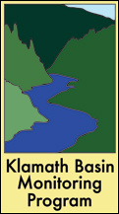

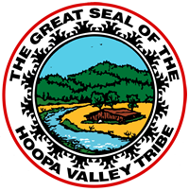



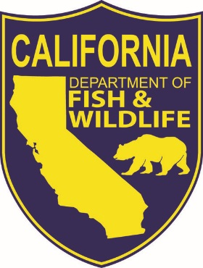

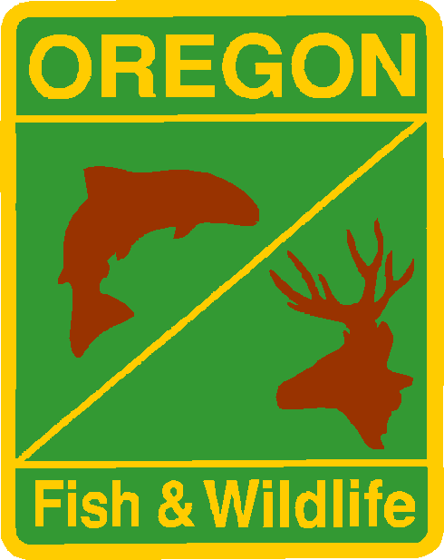

Who is KFHAT?
Shasta Valley Resource Conservation District (SVRCD)
US Fish and Wildlife Service California-Nevada Fish Health Center
Notes:
Katharine
Technical Workgroup…comprised of fishery and water quality scientists and field technicians.
KFHAT has diverse group of participants including:
Tribes, non governmental organizations, federal and state agencies, as well as env. consultants and Oregon State University.
We are the folks already working in the basin doing various fishery and water quality work. The data and information each organization shares at KFHAT meetings is information they are already collecting to fulfill the missions and mandates of their individual organizations.
KFHAT has given us the forum to share current data & information collected by members throughout basin, to assess real-time river conditions in a comprehensive and collaborative manner.
There is no dedicated funding to run or participate in KFHAT. Each organizations participation in KFHAT is funded by their individual organization and programs.
In general, participation in KFHAT entails about 3-4 hours/month for our members…and…
…on average, 10 hours/month for the coordinators.
Not a huge time commitment, but participation has a huge benefit.

Slide 11
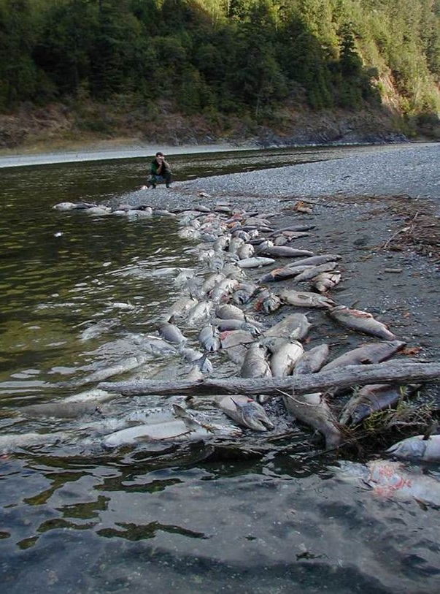
What does KFHAT do?
Assess conditions & provide “early warning”
Coordinate response monitoring
Inform resource managers of fish health conditions
Provide science-based recommendations for resource management actions
KFHAT DOES NOT set policy or allocate resources
Notes:
Katharine
What does KFHAT do?
KFHATs mission is two-fold…
(1) to provide early warning to avert a fish kill
(2) to mobilize a coordinated response effort to monitor conditions during a fish kill event
To accomplish our mission…KFHAT uses real-time data & information collected by members throughout basin, to assess river conditions and determine how likely it is that a fish kill will occur.
Information is shared with agency management and resource managers, allowing them to make science based resource management decisions
If a fish kill event is imminent or actively occurring, KFHAT is capable of initiating, very large, coordinated monitoring response to capture water quality and fisheries conditions. Framework for our response is laid out in the Response Plan (I’ll discuss in a moment) and we also provide trainings on how to respond & conduct monitoring during a fish kill.
Since KFHAT has been developed as a TECHNICAL WORKGROUP, the group itself does not have any direct policy making or resource allocation authority
…however…as a collaborative team of water quality and fishery experts, when the group determines that a fish kill is likely to occur that message is shared with management within our organizations
…and to resource managers who use the information to make decisions about agency actions and resource allocation.
(We help provide the science behind resource decisions)

Slide 12
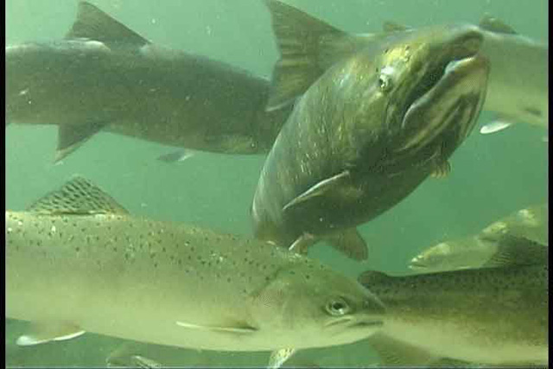
How does KFHAT do it?
Data & Information Sharing
Hydrologic conditions
Fishery data and information
Disease monitoring
Water quality data
Blue-green algae
Data and information utilized to determine the likelihood of a fish kill
Notes:
Katharine
How does KFHAT do it?
KFHAT holds teleconferences at varying frequencies depending on the liklihood of a fish kill. Begin in spring every month or two weeks, and hold calls weekly during times of heightened concern.
Calls generally last 30 minutes to 1 hour, quick check in on the latest conditions.
KFHAT members collect numerous types of data to monitor and evaluate current conditions. When determining how likely a fish kill is to occur, KFHAT members consider the available data including
-information on hydrologic conditions such as snow pack, how much water is available in the basin, river flows, access to tributaries
-Fisheries data including how large the returning run of adult salmonids is predicted to be
-Data from disease montoring efforts which convey if salmonids are at risk from different parasites and bacterial infections
-…water quality data on river temperatures and dissolved oxygen levels
…and data on blue green algae and their toxins.
You can see from this list, that KFHAT looks at all the factors that influence fish health.

Slide 13
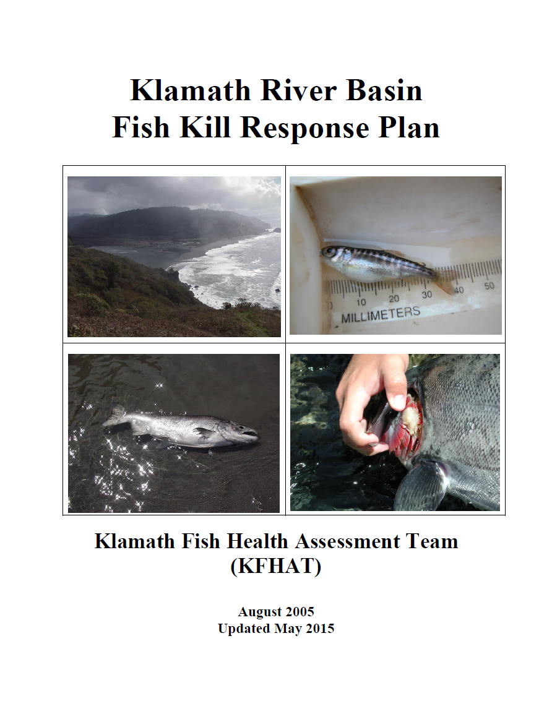
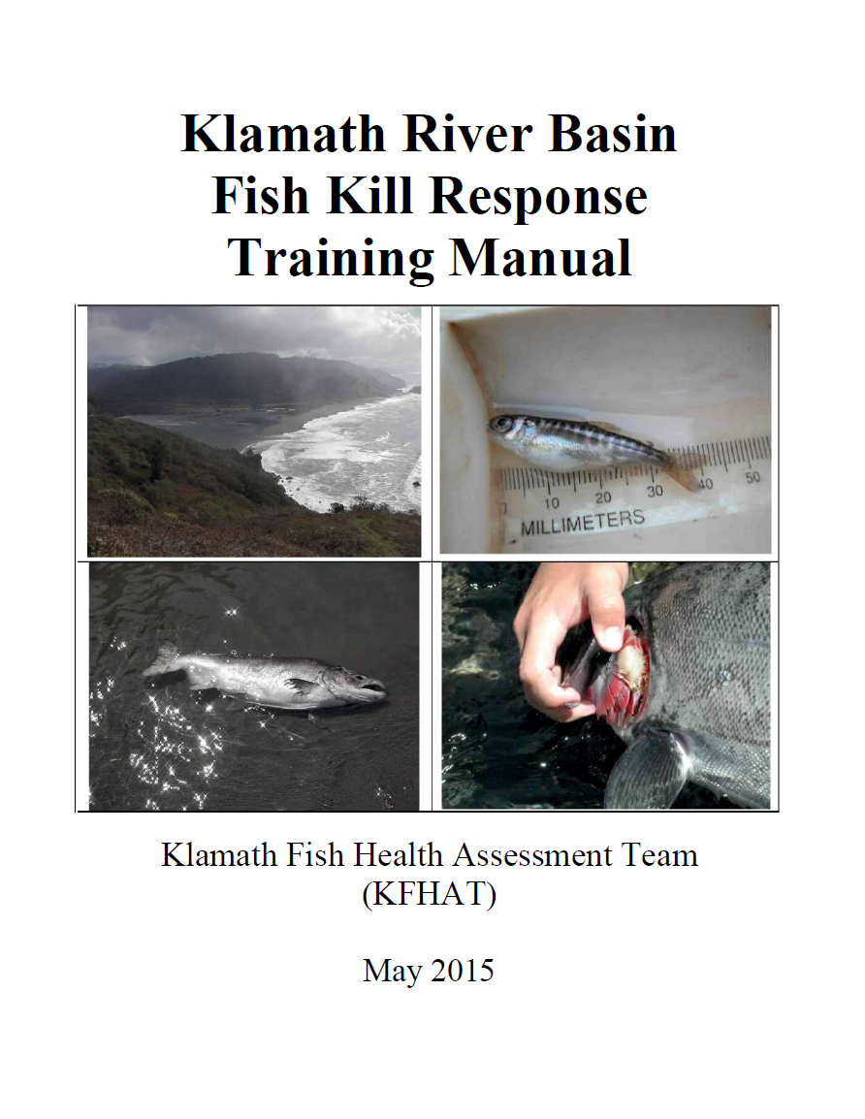
How does KFHAT do it?
Fish Kill Response Plan
Training Manual
Notes:
Katharine
To aid KFHAT in our mission we developed two documents
1) Klamath River Basin Fish Kill Response Plan…
--And the--
2)Klamath River Basin Fish Kill Response Plan Training Manual

Slide 14
How does KFHAT do it?
Fish Kill Response Plan
KFHATs mission
Communication & notification protocol
Response protocols
Data responsibilities
Post event activities
Notes:
Katharine
In the event that a fish kill occurs, KFHAT will initiate a coordinated monitoring response utilizing the process laid our in the Klamath River Basin Fish Kill Response Plan…
The Response Plan itself is a concise document (only 11 pages) lays out the framework for KFHAT response, roles, and responsibilities. The appendices…are the part of the document that evolve and are updated from year to year such as data sheets and KFHAT contacts.
The Plan
Defines role of KFHAT in the Klamath basin
Lays out coordination and monitoring actions we will take in the event of a fish kill
Response & Data reporting protocols
Data Reporting Leads for water quality, fishery, disease data.
Discusses Post event debriefing process
(next slide)

Slide 15
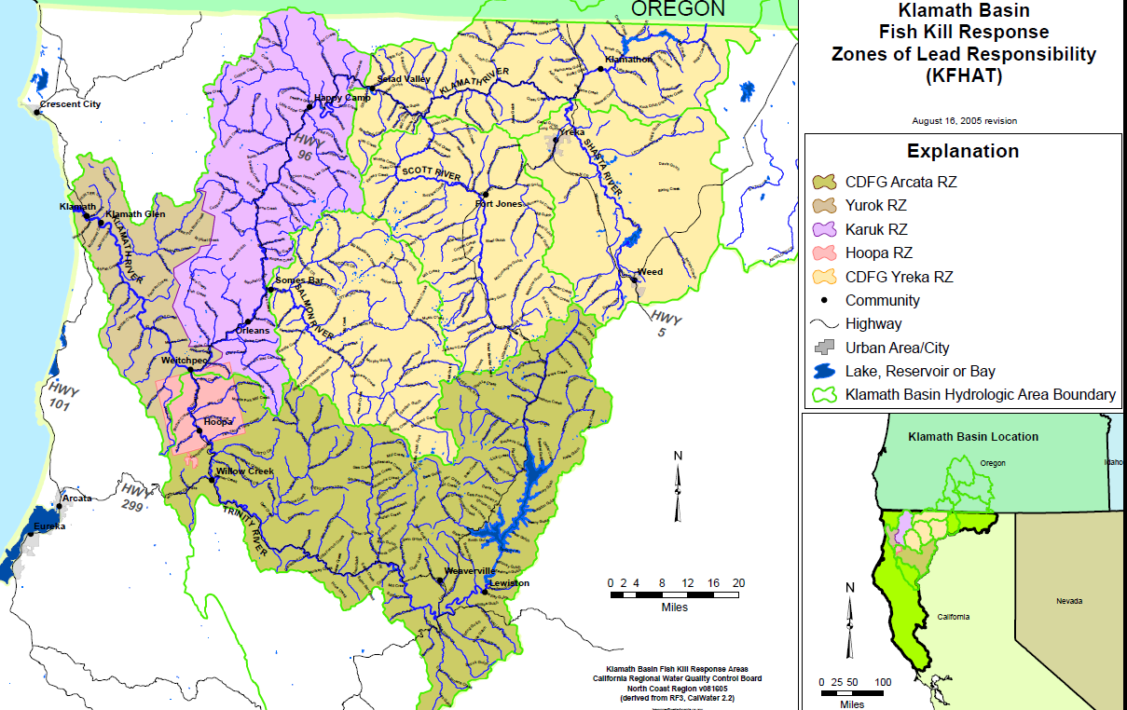
How does KFHAT do it?
Fish Kill Response Plan: Zones of Lead Responsibility
Notes:
Katharine
The Plan
Designates who is lead agency/tribe during response…depends on the location of the fish kill
I don’t intend you to be able to understand this whole map…but what it shows is that each color represents a different lead response entity
For example…if a fish kill occurs in the purple area shown here (use laser pointer), this map denotes that the Karuk Tribe would be the lead for coordinating the KFHAT response.

Slide 16
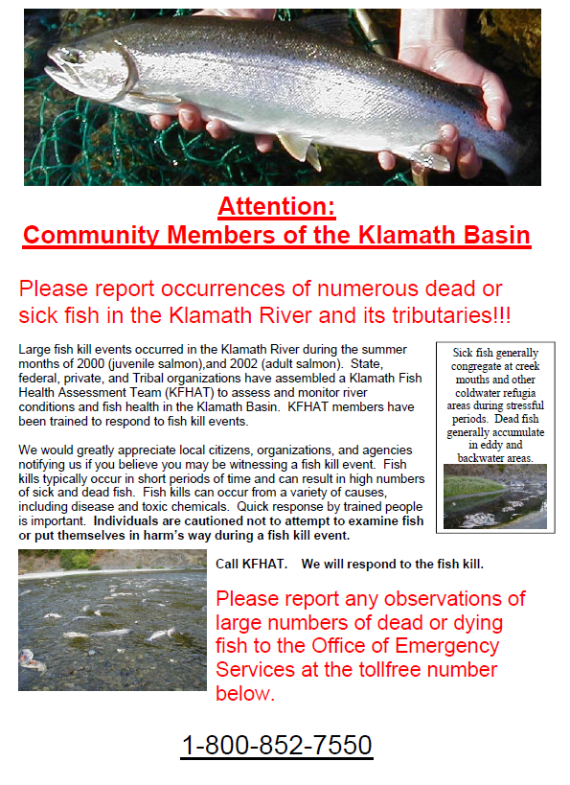
How does KFHAT do it?
Fish Kill Response Plan:
Posters for Public Outreach
Notes:
Katharine
The Plan
Contains Posters that our members put up along the river…with who the public should Notify in the event of a fish Kill. Sara has arranged for us to use the California Office of Emergency Services 24 hour number so reports can be taken any time day/night.
If a member of the pubic sees dead fish on the river, they call CA Office Emerg. Serv number on the poster…

Slide 17
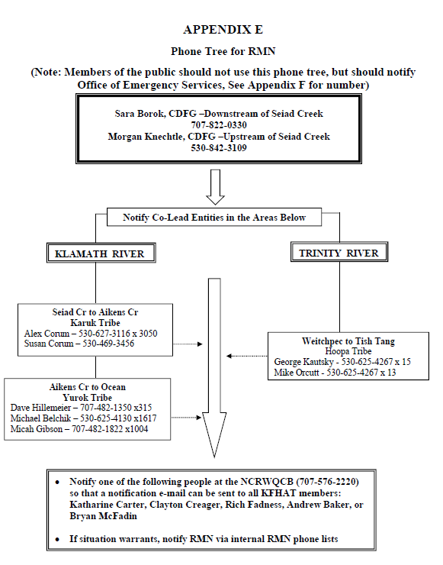
How does KFHAT do it?
Fish Kill Response Plan: Notification Phone Tree
Notes:
Katharine
…OES then calls Sara, who notes the location on the river and then refers the report to the appropriate lead entity (as shown on the map on the previous slide & in the phone tree shown here)…
….the lead entity does and initial investigation, and determines if the situation warrants notifying the larger KFHAT response group and we go from there.
As you can see, the phone tree lays out the order in in which key KFHAT members are notified
Another feature of our Response plan is that it demines, what we call our “Readiness levels”, which indicate to the public how likely a fish kill is to occur. Sara will speak to that now.

Slide 18
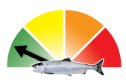
How does KFHAT do it?
Fish Kill Response Plan: Readiness Levels
Movement between levels based upon collective best professional judgment/group consensus
Considerations for movement between levels:
    Lower river flows
    Predicted run size
    Water temperature
    Disease
    Reports of dead fish
Notes:
Sara
Readiness Levels – Reflect KFHATs assessment of information and determination of how likely a fish kill is to occur. Use a stoplight symbology (shown in the picture) - Green “conditions good” to Red “fish kill occurring”
Discuss how we determine movement between readiness levels
Internal levels based on best professional judgement and consensus of the group.
Run Size of 130,000 is average
Low River Flows over 2,800 in Aug /Sept
Water Temps over 22 C
Reports of diseased fish

Slide 19
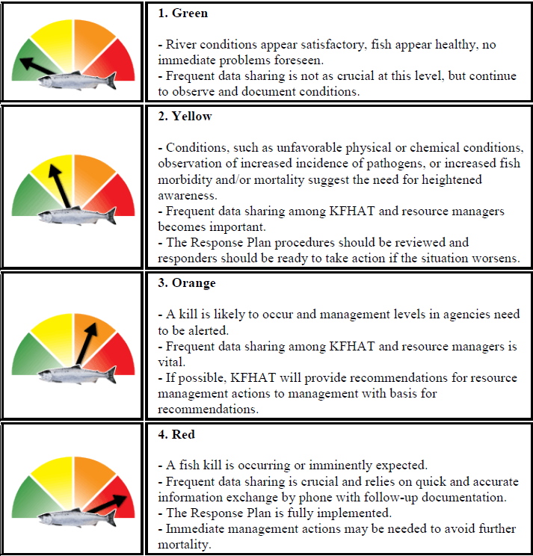
How does KFHAT do it?
Fish Kill Response Plan:
Readiness Levels
Notes:
Sara
BRIEFLY review the four readiness levels and what they each mean for our preparation/actions.

Slide 20
How does KFHAT do it?
Training Manual
Reviews Sampling protocols for:
Water quality sampling
Adult enumeration
Juvenile enumeration
Disease assessment
Notes:
Sara
KFHAT also developed Klamath River Basin Fish Kill Response Plan Training Manual with sampling protocols:
WQ sampling
Counting adult and juvenile dead fish
And for disease assessment

Slide 21
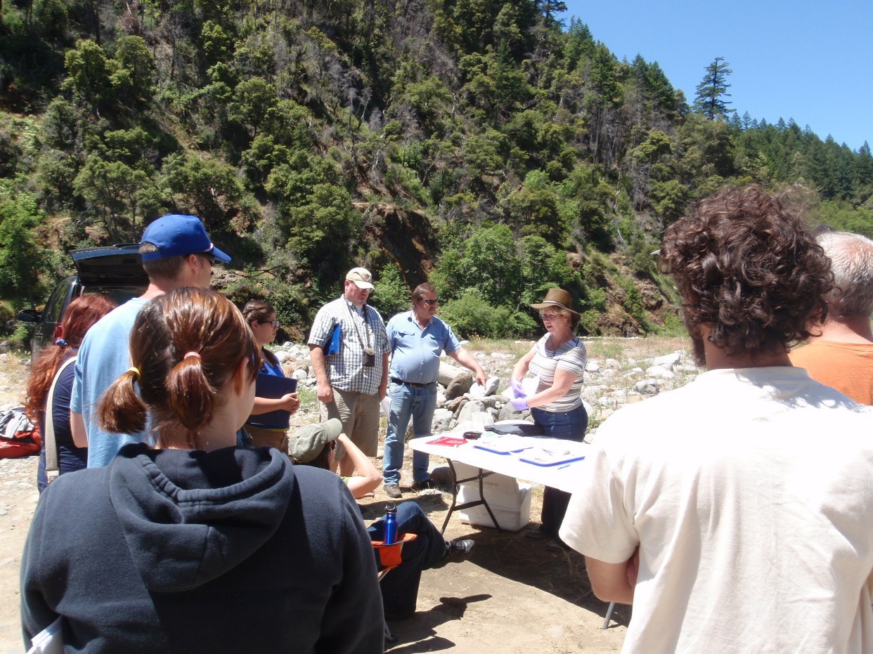
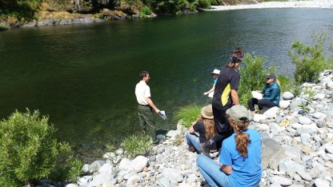
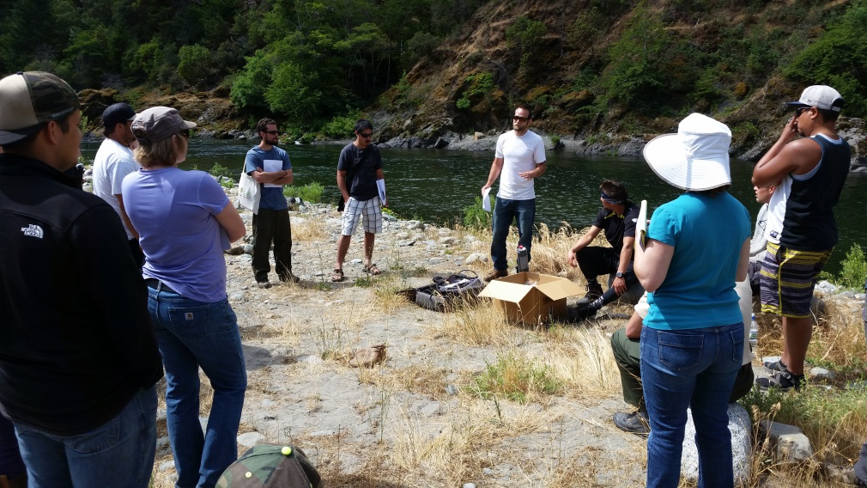
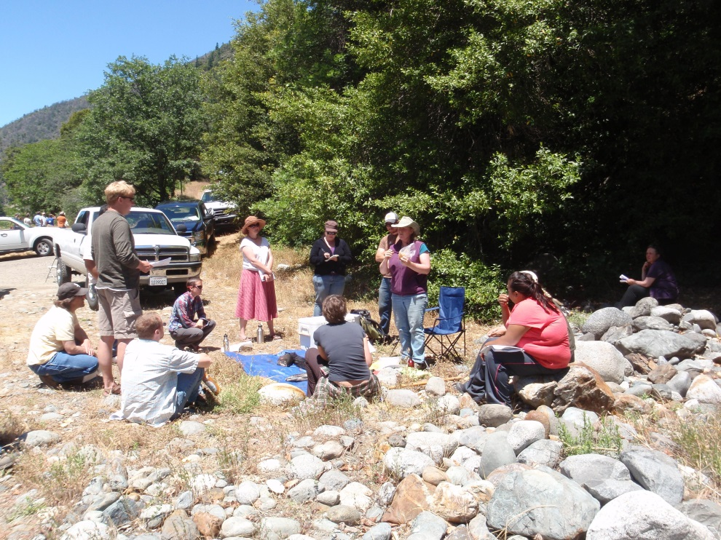
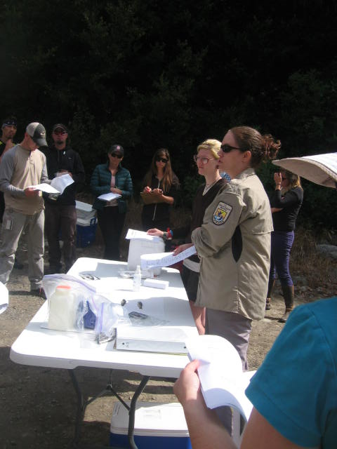
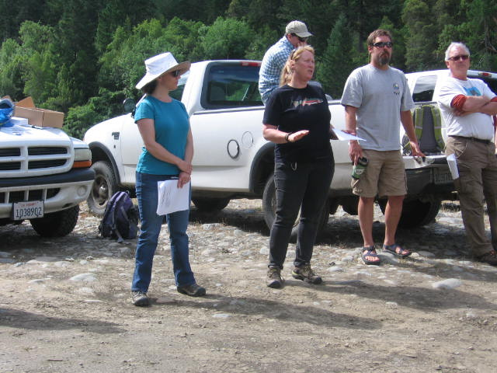
How does KFHAT do it?
Training Manual
Notes:
Sara
WE HAVE CONDUCTED Four TRAININGS TO DATE, the last one in 2015
No dedicated funding for training, but diverse organizations each sponsor a section and management in federal, state, NGO, and tribes support the effort as we are a well known entity in the basin with a critical mission.
We have trainers that do this sort of work on a regular basis teach technician level sampling to field personnel.
Let trainees know they will not be sent out on their own to do this in the event of a fish kill, they will be part of a team.
Expose them to the sorts of things that will be sampled and they will go with crews in their area of experience.
Let other cooperators know what kind of gear they need to have on hand in case of a kill and to bring with them.

Slide 22
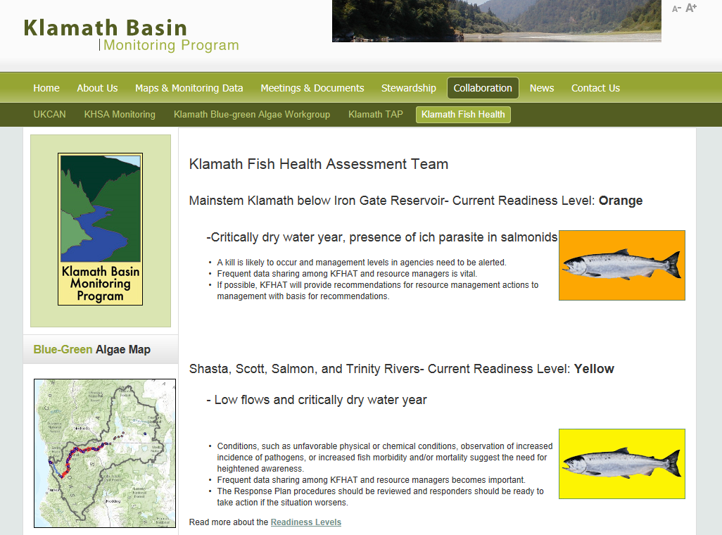
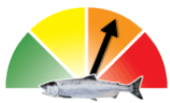
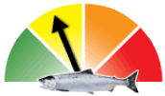
How does KFHAT do it?
KFHAT Website: http://www.kbmp.net/collaboration/kfhat
Notes:
Katharine
KFHAT has a website we use to share information with the public and with our members.
KFHAT doesn’t have dedicated funding we have benefited by collaborating with the Klamath Basin Monitoring Program, webpage house on the KBMP website.
The Klamath Basin Monitoring Program is comprised of many of the organizations who participate in KFHAT, as well as representatives from Oregon working in the Klamath Basin.
It has 50 member organizations…and much like KFHAT participation is voluntary.
Its members coordinate and collaborate on water quality, fishery, and fish diease monitoring and research throughout the Klamath Basin.
This coordination allows entities to collaborate and share data and information, to avoid data duplication, promote best use of resources, and standardize data collection protocols and lab reporting limits.
Much of the information collected by KBMP participants is shared during the KFHAT calls, so this collaboration is a great benefit to everyone.
As you can see the webpage…
Reflects current readiness level (here orange shown for the mainstem Klmamath, and yellow for the tribs)
This is where the response plan and training manual can be found
Its where we post meeting notes, important documents, press releases, etc.

Slide 23
Example of KFHAT in Action
2002
Early, above average adult fall Chinook run size (169,297)
16th driest year (1981-2014)
Klamath snow pack 120% of normal
Prolonged resident time for adult spring/fall Chinook in lower river due to fish passage barriers
Tributary flows below average
Ich parasite infections (adults)
Columnaris & C. shasta (adults)
2014
Early, below average adult fall Chinook predicted run size (92,000)
3rd driest year (1981-2014)
Klamath snow pack 31% of normal
Prolonged resident time for adult spring Chinook in lower river due to high water temperatures
Tributary flows below average, record low flows
Ich parasite infections (adults)
Columnaris & C. shasta (adults)
Notes:
One of the things we do every year is use the information we have learned from the 2002 fish kill and the new research being conducted in the basin each year…to determine the outlook for the upcoming year.
For example, this slide reflects our assessment from 2014 and how those conditions compared to 2002…
This evaluation led us to hold calls more frequently than is common last year and our alert levels were at “orange” throughout much of the year. Orange signifies…
-that a fish kill is likely to occur and management levels in agencies need to be alerted
-frequent data sharing should occur
-KFHAT members should provide science based recommendations for resource management actions
In response, KFHAT members received almost daily e-mail communication from those in the field with updates on the WQ, disease, and fishery conditions (from Mid- August to October) and participated in weekly teleconferences.
Additionally, data & information collected by KFHAT members and summarized in the notes from our weekly conference call notes were provided to agency management & resource managers to enable informed management & resource allocation decision making.

Slide 24
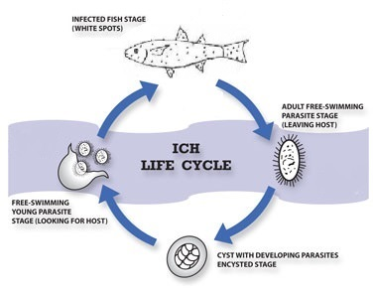
Example of KFHAT in Action
August 22 – September 14: USBR released water from Trinity Reservoir to augment lower Klamath flows
September 15: Ich infections in adult salmonids
September 16 – 22: USBR released Trinity water to double lower Klamath flows due to presence/prevalence of Ich infections
October 4: USBR released water from Iron Gate Dam on the mainstem Klamath
Notes:
Example of KFHAT information use by resource managers…
In August 2014 KFHAT determined that the data & information collected by its members reflected that a fish kill may occur. The US Bureau of Reclamation had determined that there was not sufficient water available to allow for water to be released from Trinity Reservoir for flow augmentation in the Klamath River this year.
As conditions for salmonids deteriorated, the notes and findings from the KFHAT meetings were shared with agency management, including management at the US Bureau of Reclamation, and were used as part of the science & support for Reclamations decision to released from Trinity Reservoir to help protect the returning adult run of Chinook Salmon.

Slide 25
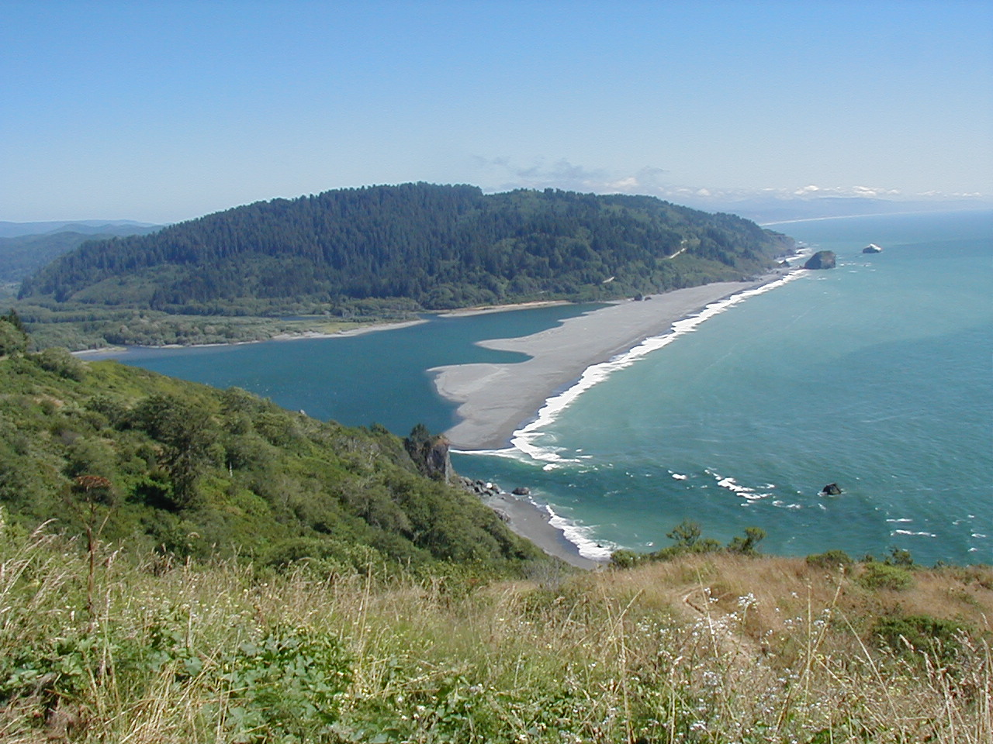
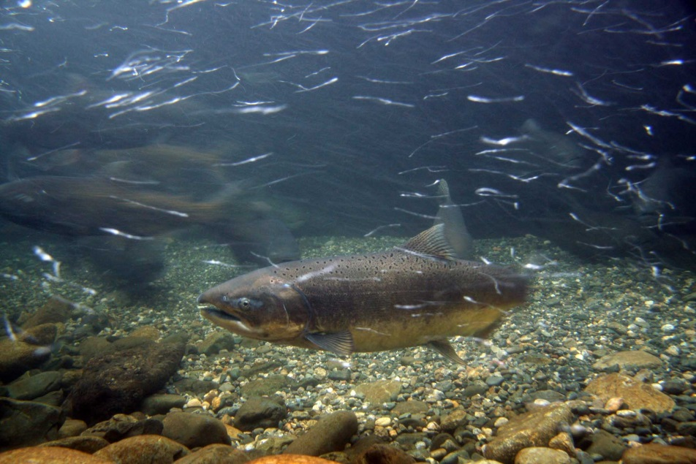
Notes:
In conclusion the benefit of KFHAT goes beyond our mission to prevent a fish kill in the Klamath Basin…
…participating in this group has help us to build strong relationships with the Tribes and other organizations…as we all work toward a common goal. It’s a great collaborative relationship and has benefited our communication with these groups in other areas or our work.
…participating in this group and the larger Klamath Basin Monitoring Program have helped advance the scientific knowledge in the basin and helped us all better our understanding of water quality and disease dynamics in the basin.
It’s a true collaborative partnership and its been a great benefit to the Klamath basin and its fishery.

Slide 26
Sara Borok
CA Department of
Fish and Wildlife
Sara.Borok@wildlife.ca.gov
707-822-0330
Katharine Carter
CA North Coast Regional Water
Quality Control Board
Katharine.Carter@waterboards.ca.gov
707-576-2290
Notes:
Contact info

