Slide 1
Power Supply Adequacy for the 2021 Operating Year
Resource Adequacy Advisory Committee
Steering Committee Webinar
June 8, 2016

Slide 2
2021 Reference and Sensitivity Cases

Slide 3
2021 Reference Case (see next 3 slides for more detail)
Loads (from long-term model hybrid method)
Long-term model weather-normalized frozen-efficiency monthly loads
Add weather-normalized daily and hourly shapes
Add 7th plan EE targets by applying monthly effects
Add temperature variations from short-term model
Demand Response: Existing + 121 MW planned DR
Import availability
Spot (available all hours, winter only)
Purchase Ahead (available light-load hours, all year)
IPP generation
Full availability (2,943 MW) winter
Limited availability (1,000 MW) summer
Wind 4,896 MW nameplate (modeled as Columbia Gorge wind)
Solar 396 MW nameplate, fixed generation pattern

Slide 4
Reference Case Assumptions
Item | Quarter 4 | Quarter 1 | Quarter 2 | Quarter 3
Mean Load (aMW) | 21,234 | 20,975 | 18,813 | 19,987
Peak Load (MW) | 33,768 | 33,848 | 26,504 | 28,302
DSI Load² (aMW) | 338 | 338 | 338 | 338
Mean EE (aMW) | 1,545 | 1,574 | 1,274 | 1,208
Peak EE (MW) | 2,660 | 2,660 | 1,680 | 1,680
Spot Imports (MW) | 2,500 | 2,500 | 0 | 0
Purchase Ahead (MW) | 3,000 | 3,000 | 3,000 | 3,000
²DSI load is 338 aMW in low, med and high load cases in 2021.

Slide 5
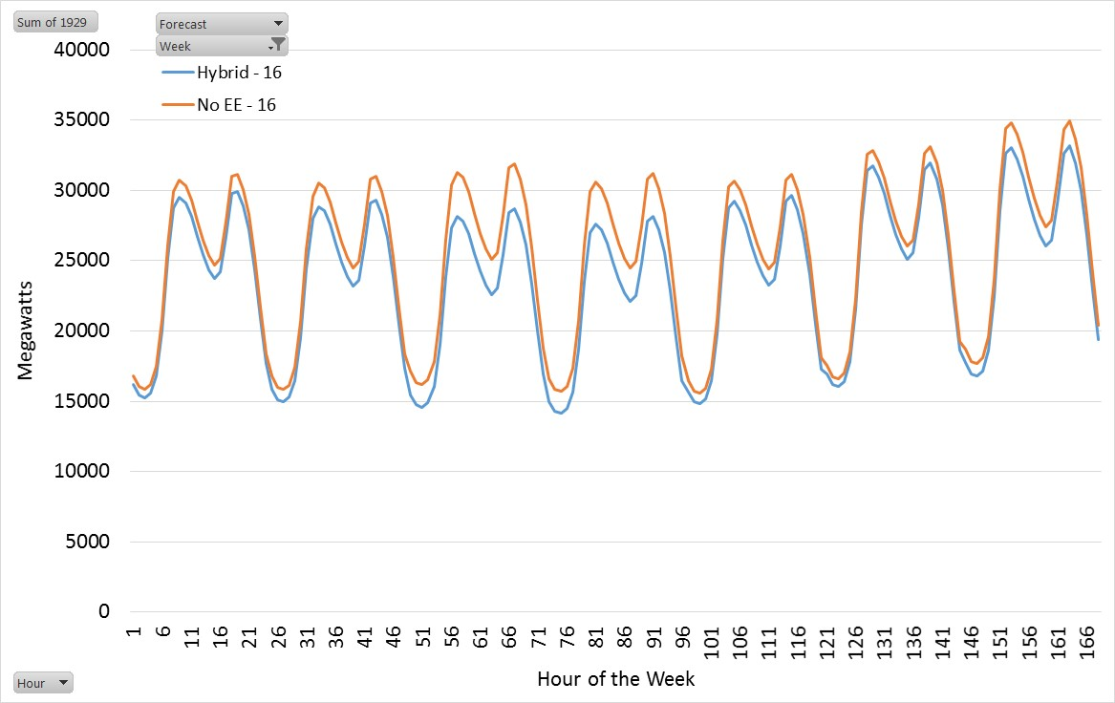
Example of Energy Efficiency Savings 2021 Hybrid Loads January (1929 Temp)
Average On-Peak Savings = 1,736 MW-Weeks
Average Off-Peak Savings = 1,097 MW-Weeks
Average Weekly Savings = 1,416 MW-Weeks

Slide 6
Scenarios
Reference Studies (for heat map)
Reference Case (see previous slides)
Load Ranges (low, medium and high)
Import Ranges (1700, 2500, 3400 MW)
Sensitivity Studies
Reference Case using STM loads
Fuel Limitation Case: Reduce winter gas IPP capability by 35% (650 MW), reduces all-fuel winter IPP cap by 22%
Reduces winter IPP total cap from 2943 to 2293 MW
Reduces summer IPP total cap from 1000 to 779 MW
Standby Resource Sensitivity
Existing + Planned DR and Emergency Generation
Existing + Planned + RPM Minimum DR (500 MW)
Existing + Planned + RPM Expected DR (1,257 MW)

Slide 7
2021 Adequacy Assessment

Slide 8
2021 Power Supply Adequacy
10% LOLP = Inadequate Supply (medium case)
Counting existing and expected resources only, and
Seventh plan EE targets, and
Existing + 121 MW of planned DR + standby generation
Primarily capacity short – 1,040 to 2,230 MW of new capacity needed (for medium and high load growth cases)
Seventh power plan resource strategy should be used for resource acquisition plans.
Part of needed capacity can come from demand response. Any amount of new DR will increase adequacy.

Slide 9
Comparison to last year’s 2021 Assessment (from 8.3 to 9.9% LOLP)
2021 Annual Load:
Last year’s forecast 21,780 aMW
Current forecast¹ 20,250 aMW (range 19,580 to 20,900)
Net decrease - 1,530 aMW
2021 Average Winter Peak Load:²
Last year’s forecast 30,865 MW
Current forecast 33,848 MW
Net increase 2,983 MW
Resources
Small amount of new solar capacity
Up to 2,000 MW less hydro peaking (from BPA-only to regional INC/DEC)
Newer version of GENESYS (tends to show slightly higher LOLP)
Main reasons why LOLP is higher in this year’s assessment
¹Load forecasting method was modified for a more accurate reflection of energy efficiency savings and the impacts of future codes and standards.
²Even though the current annual average load forecast for 2021 is lower than last year’s, this year’s winter peak load forecast is much higher. Council will continue to investigate this and also why off-peak loads in this year’s forecast appear to be lower than expected.

Slide 10
Comparison to Past Assessments
Year Analyzed | Operation Year | LOLP | Observations
2010 | 2015 | 5% | Was part of the Council’s 6th Power Plan
2012 | 2017 | 7% | Imports deceased from 3,200 to 1,700 MW, load growth 150 aMW per year, only 114 MW of new thermal capacity
2014 | 2019 | 6% | Load growth 0.6%, over 600 MW new generating capacity, increased imports by 800 MW
2015 | 2020 | 5% | Lower load forecast, 350 MW of additional EE savings
2015 | 2021 | 8.3% | Early estimate (BPA INC/DEC only) Loss of Boardman and Centralia 1 (~1,330 MW)
2016 | 2021 | 10% | 2021 loads lower than last year’s forecast (~1,500 aMW) but winter peaks are higher (~3,000 MW), using regional INC/DEC reduces hydro peaking by as much as 2,000 MW

Slide 11
Sensitivity Studies

Slide 12
LOLP (%) Heat Map (existing standby resources)
Let’s examine the effects of adding DR to the reference case.
Imports
3400
2500
1700
Loads
High
22
24
26
Med
8
10
12
Low
2
4
6

Slide 13
Effects of DR on LOLP (2500 MW import)
Standby Loads | Exist | + Minimum RPM DR | + Average RPM DR
High Load | 24 | 19 | 10
Med Load | 10 | 8 | 5
Low Load | 4 | 3 | 2

Slide 14
Loss of Gas/Market Friction (Loss of 650 MW IPP, 2500 MW import)
Standby Loads | Ref Case | Existing DR | + Minimum RPM DR | + Average RPM DR
High Load | 24 | 30 | 23 | 13
Med Load | 10 | 13 | 10 | 6
Low Load | 4 | 6 | 5 | 3

Slide 15
Other Adequacy Metrics

Slide 16
EUE (MW-hours) (existing standby resources)
Imports Loads | 3,400 | 2,500 | 1,700
High Load | 6,400 | 8,700 | 11,800
Med Load | 1,200 | 2,500 | 3,000
Low Load | 200 | 700 | 1,600

Slide 17
Effects of DR on EUE (2500 MW import)
Standby Loads | Exist | + Minimum RPM DR | + Average RPM DR
High Load | 8,700 | 6,400 | 4,100
Med Load | 2,500 | 1,800 | 900
Low Load | 700 | 500 | 200

Slide 18
Expected Hours Curtailed (hours) (existing standby resources) (Green satisfies 1-in-10 year criterion of 1.1 max)
Imports Loads | 3,400 | 2,500 | 1,700
High Load | 8.2 | 9.4 | 10.7
Med Load | 1.6 | 2.4 | 3.1
Low Load | 0.3 | 0.7 | 1.3

Slide 19
CVaR Peak (MW) (existing standby resources)
Imports Loads | 3,400 | 2,500 | 1,700
High Load | 2,513 | 3,293 | 4,178
Med Load | 1,374 | 2,185¹ | 3,045
Low Load | 302 | 909 | 1,831
¹Implies a 1,145 MW threshold for a 5% LOLP (2,185 – 1,040 needed for 5%).

Slide 20
Historical vs. Forecast Loads
Why do the 2021 forecasted hourly loads look peakier than historic hourly loads?
Historic loads based on 1993 to 2014 record
Forecasted loads use 1929-05 temperatures
Historic load period misses some extreme temperature years (e.g. 1950)
When same period is used, forecasted loads are not peakier
Minimum hourly loads seem to be too low but peak and average loads seem alright

Slide 21
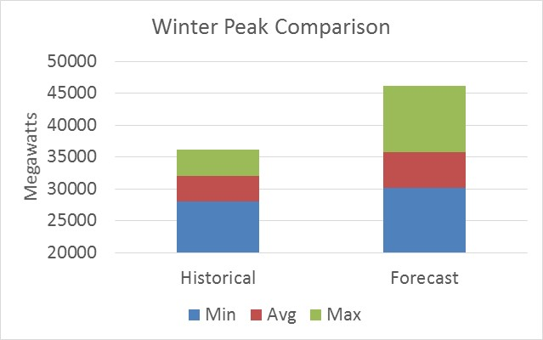
Winter Max Load Hour Historical (’93-’05) vs. Hybrid Forecast (’29-’05)

Slide 22
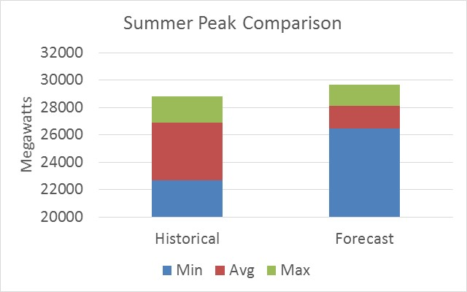
Summer Max Load Hour Historical (’93-’05) vs. Hybrid Forecast (’29-’05)

Slide 23
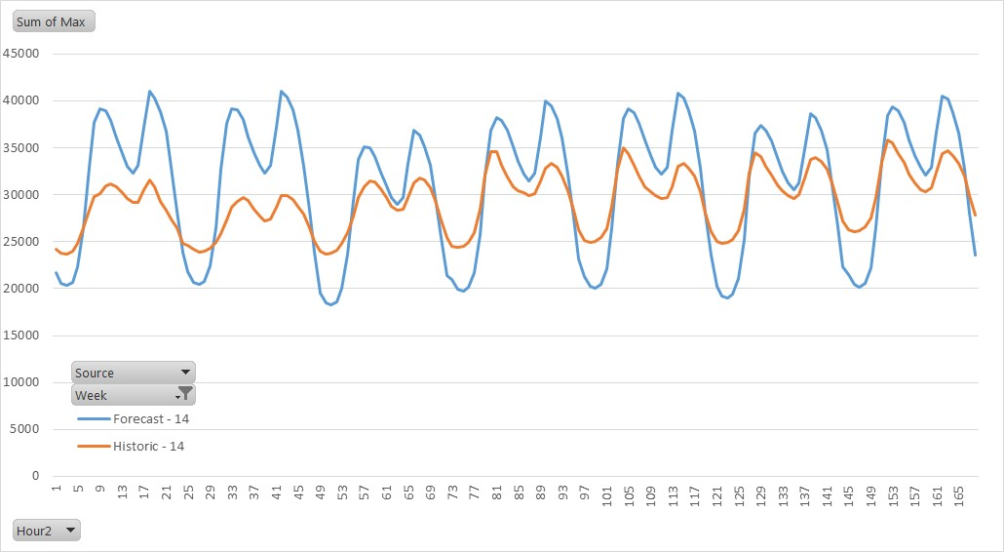
Max Historic (93-05) vs Max Forecast (29-05) Week 14

Slide 24
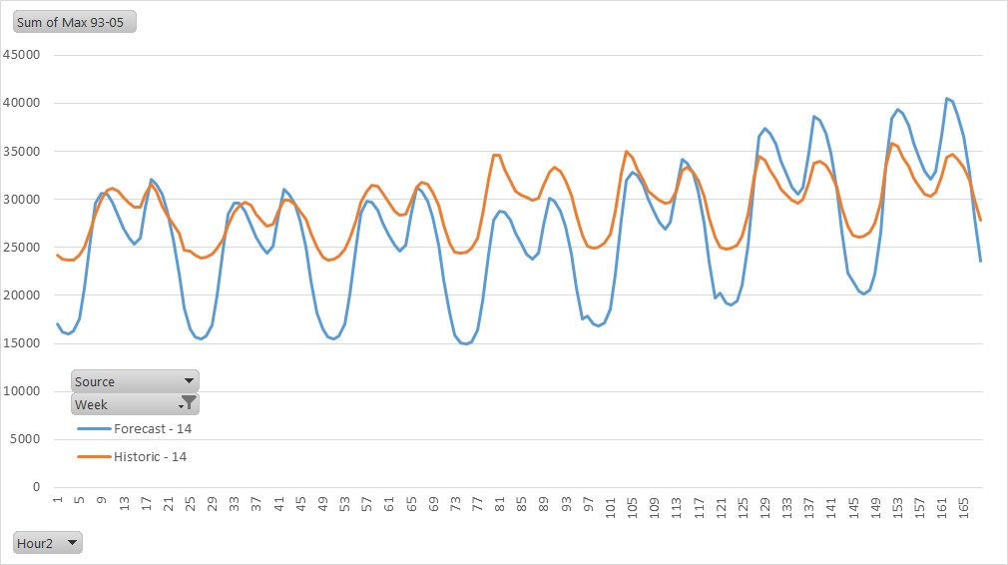
Max Historic (93-05) vs Max Forecast (93-05) Week 14

Slide 25
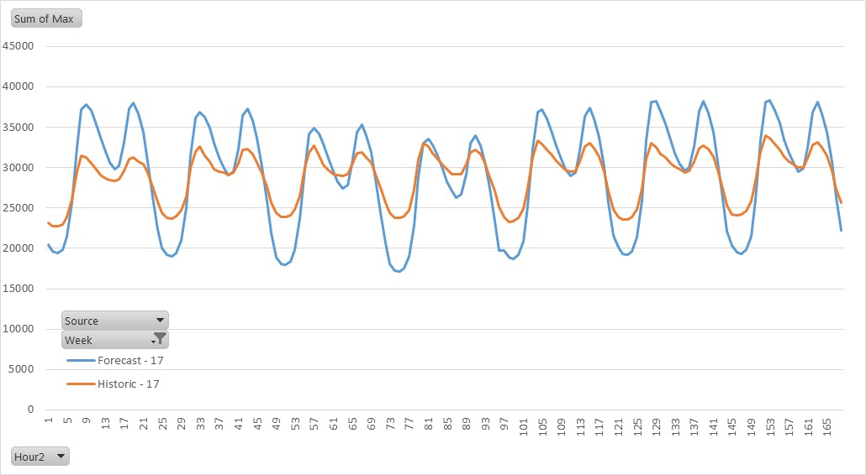
Max Historic (93-05) vs Max Forecast (29-05) Week 17

Slide 26
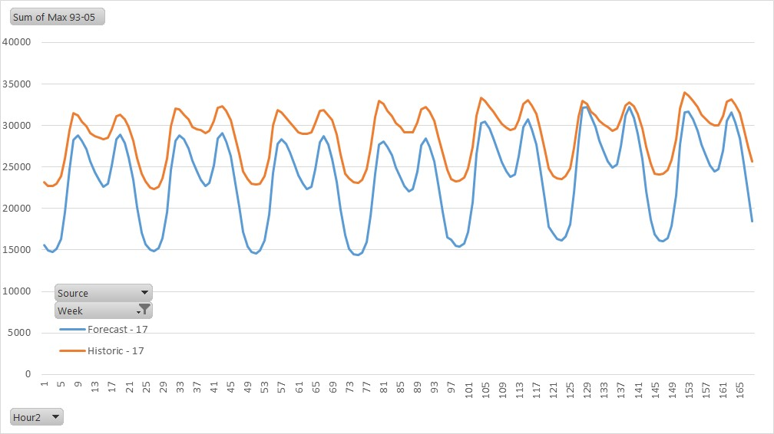
Max Historic (93-05) vs Max Forecast (93-05) Week 17

Slide 27
Additional Slides

Slide 28
Curtailment Statistics (before standby resources)
6160 = number of simulations (years)
838 = number of event years
13.6 % = LOLP (9.9% after standby resources applied)
2374 = total number of events
11.1 hours = average event duration
2,704 MW-hours = average event magnitude
1,183 MW = average event peak outage
2.6 = expected number of events/year (over all years)
4.3 hours = expected hours curtailed/year (over all years)

