Slide 1
System Analysis Advisory Committee
February 26, 2015

Slide 2
Current SAAC Members:
  Clint Kalich, AVISTA
  Mike McCoy, BECKER CAPITAL
  Marty Howard, BMH3 (CONSULTANT)
  Ehud Abadi, BPA
  Robert J Petty, BPA
  John Scott, EPIS
  Kevin Nordt, GCPUD
  Rick Sterling, IDAHO PUC
  Mark Stokes, IDAHO POWER
  Jim Litchfield, LITCHFIELD CONSULTING (CONSULTANT)
  Fred Huette, NW ENERGY COALITION
  Diane Broad, ODOE
  Mike Hoffman, PNL
  Michael Deen, PPC
  Dick Adams, PNUCC
  Sima Beitinjaneh, PORTLAND GENERAL ELECTRIC
  Villamor B Gamponia, PSE
  Phillip. Popoff, PSE
  Mark Dyson, ROCKY MOUNTAIN INSTITUE
  Tom Chisholm, USACE

Slide 3
RPM Redevelopment
Phase 3 model delivered on-time
Council is in the 30-day evaluation period
Initial inputs based on Draft 7th Plan data are mostly in the model
Targeting March 27th for finalizing inputs with the exception of some work on scenarios

Slide 4
Electricity Price Futures
Similar to the natural gas price and load models, electricity price has an annual trend factor, seasonal price factor and a jump factor
It adds a dependent factor which relies on the natural gas price forecast, load forecast and hydro generation forecast

Slide 5
Annual Trend Factors
Controls annual spread in RPM
Of the form:

Slide 6
Seasonal Factors
Add deviation from annual trends
Of the form:

Slide 7
Jump Factors
Controls temporary deviations from the annual trend, i.e. jumps
Of the form:

Slide 8
Dependent Factor
Scales the electricity price forecast based on input forecasts of gas price, load and hydro generation related to the generated futures for each of these elements:

Slide 9
Electricity Price Future Model
Modifies on-peak and off-peak forecast from AURORAxmp
For example on-peak:

Slide 10
Independent Price Distribution

Slide 11
Dependent Price Distribution
Dependent Factor adds significant volatility to the price forecast

Slide 12
Parameter Estimation for 7th Plan Draft Futures
Establish methods for parameter estimation
Draft inputs are not finalized until March 27, thus parameters may change slightly
Some parameters based on historic data will likely not need to be changed

Slide 13
High/Low Difficulties
For estimation, one point makes a location, two points makes a range, three points in the distribution is less clear
Load was close to log-symmetry, natural gas prices and electricity prices were not
Because of the risk focus of RPM, fitting estimates based on the high forecast is recommended

Slide 14
Recall Load Model Estimation
Estimate factors using simple linear regression
Natural gas price and electricity price are fit in the same manner using the high forecast

Slide 15
Normal versus Triangular
Regression assumptions are much more compatible with normal distributions versus triangular distributions
Recommend moving all distributions with regression estimated parameters to standard normal rather than triangular

Slide 16
Annual Factor Load Example

Slide 17
Adding Seasonal Factor to Load
Seasonality adds a little shape variation but not extreme changes for quarterly average load

Slide 18
Annual Factor Natural Gas Price Example

Slide 19
Adding Seasonal Factor to Natural Gas Price
Seasonality adds much more volatility to prices

Slide 20
Seasonal Factor Estimation
Historic natural gas price record is extremely volatile

Slide 21
Quarterly Price / Annual Price
Factors show seasonal shapes

Slide 22
Estimating Seasonality
Taking the standard deviation of the log of the quarterly historic prices over annual prices allows for seasonal factor estimation
In the 6th plan the seasonal factor was used in a much more limited manner

Slide 23
Estimating Dependent Factor
Use historic Electricity Price, Natural Gas Price, Load and Hydro
Setup regression with electricity price depending on the other three and without an intercept

Slide 24
Jump Factors
Should load have jumps?
What is the likelihood of price jumps? How long should they persist?
Limited feedback from Natural Gas Advisory Committee and Demand Forecast Advisory Committee

Slide 25
Load Jumps
Recommend removing load jumps
  There is no obvious data to use in estimation
  Limited feedback supported not including jumps
  Feedback from the SAAC?

Slide 26
Natural Gas Price Jumps
Proportional duration logic from 6th plan did not allow for down jumps
Specified duration allows for symmetric jumps
Using historic record to determine largest normalized quarterly jump (largest quarterly price / annual price) gives a jump around 160%
Limited feedback says price jumps would be expected to roughly double, at extremes quadruple, duration of deviations would be expected to be up to 4 or 5 years no more than 8 and supported price recovery in the opposing direction
Recommend using historic record for jump magnitude, duration between 1 quarter and 5 years, with price recovery and a 50% chance of a jump within a game.
Feedback from the SAAC?

Slide 27
Electricity Price Jumps
Same as natural gas price, switch to specified duration jumps, use historic record to estimate largest jump including energy crisis in 2001 around 211% upward and 18% downward jumps
Match duration and chance of a jump assumptions for natural gas price

Slide 28
Adjustment to Median
Jumps can move the distribution off the input forecast
Respect
Recommend adjusting all input forecasts to be consistent with the median of the futures

Slide 29
Electricity Price No Jumps

Slide 30
Electricity Price with Jumps

Slide 31
Electricity Price with Jumps and Median Adjustment

Slide 32
RPM Thermal Dispatch
Based on option pricing theory (Black-Scholes)
Derivation is a bit messy
General principal is fairly basic

Slide 33
Value of a Thermal Resource
Value is derived by taking the capacity times the earnings per MWh for each hour in a period

Slide 34
Expected Difference between Fuel Cost and Compensation
The value can be determined on what is expected to be the difference between the variable costs for a resource and the market price given as compensation

Slide 35
Bag of Statistical Tricks
If prices are considered to be Log-Normally distributed then many things follow
Using a bit of Nobel Prize winning work (Black-Scholes, though Black did not live long enough to get the prize money) you get a distribution for V expressed in terms of the standard normal

Slide 36
Some Ugly Theory
For those who miss Calculus:

Slide 37
Plug and Play Formula
For those who don’t miss Calculus:

Slide 38
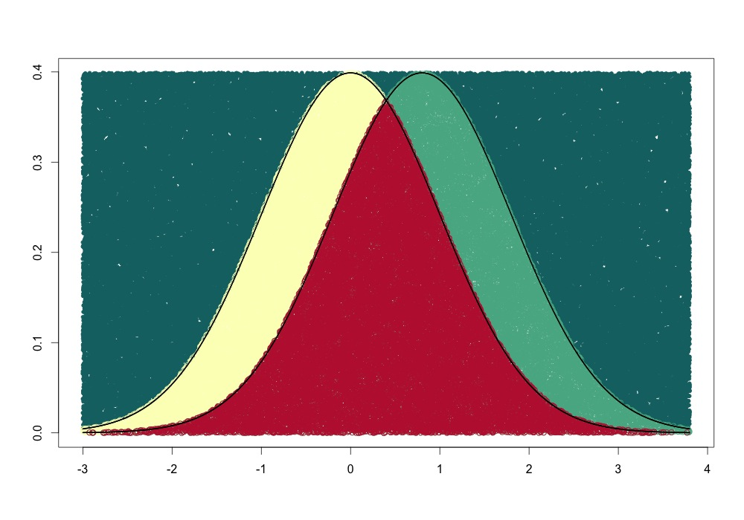
Worth 1000 Words, or Equations
This doesn’t work because the distributions are not independent

Slide 39
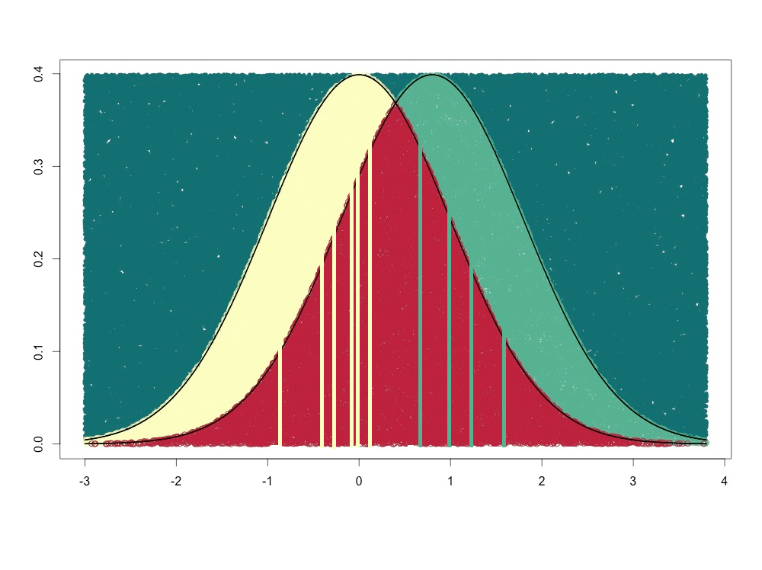
Worth 1000 Words, or Equations
Sometimes the price for electricity is high but the cost of fuel is higher

Slide 40
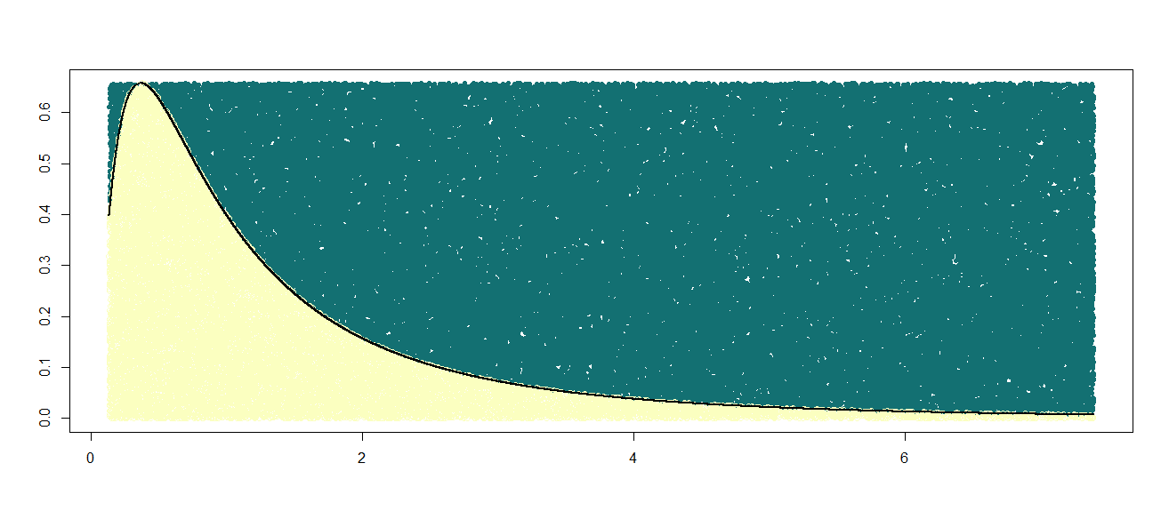
Worth 1000 Words, or Equations
So look at the distribution of the difference between the two capturing correlation
Capacity Factor for the thermal is the area under the curve greater than zero

Slide 41
RPM Thermal Dispatch Decision
S1n – Market Price – VOM
S2n – Fuel Cost + CO2 Cost
Then S1n – S2n = $ per MW earned by dispatch
So max(S1n – S2n, 0) determines how much money a generator would make when added over each period

Slide 42
Within Period Variation
Market price within a period has a distribution and gas price within a period has a distribution
The probability of the two distributions overlapping requires the computation of the location, range and correlation

Slide 43
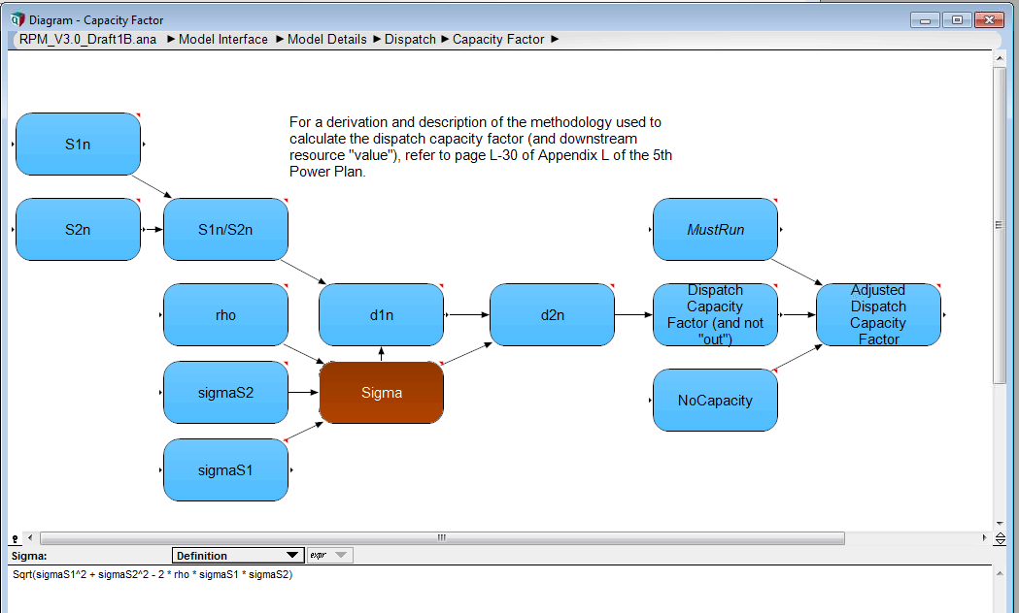
Model Thermal Dispatch Logic
Location
Correlation
Range

Slide 44
Sixth Plan Intra-period Correlations
Electric Price Intra-Period Volatility is .3
Fuel Price Intra-Period Volatility is .1
Natural Gas East and West have correlation coefficients of .6 with electricity price

Slide 45
RPM NPV Calculation
Collection of costs and offsetting benefits
Market price in RPM covers more than the region
Exports are common, so what is the cost to the region?

Slide 46
On Average Generation Exceeds Loads

Slide 47
General Concept
Formulation can be a bit strange, e.g. note considering the value of a MWh
  Value of Dispatched Generation = Market Price – Variable Costs
  Market Price – Value of Dispatched Generation = Market Price – (Market Price – Variable Costs) = Variable Costs
So the formulation uses Market Price – Value of Dispatched Generation as a proxy

Slide 48
NPV Cost and Benefits
Costs in the NPV formulation
  Cost of serving load at market price
  Cost of acquiring new resources
  Cost of generation curtailment and load shedding
  Cost of fixed O&M for existing resources
  Resource Adequacy Penalties
Offsetting benefits
  Value of generation
  Value of conservation
  REC Values

Slide 49
NPV End Effects
Calculation uses a discount rate and adjusts for perpetuity
Tracking impacts on NPV in the RPM can help in understanding the formulation

Slide 50
Perpetuity Formulation
If you miss geometric series recall:
So discounting out into infinity from the start of the perpetuity period gives:
where E is the end of the study in periods (80) and S is the start of the perpetuity period (73)

Slide 51
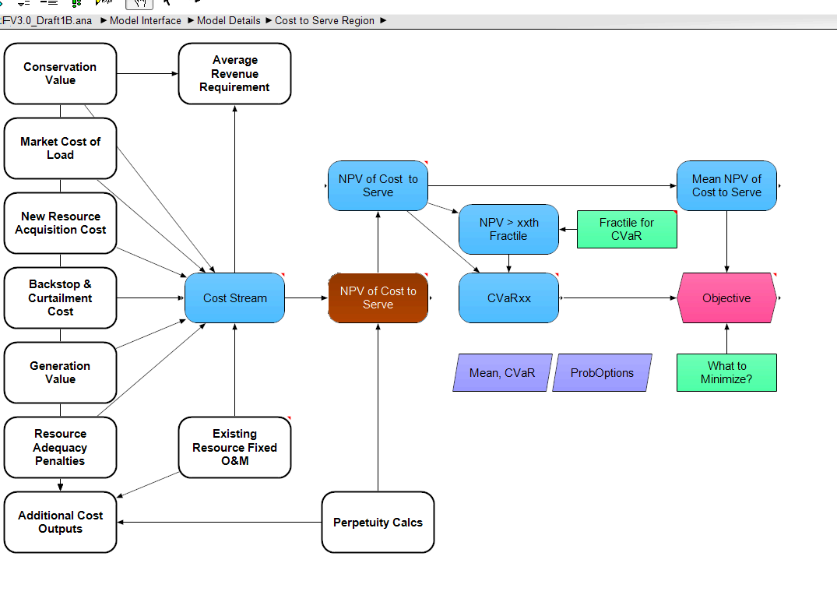
Into the RPM…

Slide 52
RPM Web Interface
See it at http://bit.ly/RPM_Navigant
Data are not updated to the latest working version
Does not perform optimization, i.e. creating an efficient frontier
Let’s go check it out…

