Slide 1
Selected Findings from Scenario Analysis Conducted To Date
Conservation Resource Advisory Committee
6/24/15

Slide 2
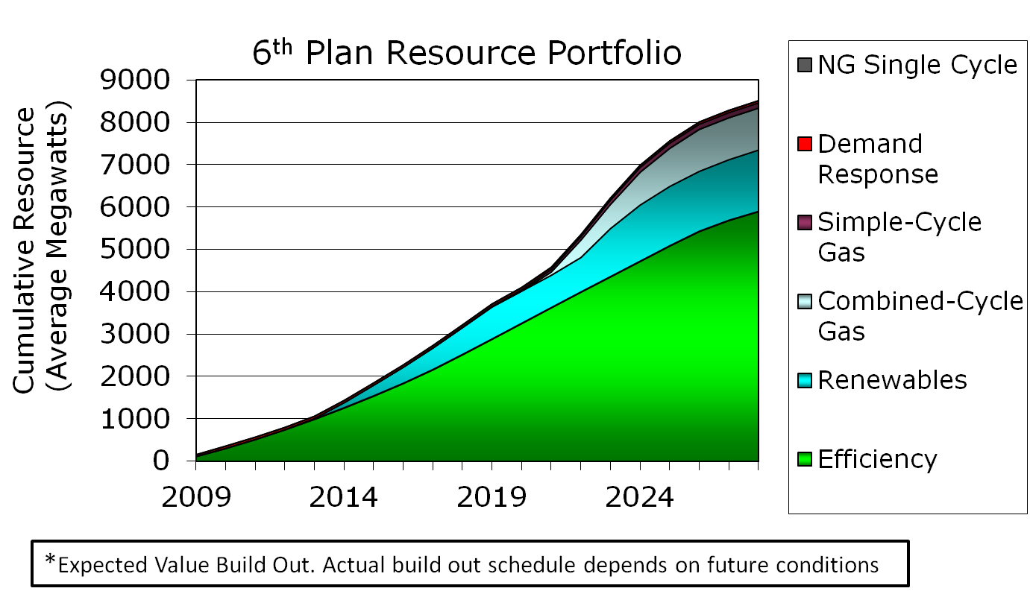
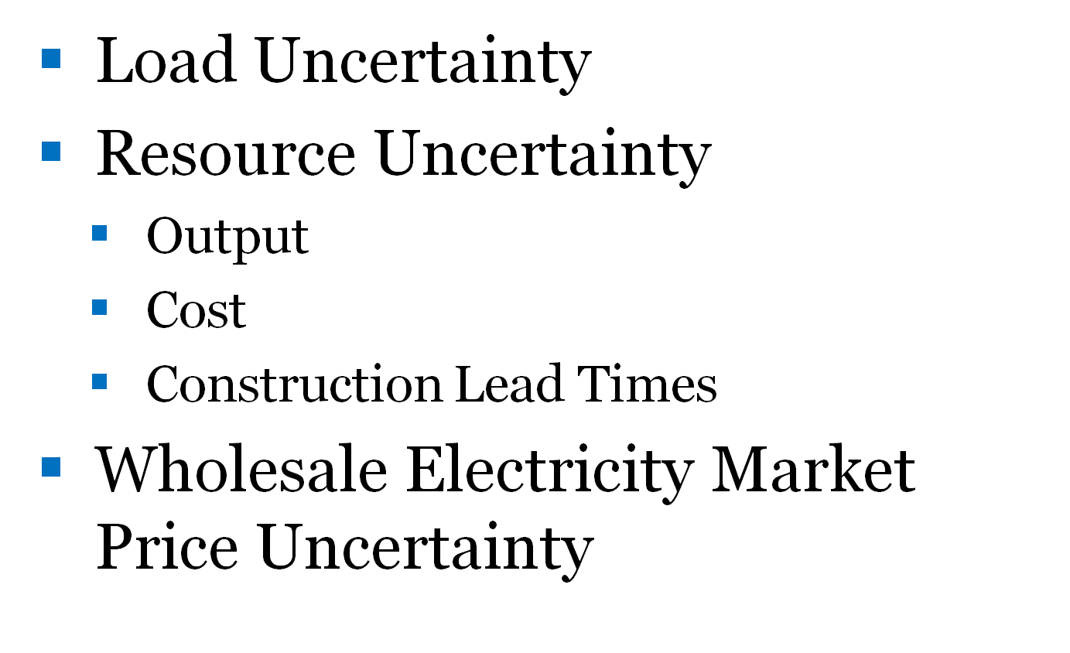
The Council Uses Scenario Analysis to “Stress Test” Resource Strategies Against These Uncertainties
Resource Strategies – actions and policies over which the decision maker has control that will affect the outcome of decisions
Futures – circumstances over which the decision maker has no control that will affect the outcome of decisions
Scenarios – Combinations of Resource Strategies and Futures used to “stress test” how well what we control performs in a world we don’t control

Slide 3
7th Plan Proposed Scenarios Were Designed By Varying “Stresses” and “Constraints”
Some scenario’s subject potential resources strategies to futures that impose one or more stresses. Examples:
  Uncertain GHG emissions limits or costs
  Unanticipated Loss of major resource(s)
  Climate change impacts on loads and hydro-system output
Some scenario’s constrain potential resources strategies across all futures: Examples:
  GHG emissions limits or costs
  Maximum pace of conservation development
  Fixed retirement schedule for existing coal generation
  Increased reliance on variable resources across the PNW/CA
  Availability of emerging technology (generation, storage and EE)
Some scenarios place no limits on the uncertainty surrounding future conditions or on potential resource strategies?

Slide 4
Today’s Presentations
Comparison of the Least Cost Resource Strategies across 800 futures for four Scenarios:
  Existing Policy with Uncertainty, w/o GHG reduction risk (1B)
  Existing Policy with Uncertainty and GHG reduction level based on Social Cost of Carbon (2B)
  Existing Policy with Uncertainty and with uncertain GHG reduction risk (2C)
  Lowering carbon emissions with current technology (3A)
Comparison Metrics
  Conservation Development
  Demand Response Development
  Renewable Resource Development
  Carbon Emissions
Observations Regarding Emerging Resource Development Strategies

Slide 5
Today’s Presentation
Reflects fine tuning (since Webinar) of RPM input assumptions for resource adequacy
  Revised peak load forecasting method now uses historical relationship between temperature and weather sensitive loads
    Increased expected peak demands
    Method consistent between GENESYS and RPM
  Calculation of Adequacy Reserve Margins (ARMs) from GENESYS revised to isolate independent energy and capacity requirements
RPM input does not yet reflect different seasonal peak capacity values for conservation
  This will result in lower summer conservation peak impacts
Implication – Generalizations Okay, Details May Change – So Don’t Fixate On the Exact Numbers!

Slide 6
Common Elements of Least Cost Resource Strategies Across Scenarios Analyzed To Date
In all scenarios least cost resource strategies rely heavily on conservation to meet both winter capacity and energy needs
In all scenarios least cost resource strategies rely on low cost Demand Response options to maintain adequate capacity margins
    DR is optioned because it has a shorter lead time, smaller incremental resource size and lower cost than generation options
In all scenarios least cost resource strategies build renewable resources to satisfy state RPS requirements
  REC banking delays the need for constructing RPS resources until well past the action plan period
  The only exception is the Scenario 4D – Slower Conservation Ramp Rate

Slide 7
Average Conservation Development Across Scenarios Increases When Carbon Risk Are Considered
But Does Not Increase With Full Coal Retirement or Consideration of the Social Cost of Carbon
No Difference
5% Increase

Slide 8
Average Conservation Winter Peak Development in Least Cost Resource Strategies for Scenarios 1B, 2B, 2C and 3A

Slide 9
Regional Net Load After Conservation Remains “Flat On Average” Through 2035 Under the Least Cost Strategy in Scenarios 1B, 2B, 2C and 3A

Slide 10
This Result is Very Similar To The 6th Plan
Net Load After Conservation Scenarios 1B, 2B, 2C and 3A Least Cost Strategy and 6th Plan

Slide 11
Common Elements of Least Cost Resource Strategies Across Scenarios Analyzed To Date
In all scenarios least cost resource strategies rely heavily on conservation to meet both winter capacity and energy needs
In all scenarios least cost resource strategies rely on low cost Demand Response options to maintain adequate capacity margins
    DR is optioned because it has a shorter lead time, smaller incremental resource size and lower cost than generation options
In all scenarios least cost resource strategies build renewable resources to satisfy state RPS requirements
  REC banking delays the need for constructing RPS resources until well past the action plan period
  The only exception is the Scenario 4D – Slower Conservation Ramp Rate

Slide 12
Average Demand Response Winter Peak Development in the Least Cost Resource Strategies for Scenarios 1B, 2B, 2C and 3A
Are VERY LARGE, Nearly Identical – And Change Little Through Time

Slide 13
Common Elements of Least Cost Resource Strategies Across Scenarios Analyzed To Date
In all scenarios least cost resource strategies rely heavily on conservation to meet both winter capacity and energy needs
In all scenarios least cost resource strategies rely on low cost Demand Response options to maintain adequate capacity margins
    DR is optioned because it has a shorter lead time, smaller incremental resource size and lower cost than generation options
In all scenarios least cost resource strategies build renewable resources to satisfy state RPS requirements
    REC banking delays the need for constructing RPS resources until well past the action plan period

Slide 14
Average Renewable Resource Development for Energy Occurs After RECs are Used and Loads Begin To Increase

Slide 15
Change in Renewable Resource Dispatch
Scenario 1B vs. Scenario 2C

Slide 16
Scenario 2B and 2C Cost of Carbon Assumptions

Slide 17
CO2 Emissions Across Least Cost Resources Strategies - 2030
EPA Proposed 111(d) Emissions Limits – 26.2 MMTE

Slide 18
Thermal Resource Dispatch without Carbon Risk – 1B

Slide 19
Thermal Resource Dispatch with Carbon Risk – 2B

Slide 20
Thermal Resource Dispatch with Carbon Risk - 2C

Slide 21
Thermal Resource Dispatch with Coal and Inefficient Gas Retirement

Slide 22
Change in Coal Dispatch
Scenarios 1B, 2C and 3A

Slide 23
Change in Existing Gas Dispatch
Scenario 1B, 2C and 3A

Slide 24
Sensitivity Studies
The following sensitivity studies have been suggested:
  Remove transmission credit for “west side” resources (DR, EE and gas turbines)
  Remove DR as resource option
  Test alternative (i.e., lower) EE winter capacity contribution
  Test sensitivity to natural gas price assumptions
  Assume Boardman and Centralia are not retired
Others?

Slide 25
Backup Slides

Slide 26
Scenario | Scenario Name | Priority | Modeling Effort | Revised Schedule
1B | Existing Policy with Uncertainty, w/o GHG reduction risk | 1 | Med | Early May
1A | Existing Policy without Uncertainty, w/o GHG reduction risk | 2 | Med | Early May
2C | Existing Policy with Uncertainty and with uncertain GHG reduction risk/target. | 3 | Low | Early May
4C | Major Resource Uncertainty – Faster Pace of Conservation Deployment | 4 | Low | Late May
4D | Major Resource Uncertainty – Slower Pace of Conservation Deployment | 5 | Low | Late May
2A | Existing Policy with Uncertainty and with certain GHG reduction risk/target. Example Policy Target = Clean Power Plan/Clean Air Act 111(d) goal (e.g., 30% below 2005 level by 2030 | 6 | Med | May not need to model
2B | Existing Policy with Uncertainty and with certain GHG reduction risk/target. Example Policy Target = Mitigate to Estimated GHG Damage Cost | 7 | Low | Early June
6A | Climate Change Load Impacts Resulting from Direct Effects of Climate Change | 8 | Low | Mid-June
4B | Major Resource Uncertainty - Anticipated Loss of Major Non-GHG Emitting Resource | 9 | Low | Mid- June
5B | Southwest Market Liquidity Variability | 11 | Low | Late June
3A | Lowering carbon emissions with current technology | 12 | Med | Late June
4A | Major Resource Uncertainty - Unexpected Loss of Major Non-GHG Emitting Resource | 13 | Low | Early July
3B | Lowering carbon emissions with emerging technology (e.g., storage, CO₂ heat pumps, SSL) | 14 | High | Not Modeled
5A | Integration of Variable Resources (i.e., Managing the NW Impact of the "Duck Curve"/50% CA RPS) | 15 | Med/High | Mid-July
6B | Climate Change Hydro Impacts | 16 | High | Mid-July

Slide 27
The Least Cost Strategies for Scenarios 1B, 2B, 2C and 3A
Distributions of Conservation Development Through 2021

Slide 28
The Least Cost Strategies for Scenarios 1B, 2B, 2C and 3A
Distributions of Conservation Development Through 2026

Slide 29
The Least Cost Strategies for Scenarios1B, 2B, 2C and 3A
Distributions of Conservation Development Through 2035

Slide 30
The Least Cost Strategies for Scenario 1B, 2B, 2C and 3A
Distributions of Conservation Development Through 2021 for Winter Capacity

Slide 31
The Least Cost Strategies for Scenarios 1B, 2B, 2C and 3A
Distributions of Conservation Development Through 2026 for Winter Capacity

Slide 32
The Least Cost Strategies for Scenarios 1B, 2B, 2C and 3A
Distributions of Conservation Through 2035 Development for Winter Capacity

Slide 33
The Present Value Net System Cost for Least Cost Strategies Under All Carbon Reduction Are Similar

Slide 34
The Average Present Value Net System Cost and Risk for Least Cost Strategies Under All Carbon Reduction Are Similar

Slide 35
Average Revenue (2012$/MWh) for Least Cost Resource Strategies

Slide 36
Distribution CO2 Emissions in 2030 for Resources Subject to EPA’s Proposed 111(d) Regulations
Scenarios 1B, 2C and 3A – Least Cost Resource Strategies
Mean for 2C = 16 MMTE
Mean for 1B = 22 MMTE
Mean for 3A = 13 MMTE
90th Percentile for 2C = 24 MMTE
90th Percentile for 1B = 30 MMTE
90th Percentile for 3A = 20 MMTE
EPA Proposed 111(d) Limit

Slide 37
Distribution CO2 Emissions in 2030 for PNW Power System
Scenarios 1B and 2C – Least Cost Resource Strategies
Mean for 2C = 23 MMTE
Mean for 1B = 33 MMTE
Mean for 3A = 15 MMTE
90th Percentile for 2C = 40 MMTE
90th Percentile for 1B = 46 MMTE
90th Percentile for 3A = 24 MMTE
Range of Historical Emissions

