Slide 1

Compilation of Objectives for Salmon and
Steelhead in the Columbia River Basin
Project Task: Develop a searchable objectives database for
existing and recommended objectives
Purpose of this presentation: Describe the process used to produce the DRAFT searchable database and
provide a “tour” of the database

Slide 2
Process of Mining and Compiling
Relevant Information
STEP 1
Review documents
STEP 2
Compiled information
STEP 3
Searchable database

Slide 3
Step 1
Mining Relevant Information
Number of documents reviewed: 78
Date of publication: 1995 - 2014
Types of document:
    Recovery plans
    Subbasin plans
    Management plans
    Fish and Wildlife Program recommendations

Slide 4
Step 2
Compiling Information
Objectives
Quantitative
Qualitative
Goals
Overall (general)
Broad sense
Recovery

Slide 5
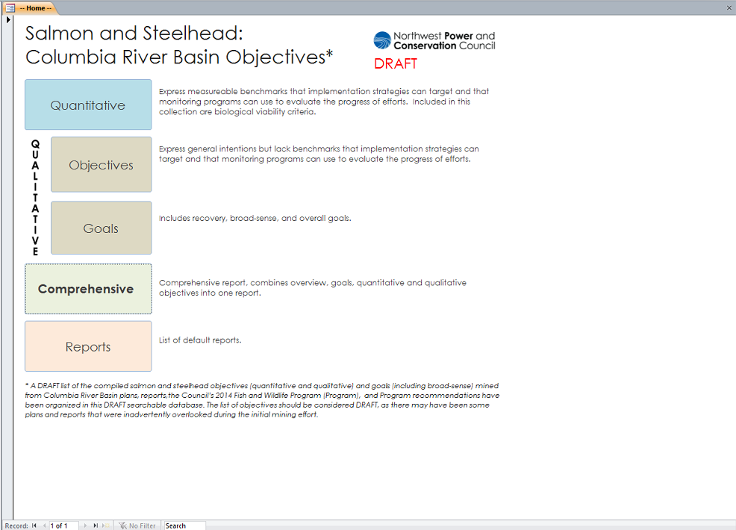
Step 3
Database Review: Main Screen

Slide 6
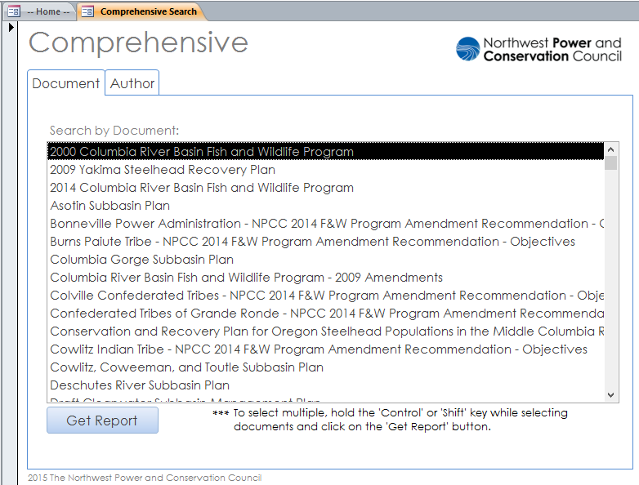
Database Review: Search Options
Retrieves all
objectives/plans by “Document”
Retrieves all
objectives/plans by “Author”

Slide 7
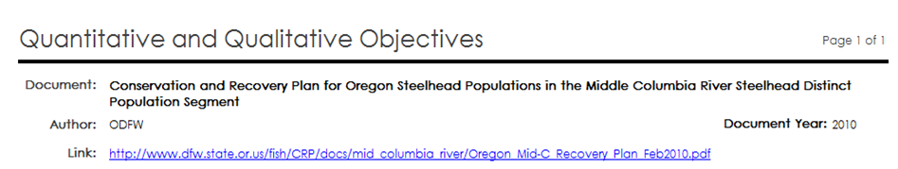
Database Review: “Comprehensive” Report Layout
Header
Document Overview
Goals
Qualitative Objectives
Quantitative Objectives

Slide 8
Database Review: demo

Slide 9
Database Review: Available Formats
Microsoft Access 2010 database
Excel File (export of database tables)
PDF’s (Comprehensive, Species, etc.)
Available for download at: http://www.nwcouncil.org/fw/am/home/

