Slide 1
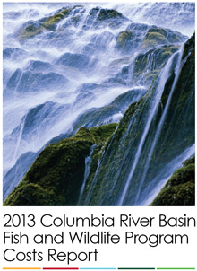
Annual Report
BPA Fish and Wildlife Costs
Mark Walker
Public Affairs Director

Slide 2
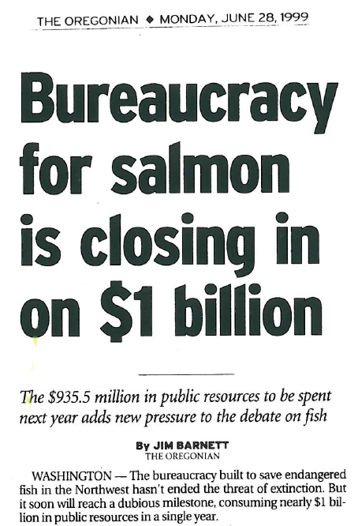

Slide 3
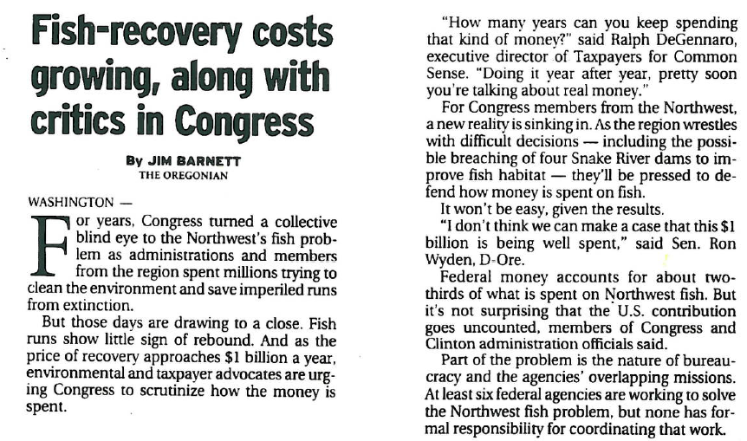

Slide 4
Report History
July 1999 request from the four governors:
Asked Council to report annually on BPA’s fish and wildlife costs, the largest source of funding
Costs, and also program successes and failures
First report issued in 2001 (took 18 months)
Noted ‘complexity and confusion’ of data collection and reporting in the Columbia River Basin, for both costs and project data

Slide 5
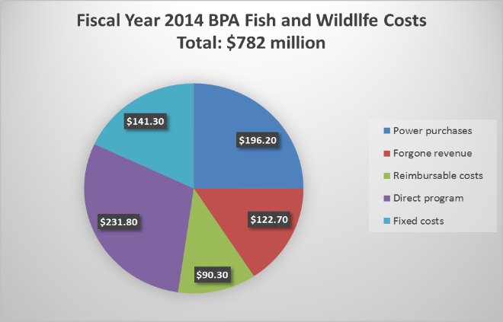
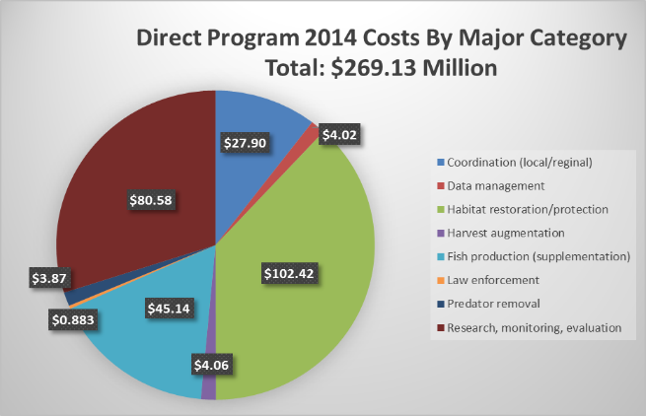
Reporting Costs
All BPA costs including the Council’s program
Council program costs by major category

Slide 6
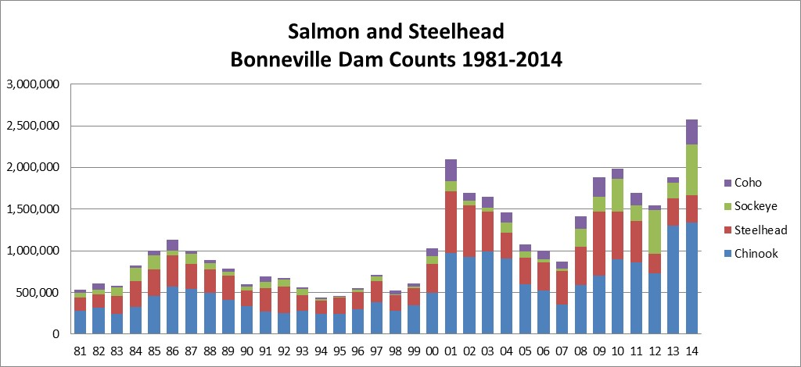
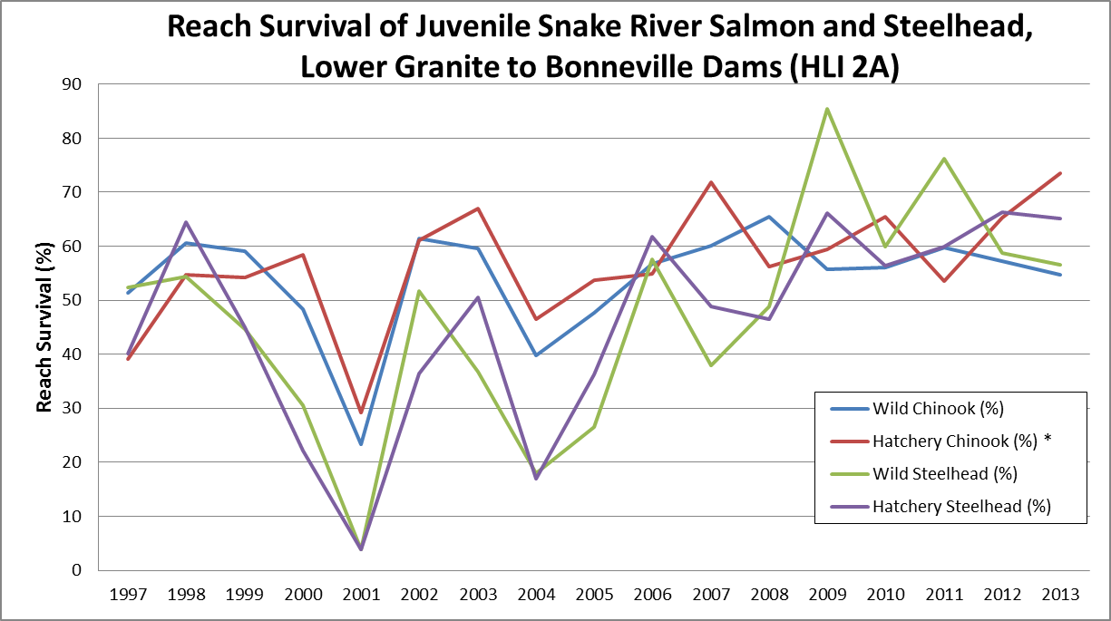
Reporting Progress
Adult salmon counted at Bonneville Dam
Survival of juvenile salmon and steelhead through the hydrosystem

Slide 7
Value of the Report
Demonstrates:
Accountability for public funding
Diversity of the program
Where money is being spent, by whom
Status of salmon and steelhead runs

Slide 8
Federal ‘Interest’ in F&W Costs
1995:
Citing financial crisis, BPA asks for cap on fish costs
NW senators, Clinton Administration find other ways to ensure BPA’s financial vitality
1996:
Sen. Gorton, seeking improved BPA spending oversight, amends Power Act to establish ISRP
2015:
BPA Administrator expresses concern about low market prices, prospect of reduced expenditures including fish and wildlife

Slide 9
Scrutiny is Inevitable
Every major federal spending program gets scrutiny at some time
It’s been almost 20 years
It’s important to be prepared

