Slide 1
Update on
O&M strategic plan
April 7, 2015

Slide 2
Background
Over the past three decades, BPA has made substantial investments in the Columbia River Basin through the Council’s Fish and Wildlife Program.
Adequate funding for O&M was one of the highest priorities recommended to the Council.
Adequate funding for O&M will ensure that existing Program funded infrastructure remains properly functioning, and will not only continue to benefit the fish and wildlife in the basin, but will continue to help BPA meet its mitigation requirements.

Slide 3
O&M Strategic planning
Planning Elements
  Fish and Wildlife Committee
  Initial sub-committee meeting was held on February 5th
    IEAB Task – January 2015, Task 211; Approaches to Improve Planning for Long-Term Costs of Fish and Wildlife Projects
    FSOC – Geographic Category review (Programmatic Issue #C)
    Asset Management Strategy
  Developing a Strategic Plan for Public Review

Slide 4
Categories
  Screens and diversions: inventory and assessment in progress – July 2015
  Hatcheries, fishways and traps: initiating, more definition is needed - ongoing
  Lands: inventory in progress, influenced by settlements
  BOG will continue to be used as a tool to address natural events, emergencies and misc. needs

Slide 5
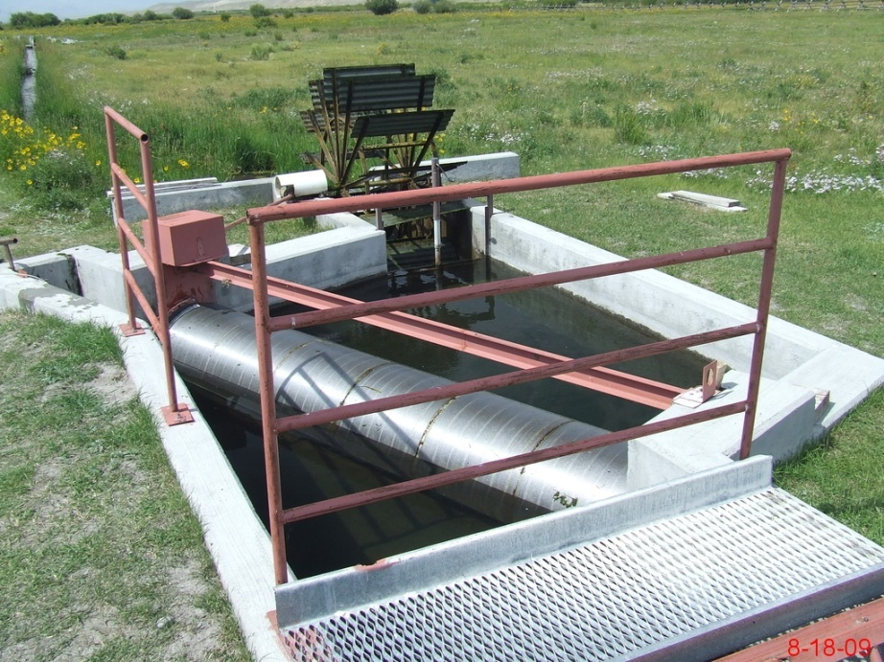
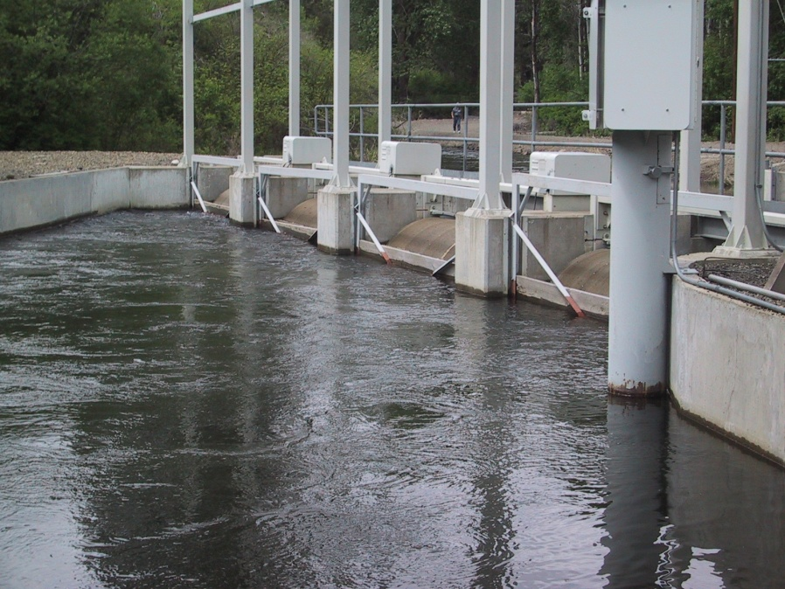
Screens and diversion
Initiated by Programmatic Issue #C of the Geographic Category review, FSOC was tasked to do an inventory of screens in the basin.
Difference in complexity of the facilities found in this category, which complicates assessment

Slide 6
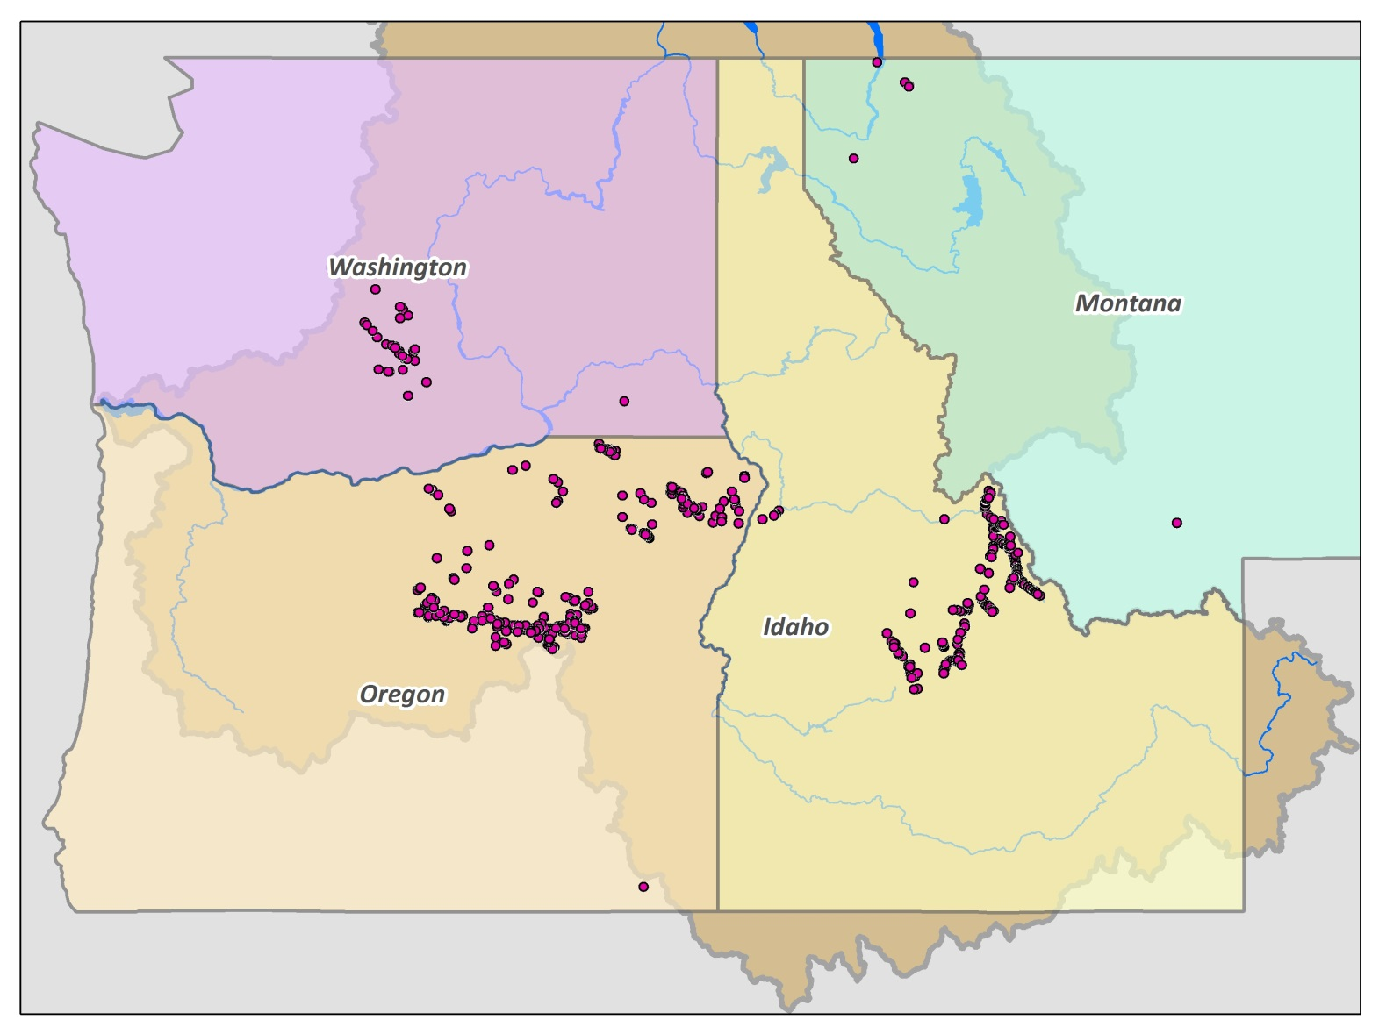
Existing Fish Screens by State

Slide 7
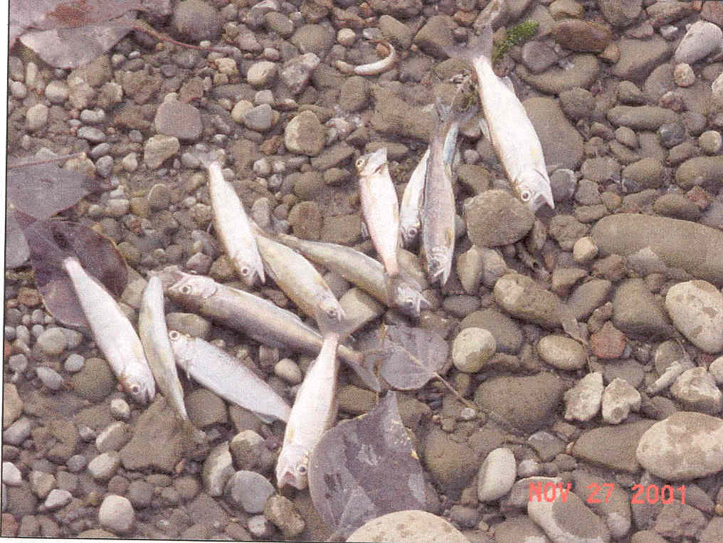
Lemhi Case Example
High entrainment losses into irrigation systems provided the impetus for fish screening in the early 1960’s.
In 1958, it was estimated that 423,000 salmon fingerlings were lost in 90 irrigation canals (Gebhards 1958).
In 1961 and 1962, it was estimated that 84 screens on the Lemhi River bypassed 271,000 and 91,500 juvenile Chinook salmon (Corley 1962).
IDFG’s effort to install fish screens in irrigation diversions has reduced the stranding of out-migrating smolts from an estimated 71 percent to 1.9 percent, preserving tens of thousands of juvenile salmon annually

Slide 8
Annika W. Walters, Damon M. Holzer, James R. Faulkner, Charles D. Warren, Patrick D. Murphy & Michelle M. McClure (2012): Quantifying Cumulative Entrainment Effects for Chinook Salmon in a Heavily Irrigated Watershed, Transactions of the American Fisheries Society, 141:5, 1180-1190
The cumulative effect of water diversion on smolt out-migration was substantial, the installation of fish screens would reduce entrainment by 50-90%.

Slide 9
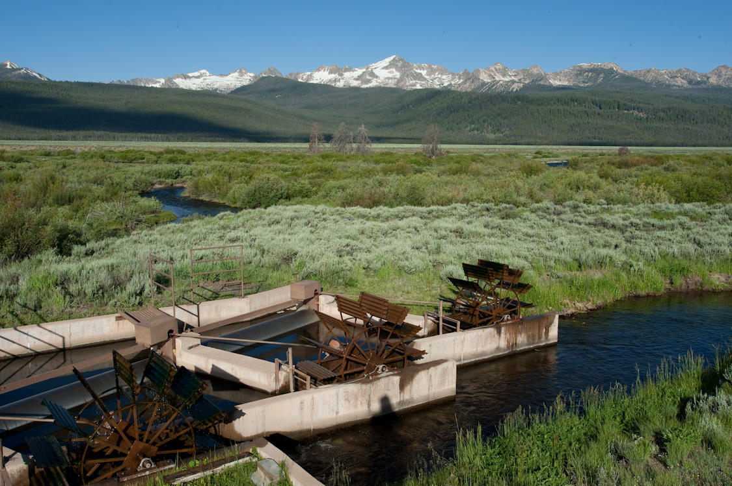
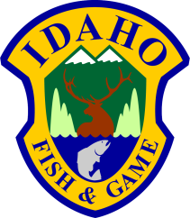
Anadromous Fish Screen Program
Paddy Murphy – Program Coordinator
Idaho Department of Fish and Game
Region 7 – Salmon, Idaho

Slide 10
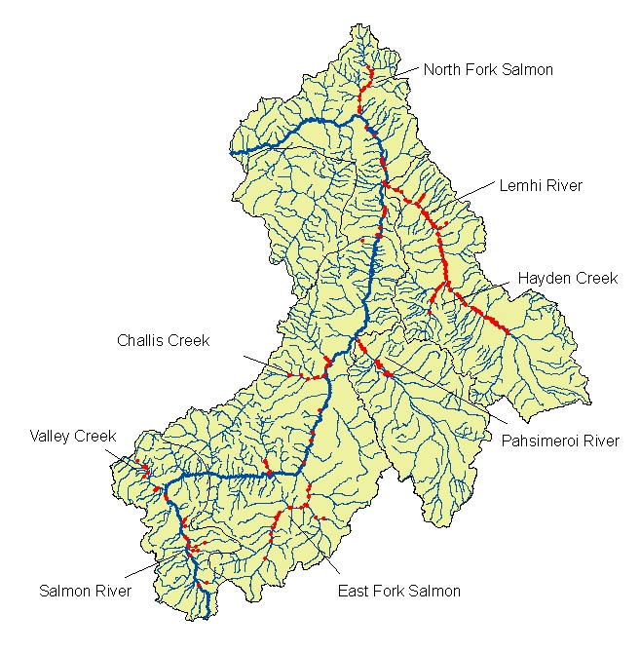
Idaho Department of Fish and Game -
Anadromous Fish Screen Program
Located in Salmon, Idaho.
12 full-time/ 17 temporary employees
Installed, operate, and maintain
263 fish screens in the USRB.
NOAA Mitchell Act / BPA.
Major Limiting Factor:
Fish passage and entrainment.
Salmon, ID

Slide 11
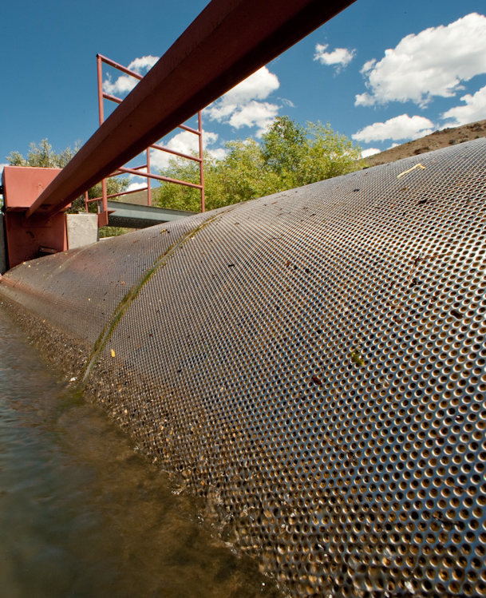
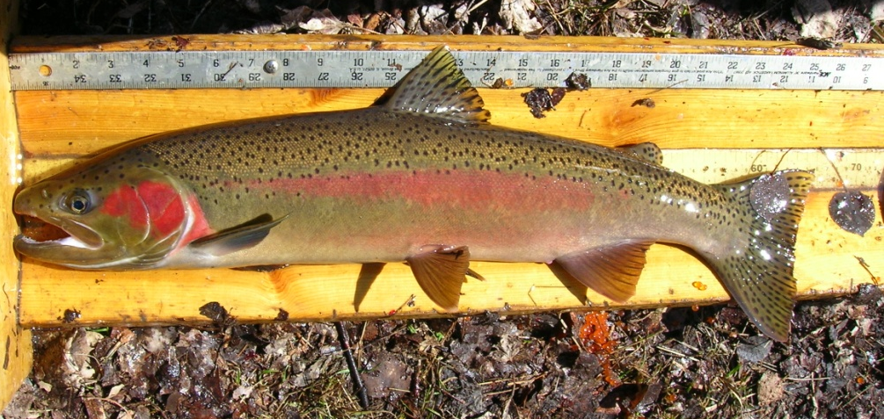
Objectives
Increasing fry to smolt survival of anadromous salmon and steelhead.
Improving fish passage to critical tributary habitat.
Increasing survival and abundance of resident salmonids.

Slide 12
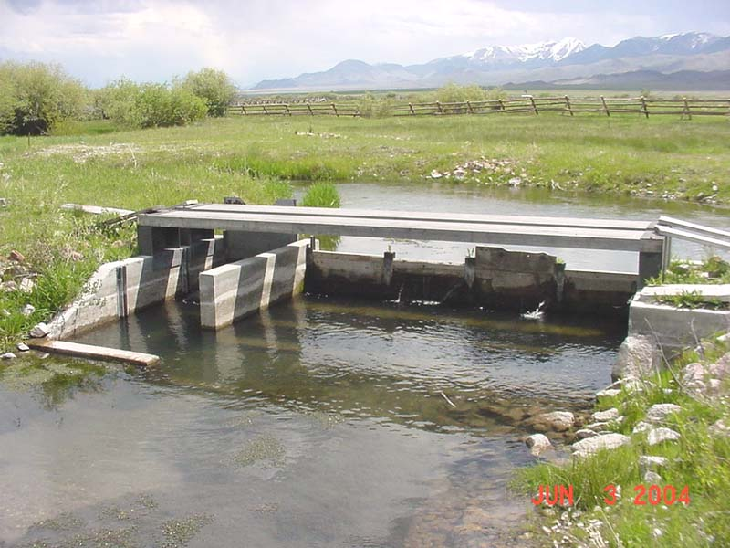
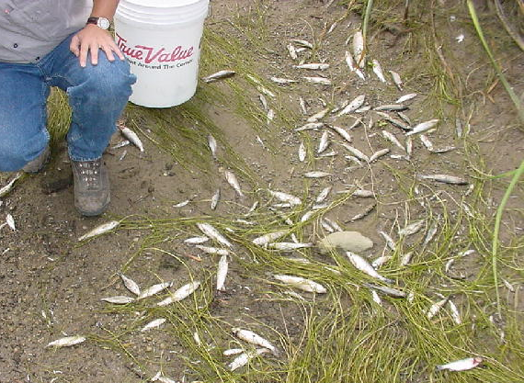
Limiting Factors – Water Diversion
Entrainment
Fish passage /Migration barriers
Isolation of populations
Alters fluvial processes.
Decreases available habitat.
Decreases productivity.
Increases water temperatures.

Slide 13
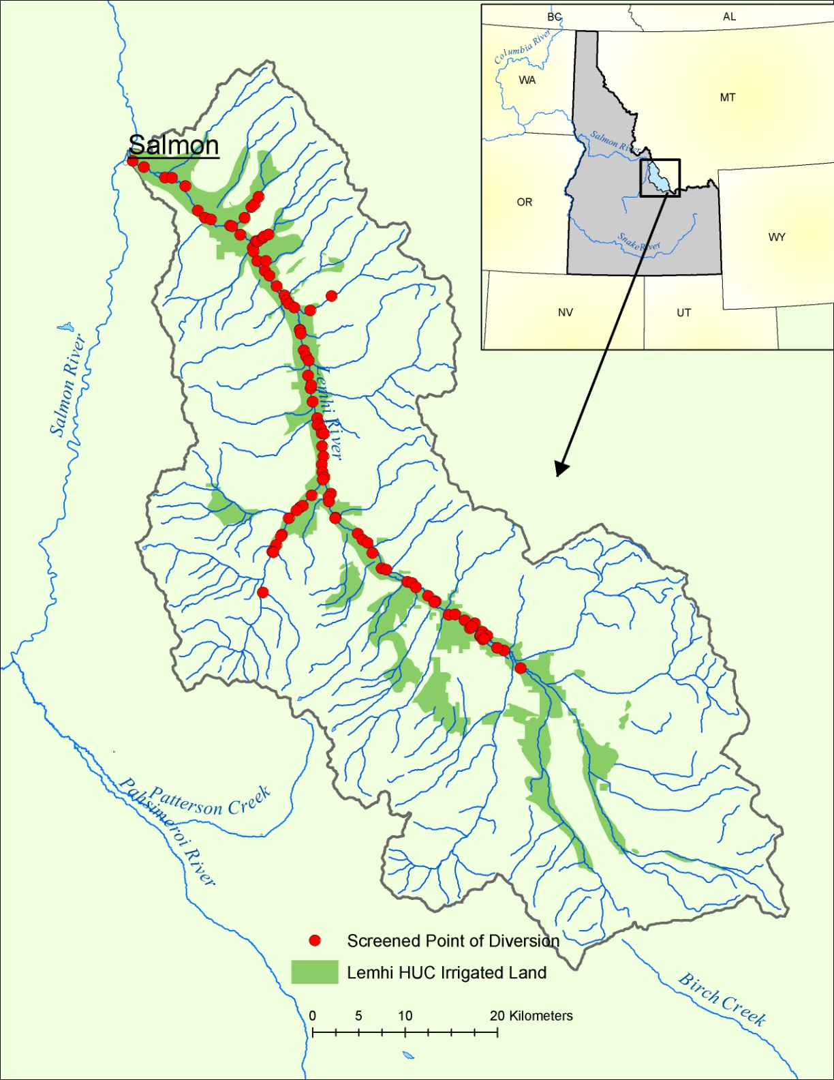
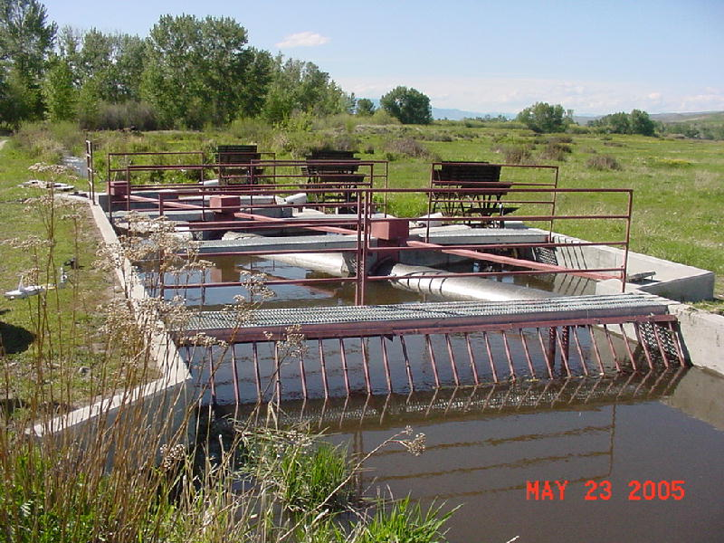
Upper Salmon River Basin
Fish Screening
High percentage (> 90%) of Chinook salmon spawn on private property.
All mainstem diversions are screened
Rotary drum screens built to NMFS Juvenile Fish Screen Criteria
High Priority – Subbasin Plans, Recovery Plans,

Slide 14
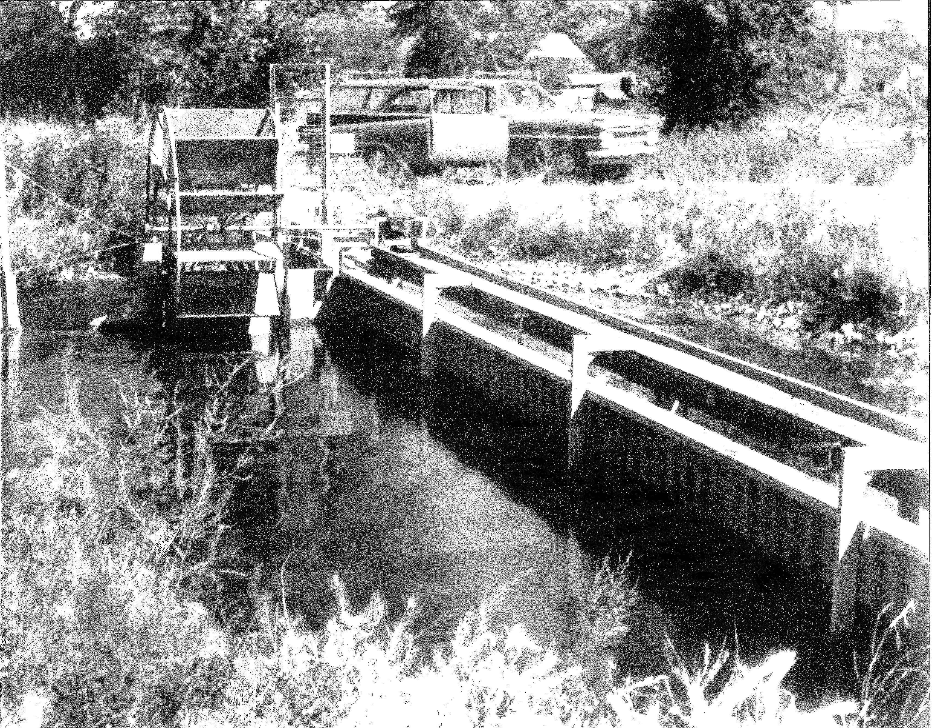
1958-1991

Slide 15
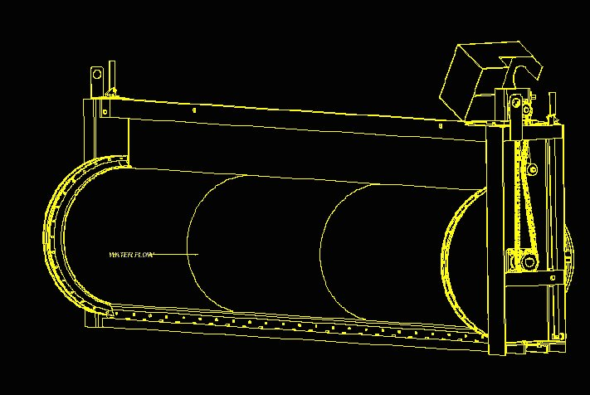
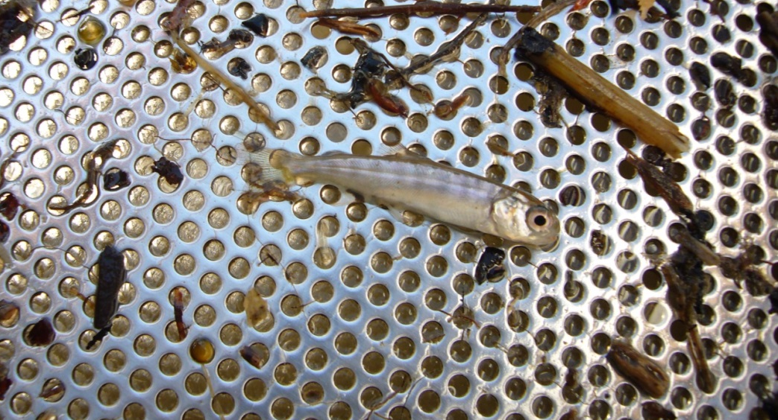
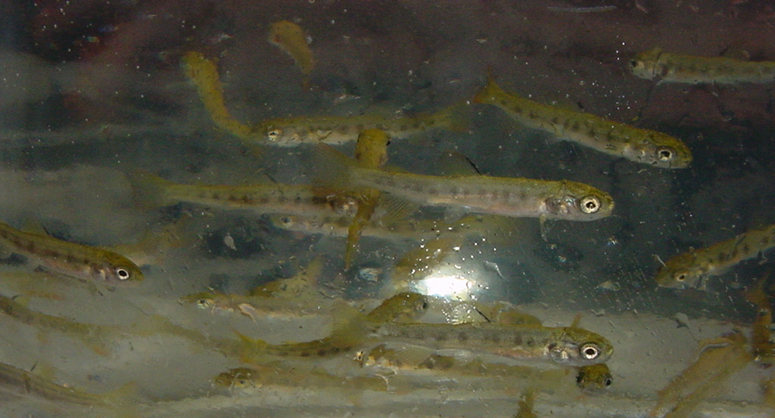
Fish Screens are Complex
Needs a true Bio-Engineering approach.
Every site has its own unique characteristics.
Engineering is critical to meet criteria .
Biological interactions need consideration.
Maintenance cannot be underestimated.

Slide 16
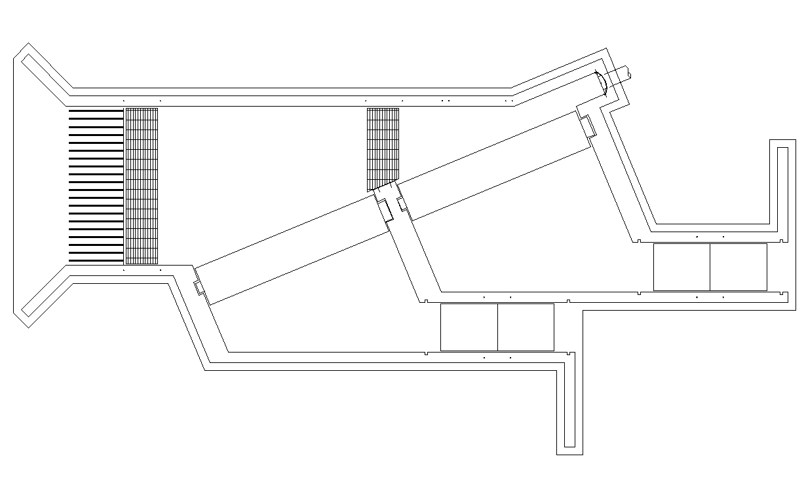
Juvenile Fish Screen Criteria
Uniform laminar flow coming into fish screen.
Uniform flow distribution over screen surface.
Bypass back to
stream.
Drum Screen
Drum Screen
“No Contact, No Delay”

Slide 17
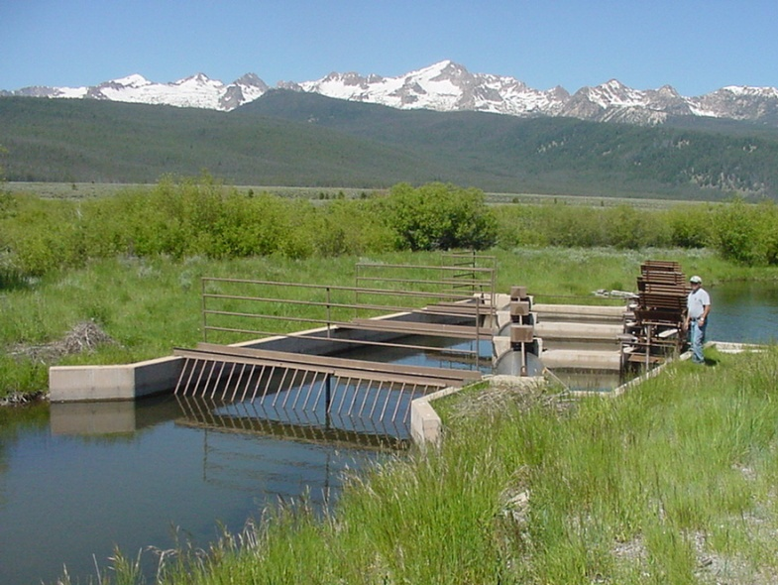
“Predictable Performance with Predictable Biological Effects”

Slide 18
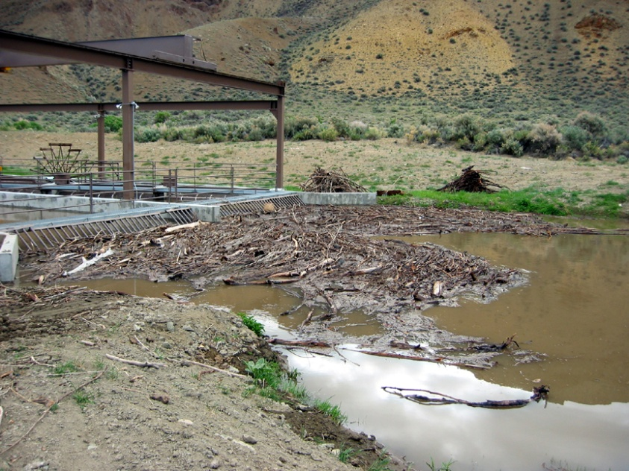
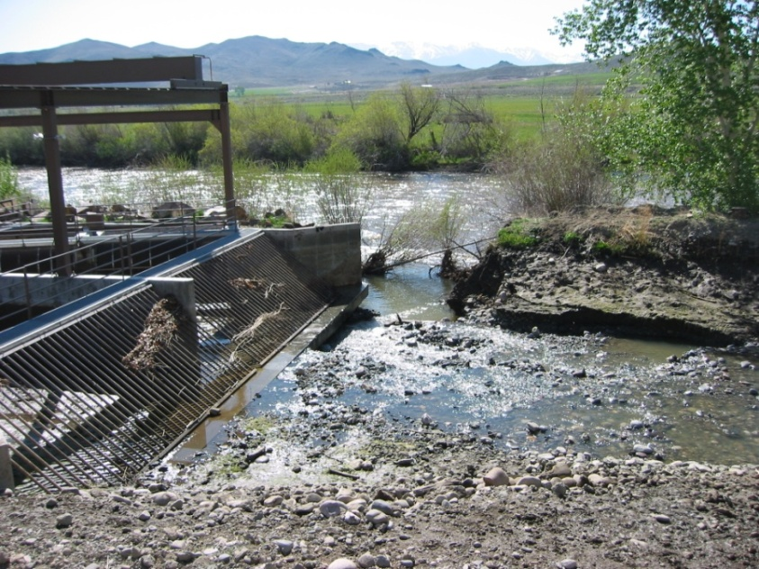
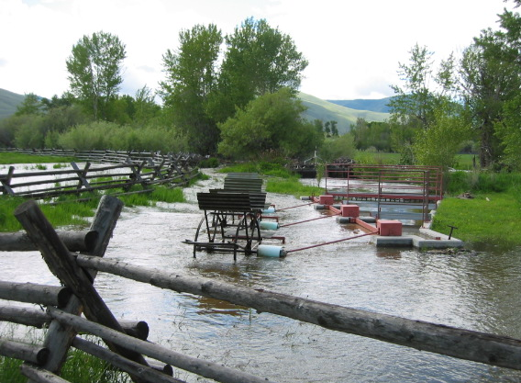
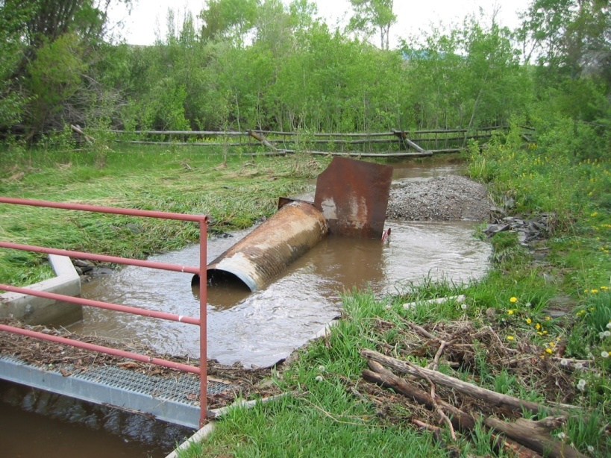
Dedicated Maintenance

Slide 19
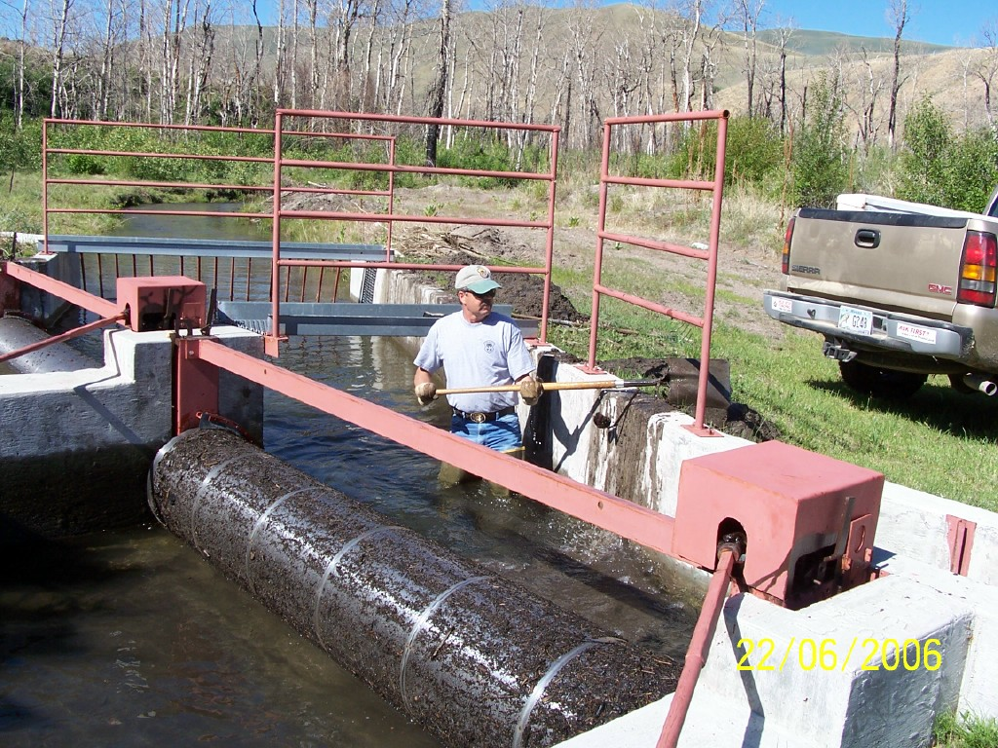
Screen Tenders

Slide 20
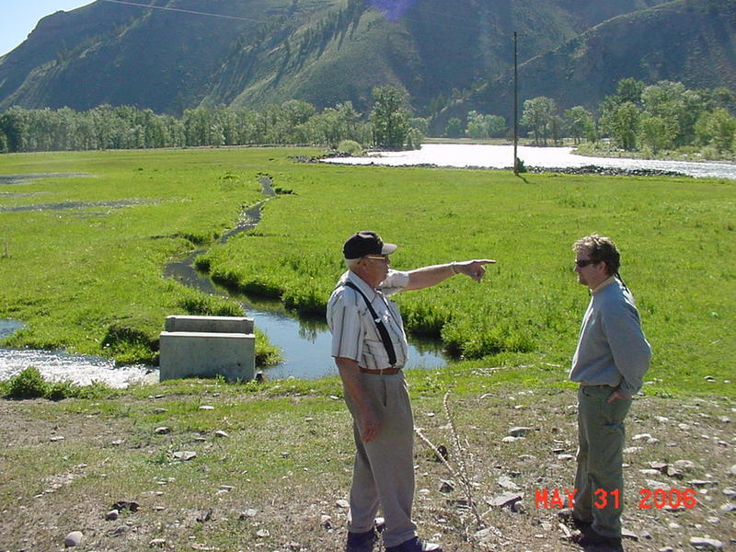
A Foundation Built on Relationships

Slide 21
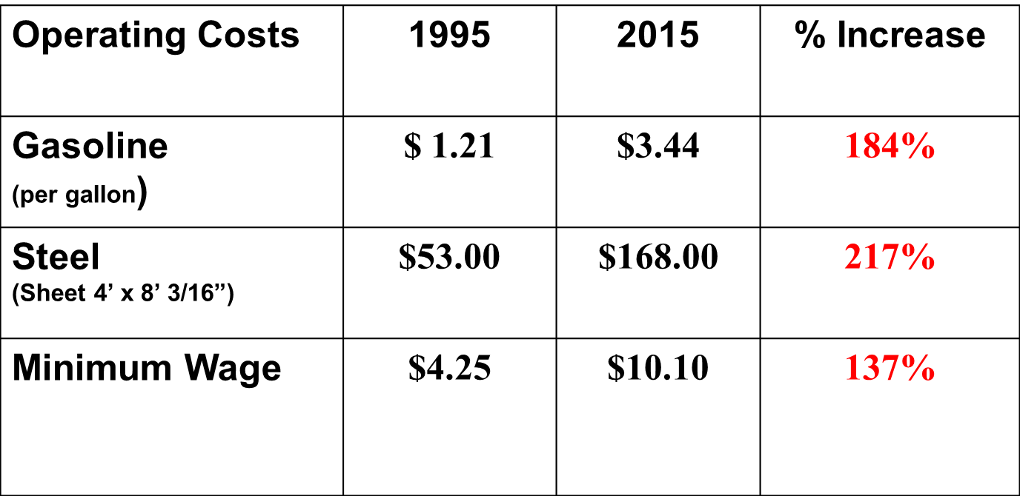
Rising Costs – Shrinking Budgets

Slide 22
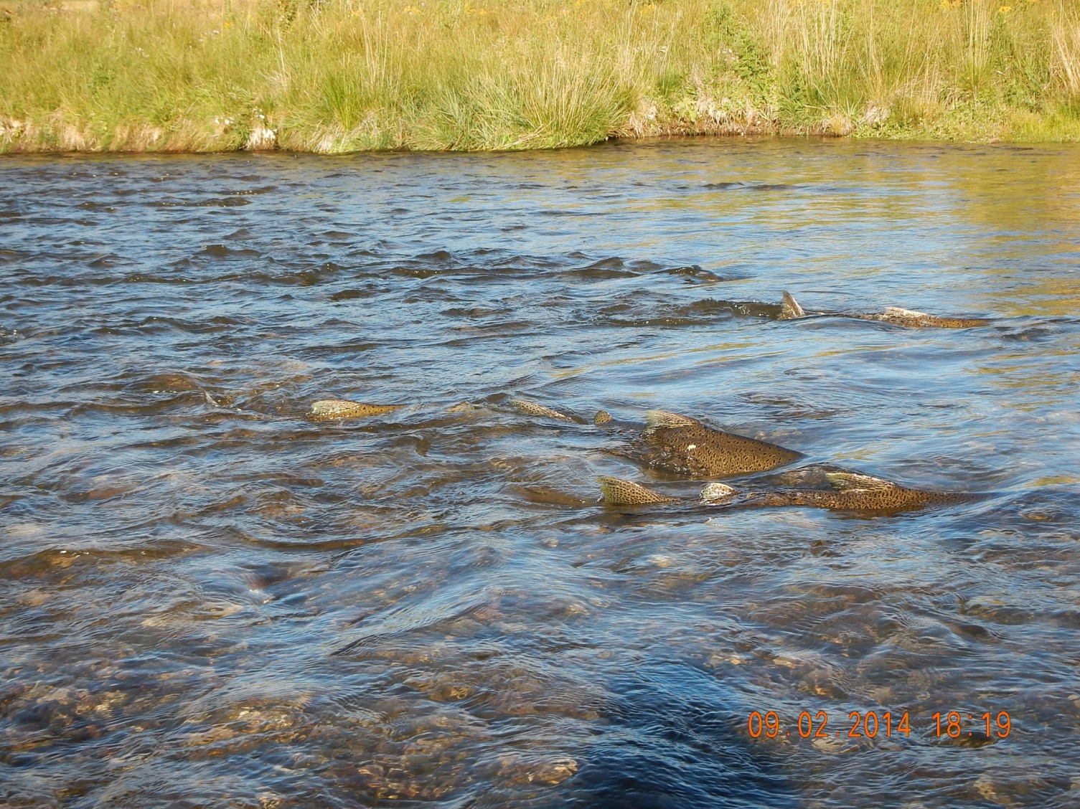
Continued Momentum.

Slide 23
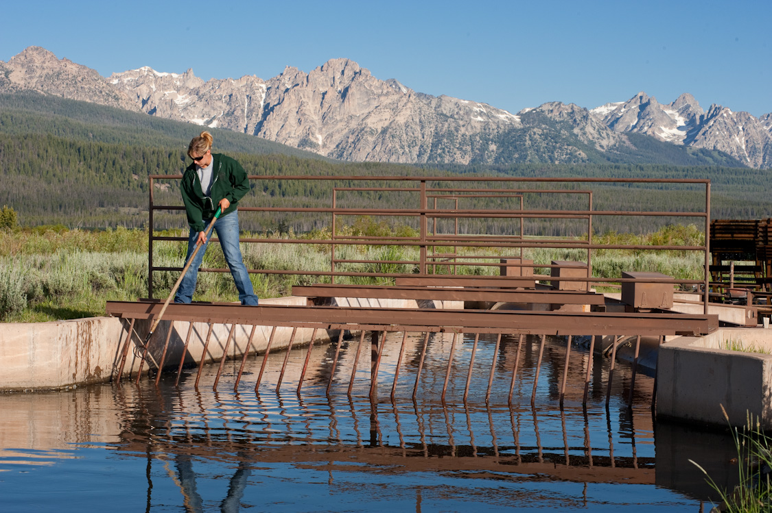
Questions

Slide 24
Hatcheries
Lower Snake River Compensation Plan (LSRCP)
Bureau of Reclamation Hatcheries
Corps of Engineers Hatcheries
Mitchell Act Hatcheries
NPCC F&W Program hatcheries
  15 hatcheries directly constructed with BPA funds. Ownership was transferred to state, tribal or federal entity.
  O&M is directly funded by BPA; a large percentage of O&M funding is RM&E

Slide 25
Program Hatcheries
Nez Perce Tribal Hatchery (NPT)
Colville Hatchery (CCT)
Umatilla Hatchery (ODFW)
Spokane Tribal Hatchery (STOI)
Sherman Creek Hatchery (WDFW)
Ford Hatchery (WDFW)
Hood River Production (CTWSRO/ODFW)
Snake River Sockeye (IDFG)
Kalispel Hatchery (KT)
Sekokani Springs Hatchery (MFWP)
Cle Elum Hatchery (YKFP)
Chief Joseph Hatchery (CCT)
Kootenai Tribal Hatcheries (KTOI)
BPA funds O&M on other hatchery-related elements including weirs, traps and satellite facilities not reflected in the list above. Currently there several new hatcheries in Step Review (e.g., Walla Walla Hatchery, Crystal Springs, and YKFP).

Slide 26
Lands
BPA currently has an asset management plan for all acquired fish and wildlife lands – focused on compliance with conservation easement terms
The majority of BPA’s wildlife mitigation program has focused on the permanent protection of high priority habitats through acquisition and conservation easements
Restoration and maintenance activities continue after acquisition to enhance and maintain conservation values, including use of stewardship funds (first piloted in the Willamette and for estuary projects)
Settlement agreements to date:
    Montana Wildlife Settlement
    Dworshak Wildlife Settlement
    Washington Interim Wildlife Agreement
    Willamette Wildlife Agreement
    Southern Idaho Wildlife Agreement

Slide 27
Lands (continued)
Wildlife mitigation on a project-by-project basis has been conducted in the following areas:
  Albeni Falls
  Southern Idaho
  Upper Columbia
  Lower Columbia
  Lower Snake
Acquisition for anadromous and resident fish is used in selected situations to secure habitat restoration opportunities and to obtain key locations for fish production.

Slide 28
Asset Management Strategy
Phase 1: Inventory
  Shared understanding of scope and scale for each category
  Standardize data for development of system support
  Clarity on rolls and responsibilities
Phase 2: Condition and Needs Assessment
  Safety – compliance – condition
Phase 3: Criteria for Prioritization
Phase 4: Strategic Planning
  Planning – funding – transition to prioritized implementation

